Slide 1
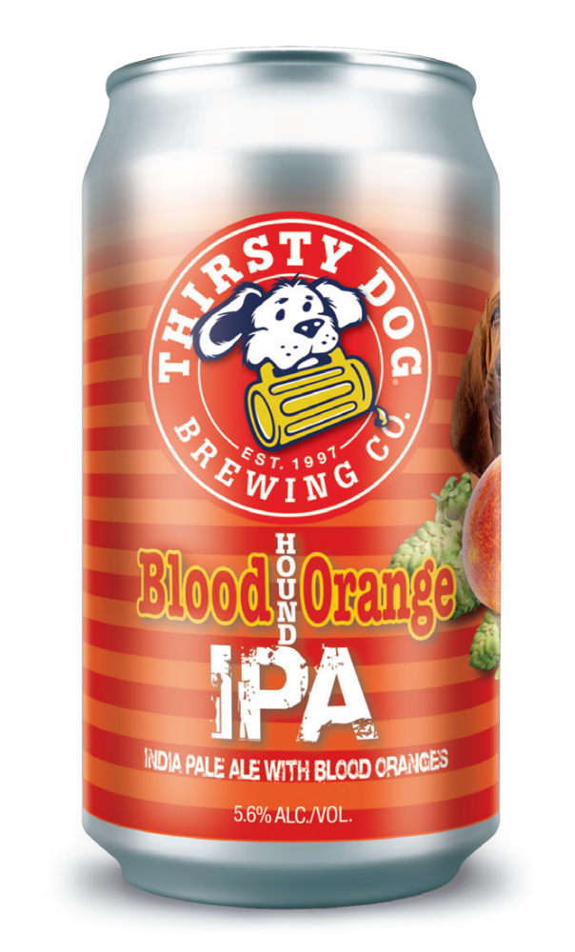
Break the bank- Sept/OCT 2026
$5,000
Thirsty dog bloodhound orange ipa off premise all accounts general market sales reps-
$20 new buying account on premise all accounts general market sales reps-
$50- ½ bbl new draft placement- $75 rebuy
$25- 1/6 bbl new draft placement- $50 rebuy
(baseline 90-day non-buy)
*KAM 50/50 draft split in kam accounts

