Slide 1






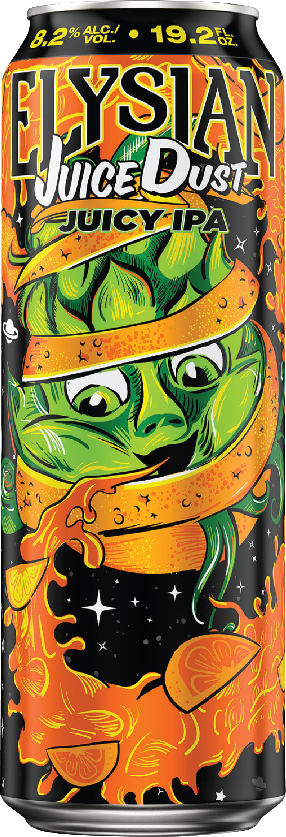
Hi5 | Off-Premise 19.2 Incentive
$300,000 Break The Bank: September - October
Eligible Accounts: Off-Premise Independent & 7-Eleven
NATIONAL FLAGSHIP BUCKET
MPD BUCKET
$150,000 Bank
$150,000 Bank
*Home Market 19.2s Included
$15
Per NEW POD
3+ MPD: $30
5+ MPD: $50
Did you know there are +10K accounts selling competitive 19.2 but no Tropical Beer Hug 19.2 & +8K accounts with No Space Dust
TTL House must be Flat to Positive NET PODs vs Baseline for payout
Source: IRIS April 2026 Surveys
ALL INCENTIVE PAYMENTS ARE MADE TO WHOLESALERS ONLY IN CASH ONLY, WHICH CASH WHOLESALERS CAN USE AT THEIR SOLE DISCRETION. ALL INCENTIVES EXCLUDE MI.

Slide 2





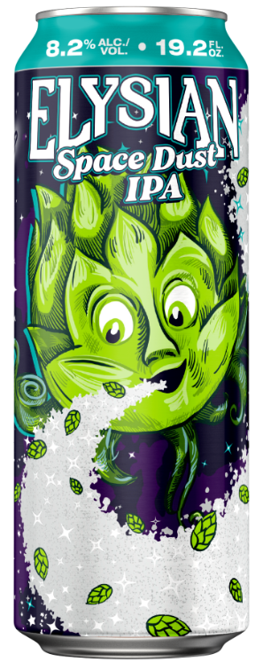

Hi5 September – October IPA 19.2 Incentive
$300K
BREAK THE BANK
BRANDS INCLUDED:
OBJECTIVE
Continue to grow National Flagship distribution & achieve full shelves of
Craft High ABV 19.2 Singles
TIMING
September – October 2026
GEO
All Equity WSLRS in States where incentives are legal, excludes MI.
CHANNEL:
All Independent C-Store, Package Liquor, 7 Eleven/Speedway
PAYOUTS
National Flagship Payout ($150K Bank): New PODs vs Baseline
$15 Per New POD of Tropical Beer Hug, Space Dust, & Pernicious 19.2
MPD Payout ($150K Bank): NEW Accounts vs Baseline
Accounts that Achieve 3 MPD: $30 Payout
Accounts that Achieve 5+ MPD: $50 Payout
QUALIFIER
TTL House must be Flat to Positive NET 19.2 PODs vs Baseline to receive payout
BASELINE &
TRACKING
L13W POD Distro ending 8/23/26. Distribution tracked at the account level.
CSO tracking provided each week & all data pulled from PowerBI HERO distribution.
**All incentive rewards/payments must be paid via cash or EFT to the wholesaler entity directly and not to individual wholesaler employees. All incentives exclude Michigan.
***Full list of Eligible SKUs by Region provided

Slide 3


IPA Nation | On-Premise Draught Incentive
INCENTIVE DETAILS
TIME:
September - October
Wholesalers Eligible: All Equity Wholesalers
Eligible Accounts: Indy B or H
Brands: Locally defined Lead IPA
SKUs: 1/2 BBL & 1/6 BBL
Qualifier: Lead IPA PODs must grow vs baseline
PAYOUT MECHANICS
$100,000 BREAK THE BANK
 | ON PREMISE
BRANDS | Buy / Rebuy (1/2 BBL)​ or (1/6 BBL)
LEAD IPA 1/6 BBL | $25 / $75​ (Indy B or H Accounts)
LEAD IPA 1/2 BBL | $75 / $150 (Indy B or H Accounts)
ALL INCENTIVE PAYMENTS ARE MADE TO WHOLESALERS ONLY IN CASH ONLY, WHICH CASH WHOLESALERS CAN USE AT THEIR SOLE DISCRETION. ALL INCENTIVES EXCLUDE MI.

