Slide 1
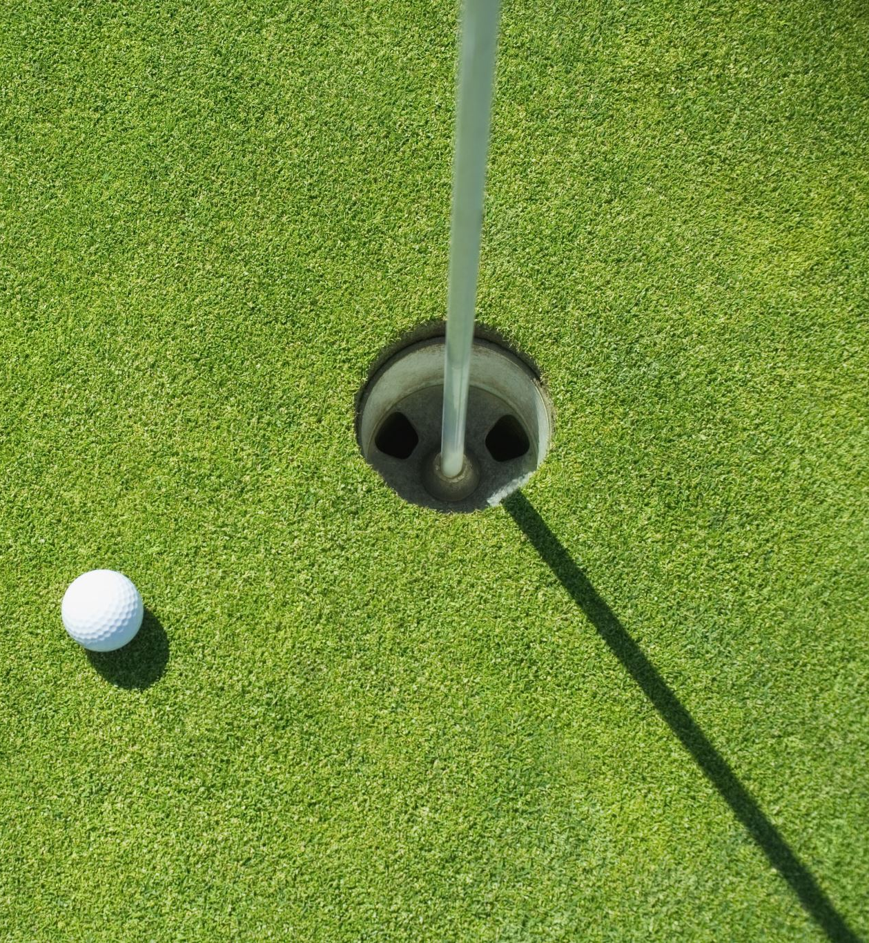
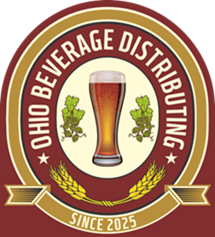

Slide 2
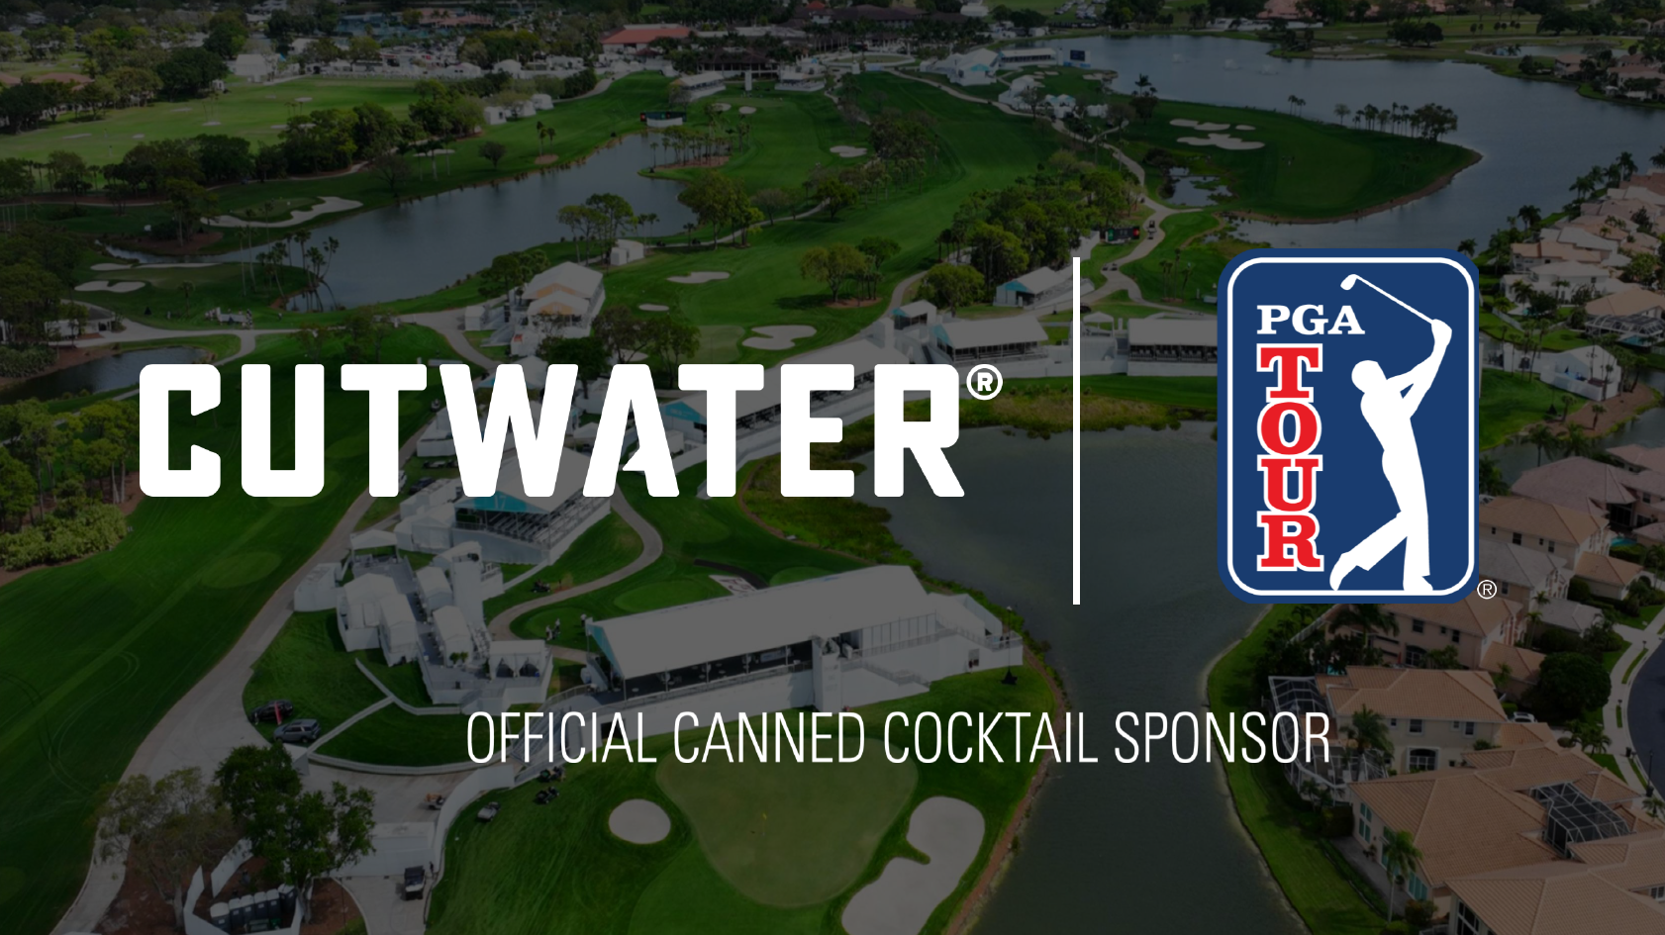

Slide 3
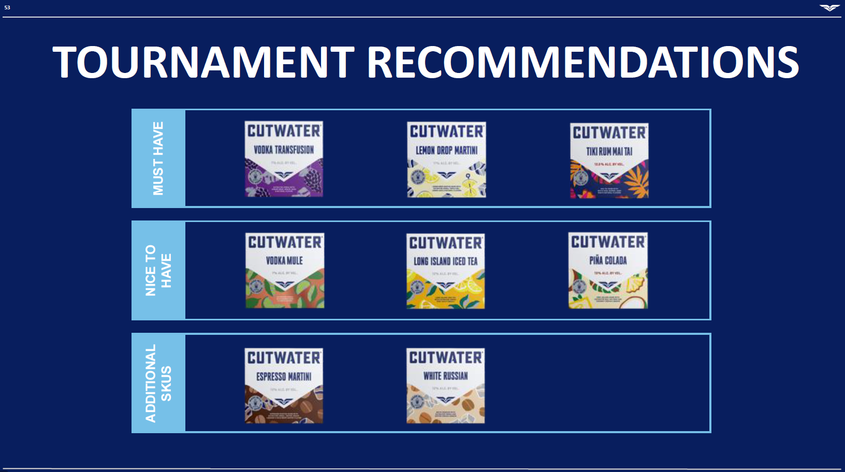

Slide 4
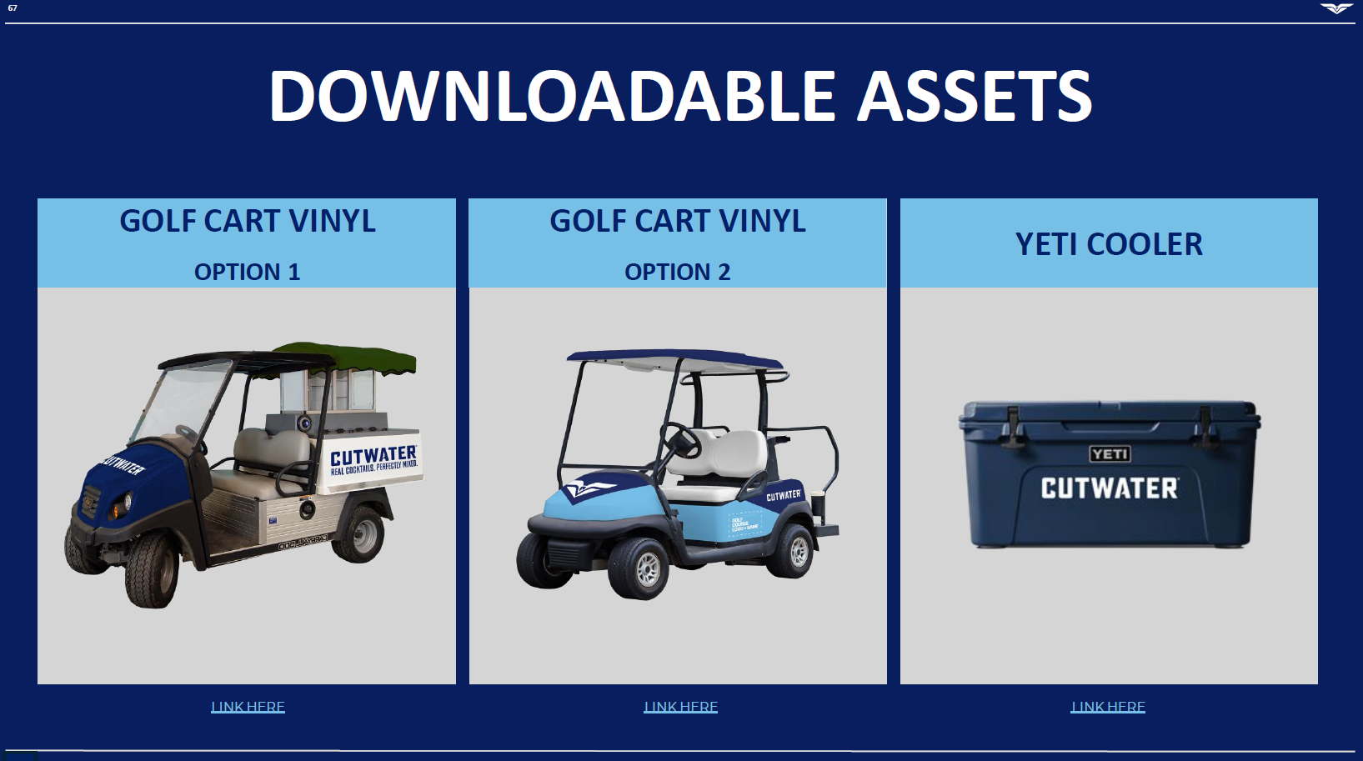

Slide 5
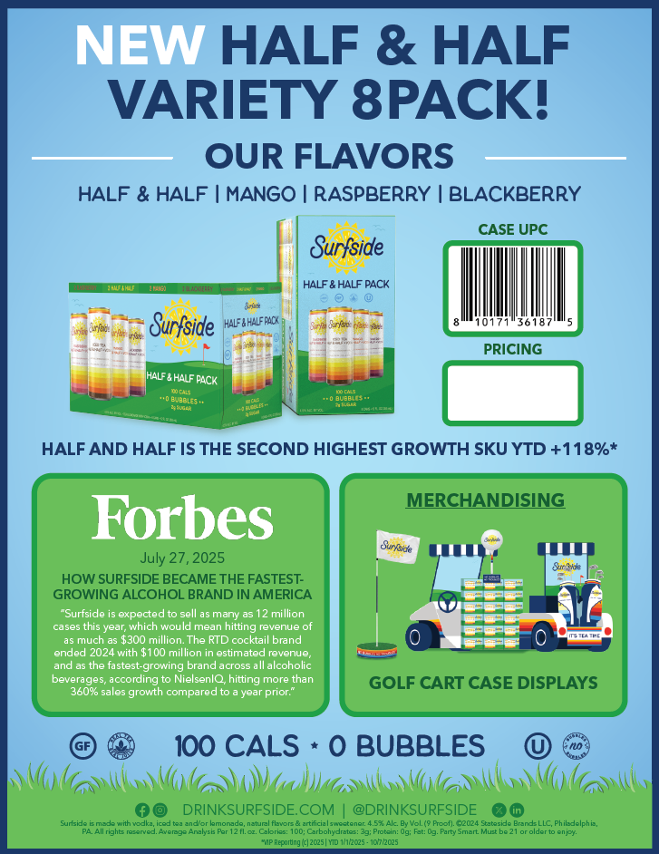
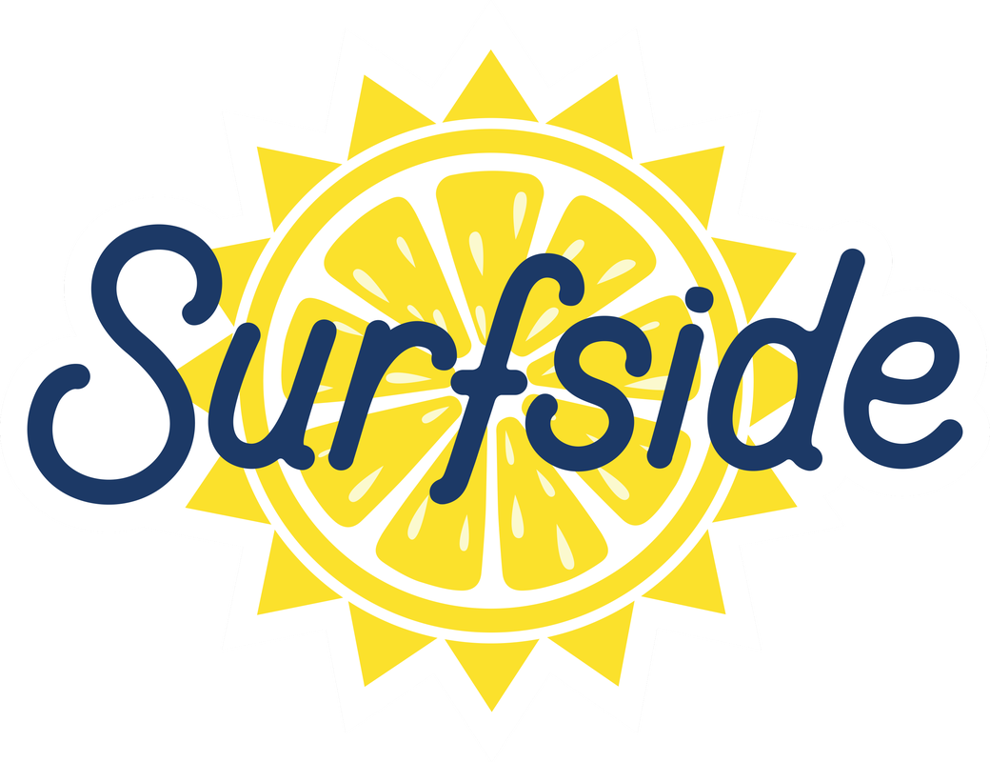

Slide 6
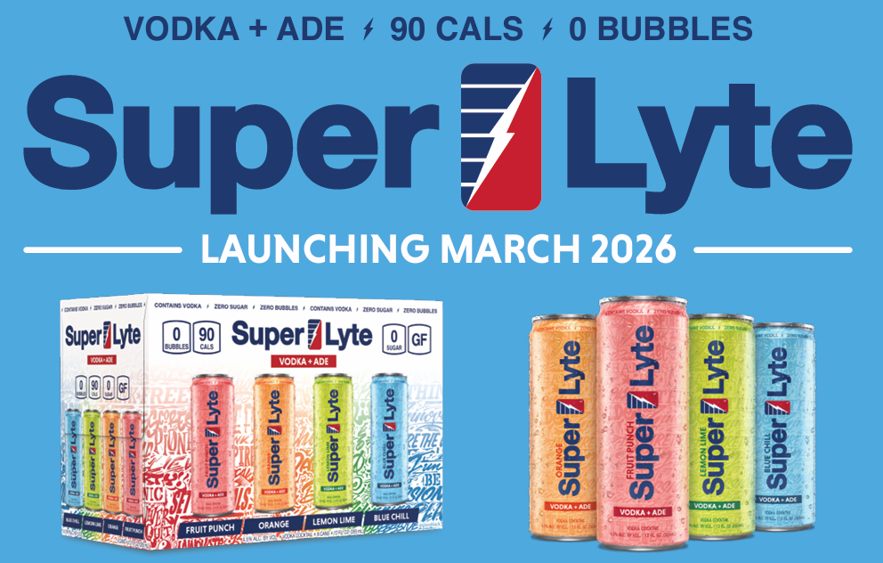

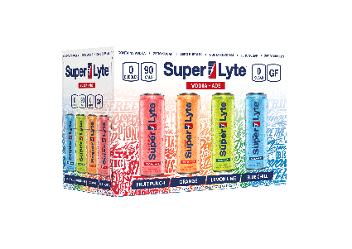
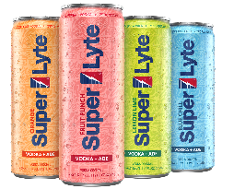

AN INNOVATIVE NEW VODKA-BASED RTD INSPIRED BY CLASSIC SPORTS DRINK FLAVORS. SUPER LYTE IS NON-CARBONATED, EASY TO DRINK, AND INCREMENTAL TO THE CATEGORY.

Slide 7
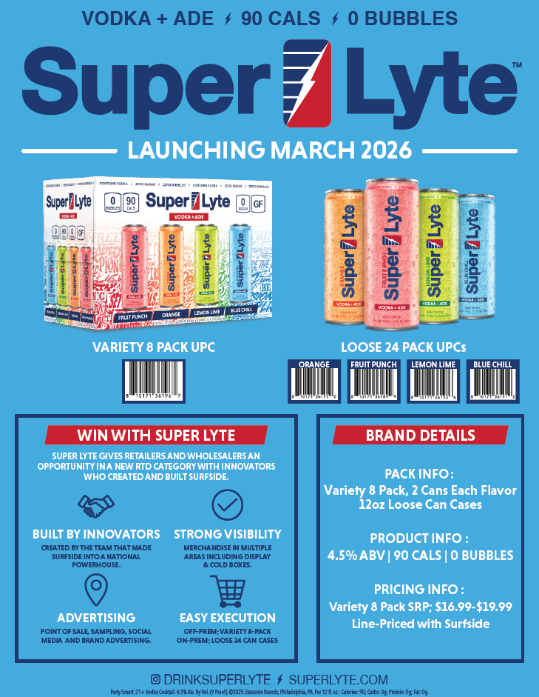

Slide 8
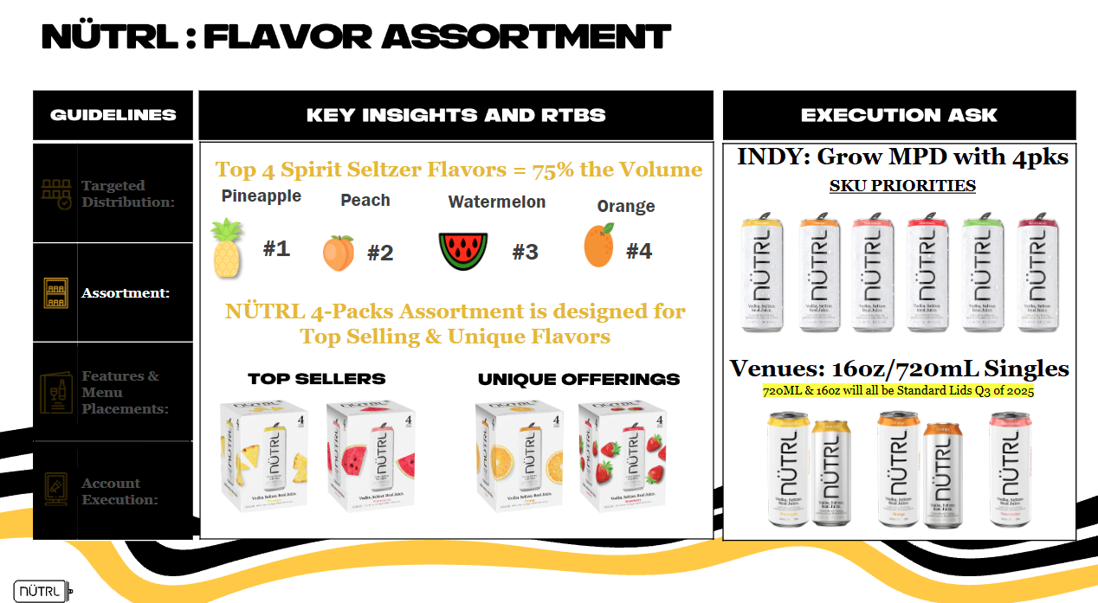

Slide 9
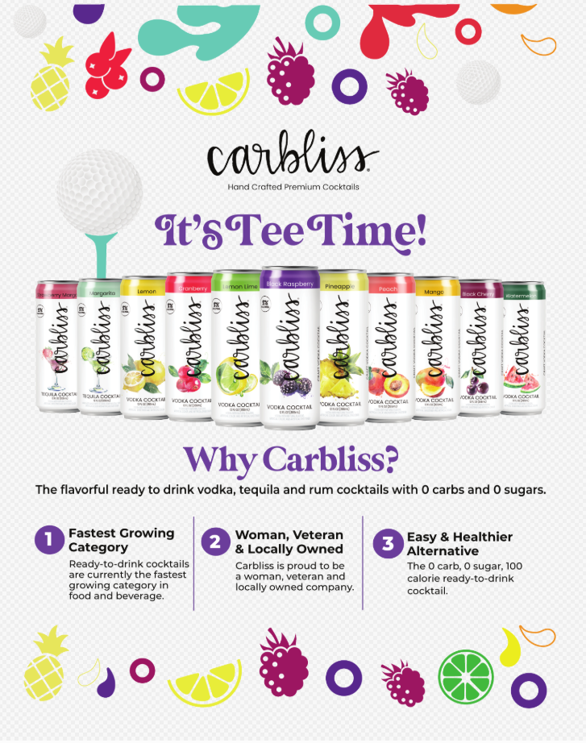
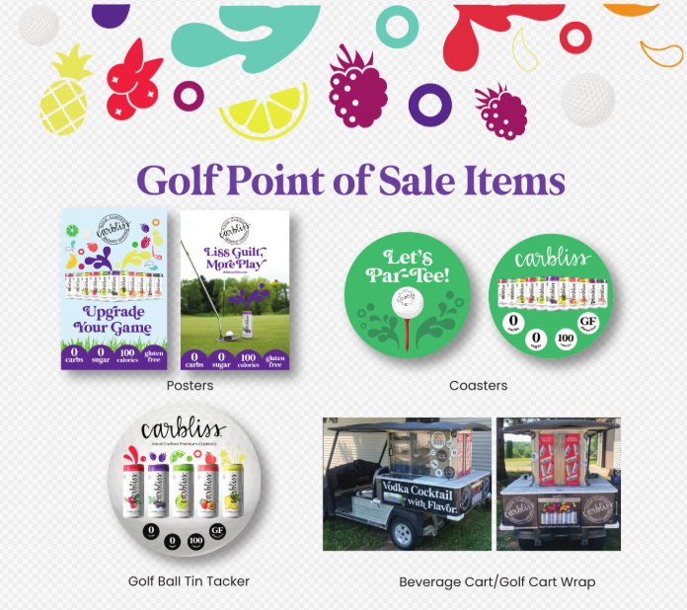

Slide 10
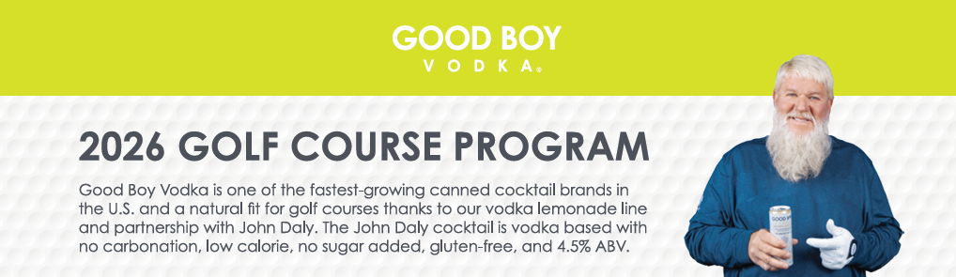
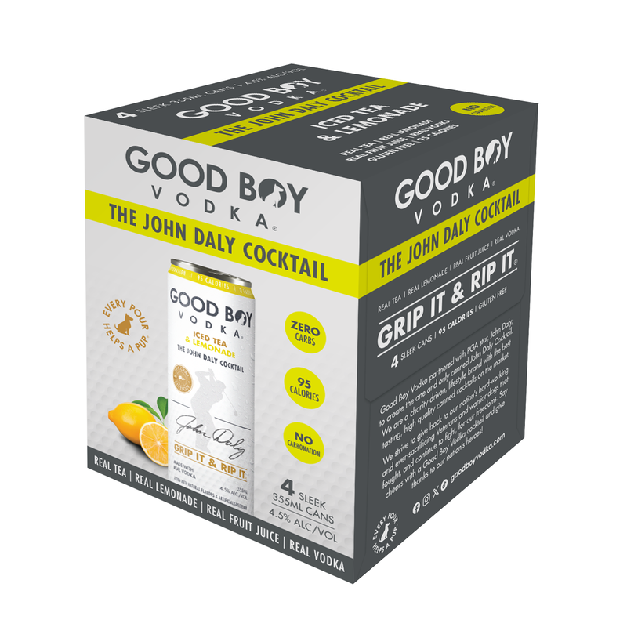
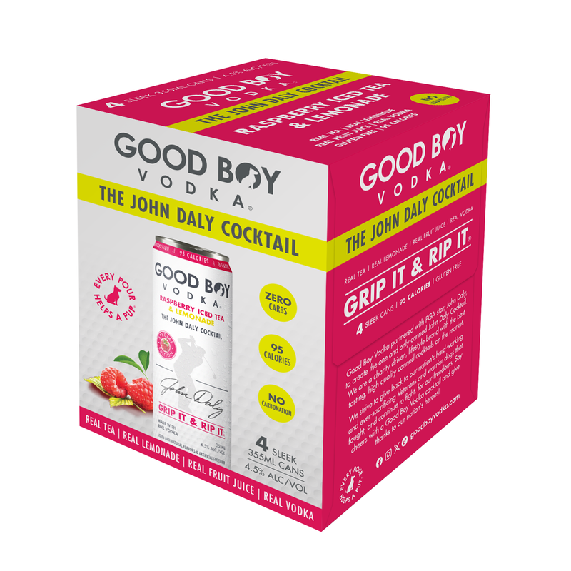
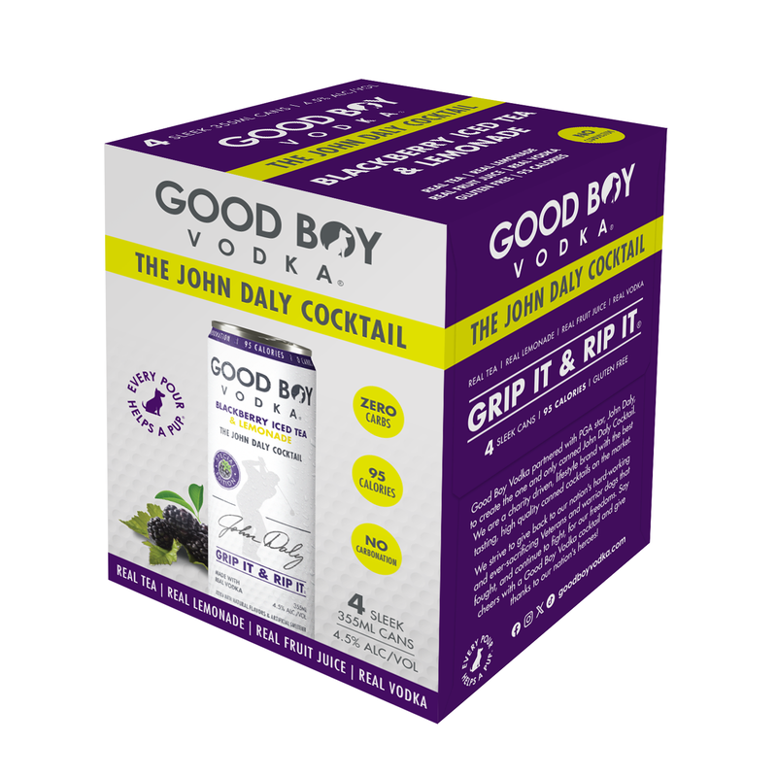
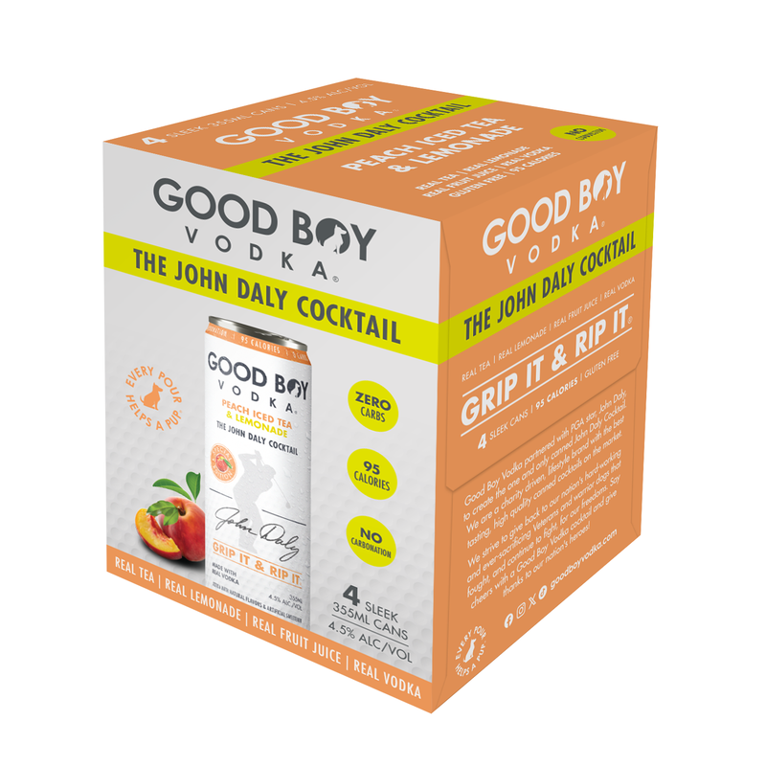

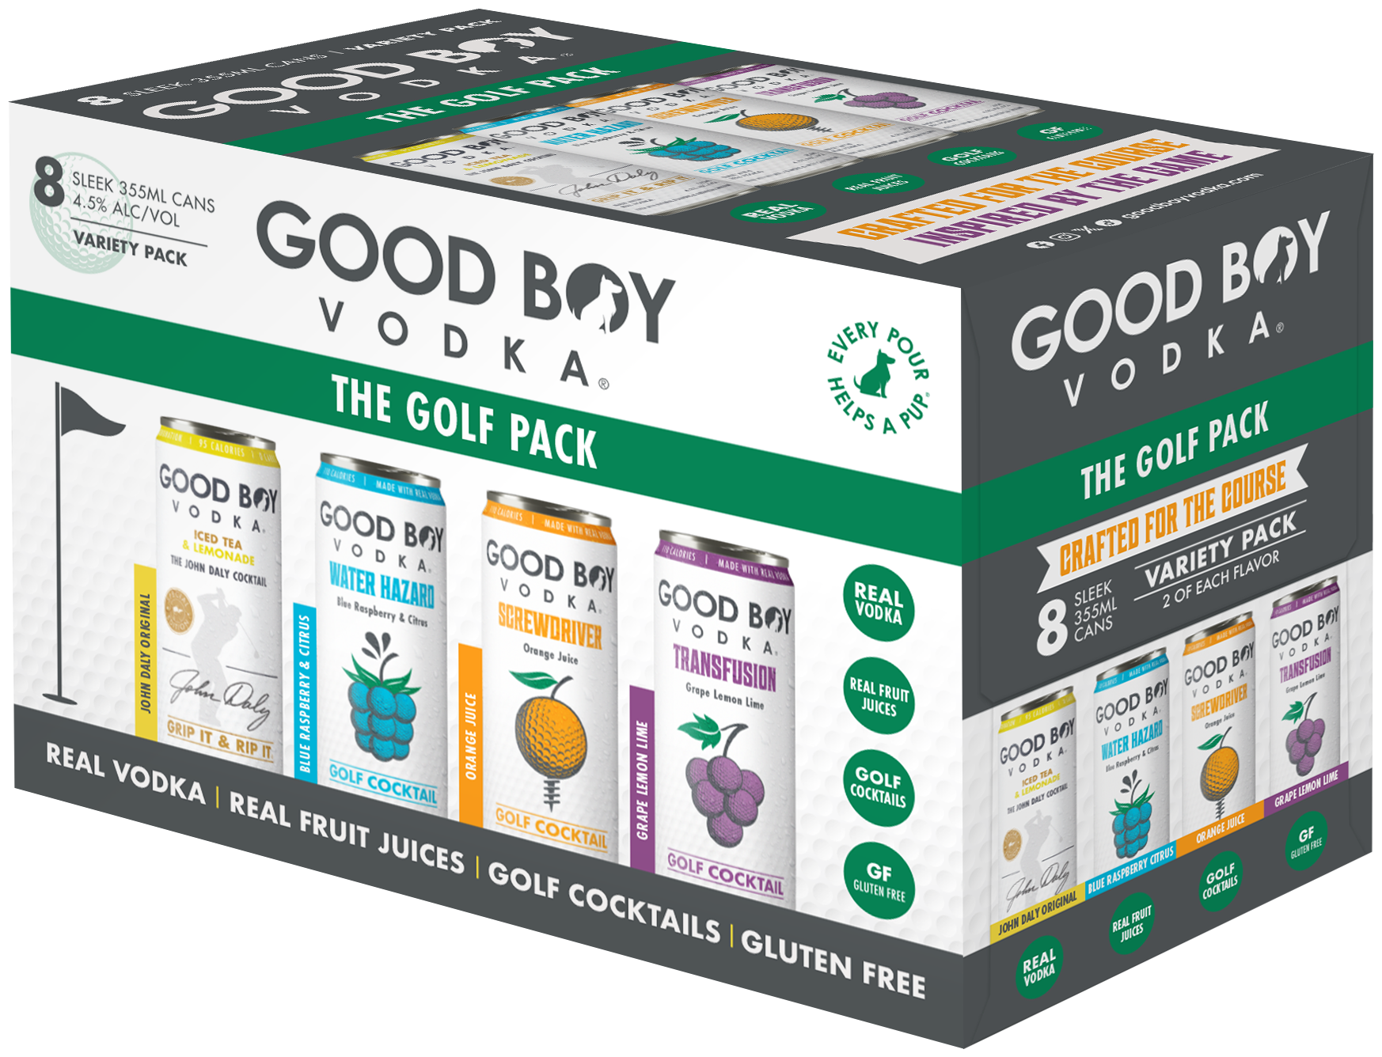
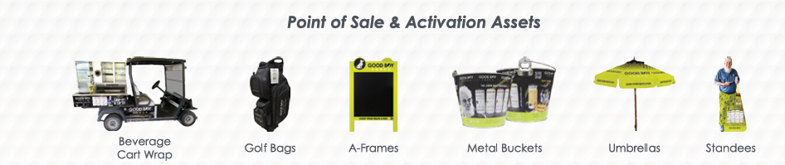

Golf Course focused items
4 different John Daly flavors ($48)
Original
Raspberry
Blackberry
Peach
*Variety pack also available (43.17)
Golf Pack Variety ($43.17)
JD OG
Screwdriver
Transfusion
Water Hazard

Slide 11
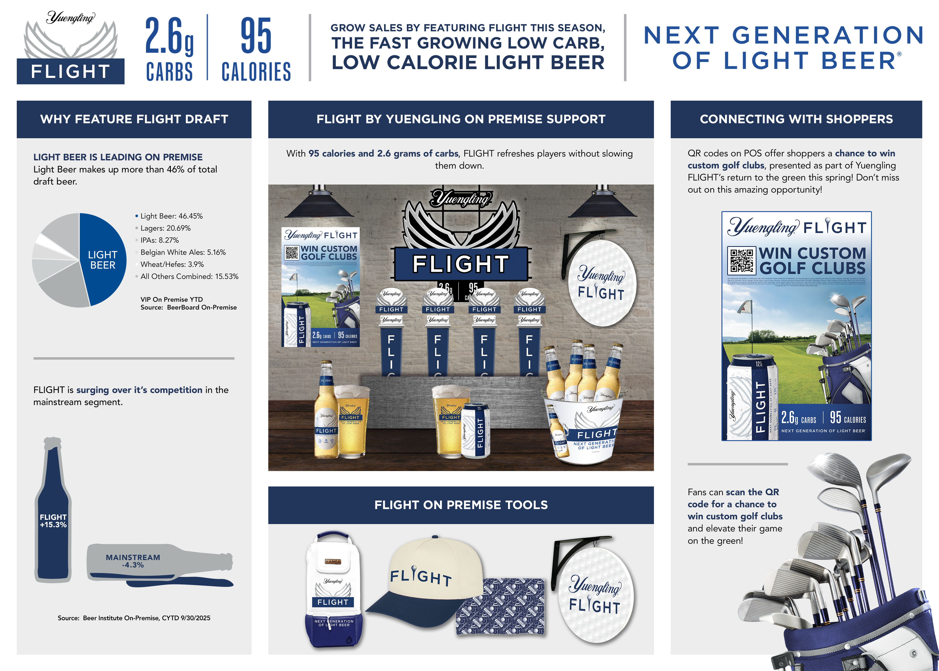

Slide 12
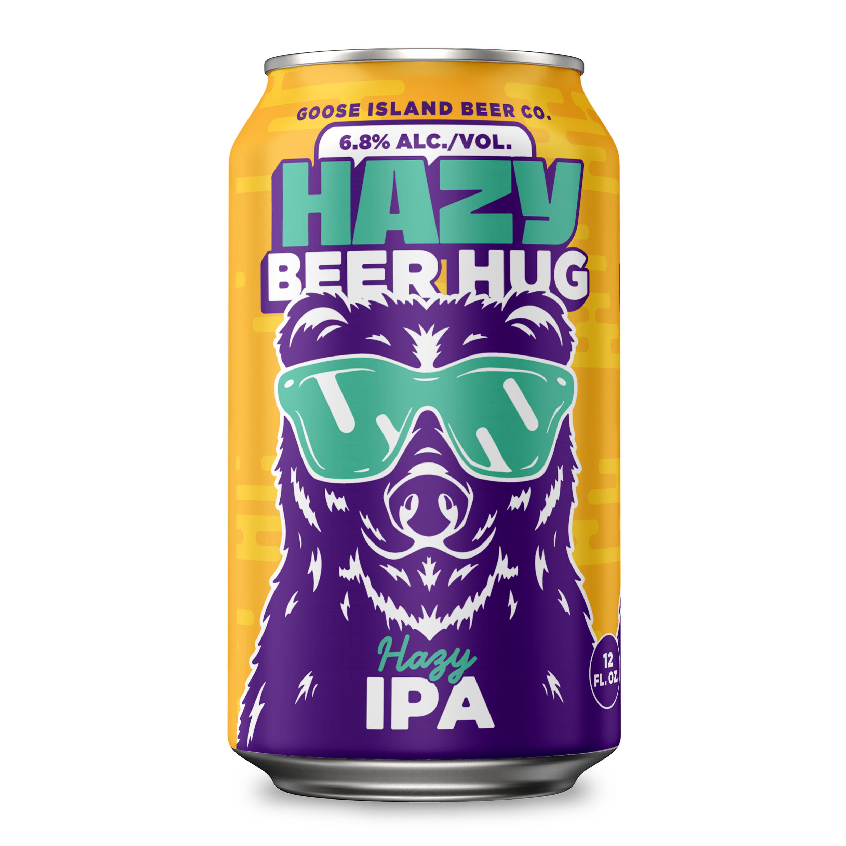
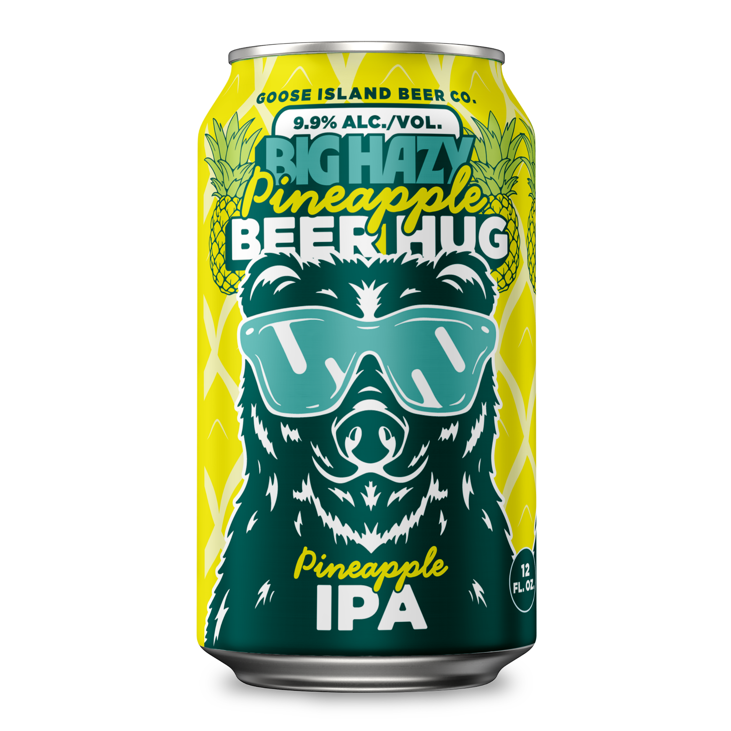
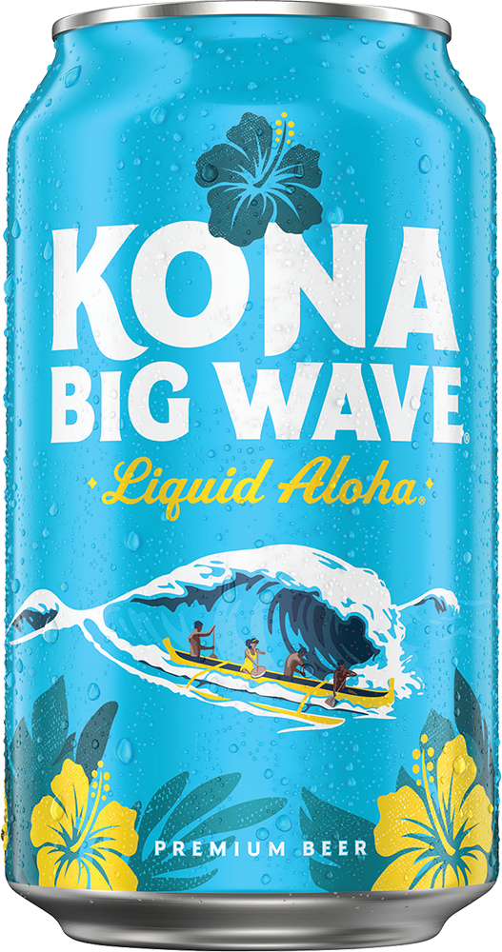
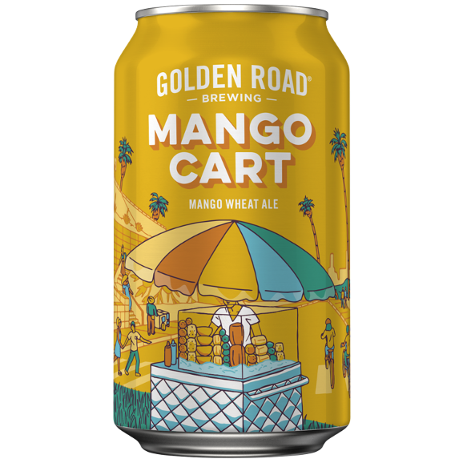
Goose Island, Chicago
An amazingly approachable true Hazy IPA, Hazy Beer Hug is filled with notes of peaches, white grapes, and guava. Hazy Beer Hug makes sure your day is filled with bright, sunshiny haze.
6.8%ABV
Craft
Goose Island, Chicago
Big Hazy Pineapple is loaded with ripe pineapple flavor and a smooth, hazy finish
9.9% ABV
Golden Road, LA
A perfectly balanced
craft wheat ale
made with real mango
4.0% ABV
Kona Brewing, Kona HI
BIG WAVE GOLDEN ALE
Liquid Aloha
4.4% ALC. BY VOL

Slide 13
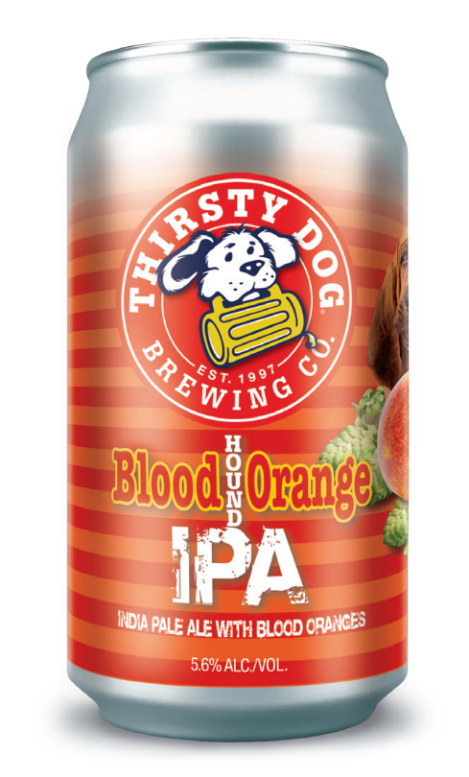
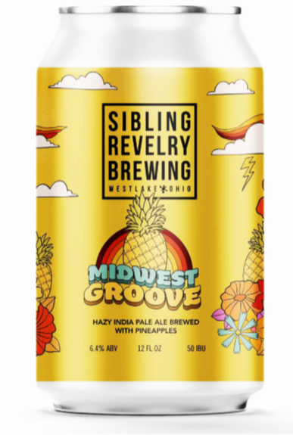
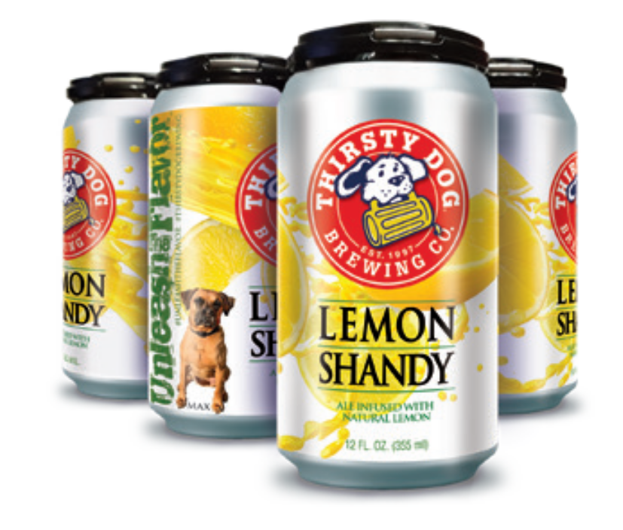
Craft local
Thirsty Dog, Akron
A bright and
refreshing beer
with a sweet body
that finishes into
a crisp lemon
aftertaste. Based
on the European
tradition of blending
beer with lemonade
to cool off on hot
days.
5.5% ABV
.
Thirsty Dog, Akron
Our New England Style IPA is infused with blood oranges
and hopped with Azacca & Centennial hops for a refreshing,
fruit flavored sensation.
5.6% ABV
Sibling Revelry, Westlake
Get groovy and take a trip back to sunny, simpler times with Midwest Groove, our pineapple IPA. Bursting with far-out flavors of juicy pineapple
6.4%ABV

Slide 14
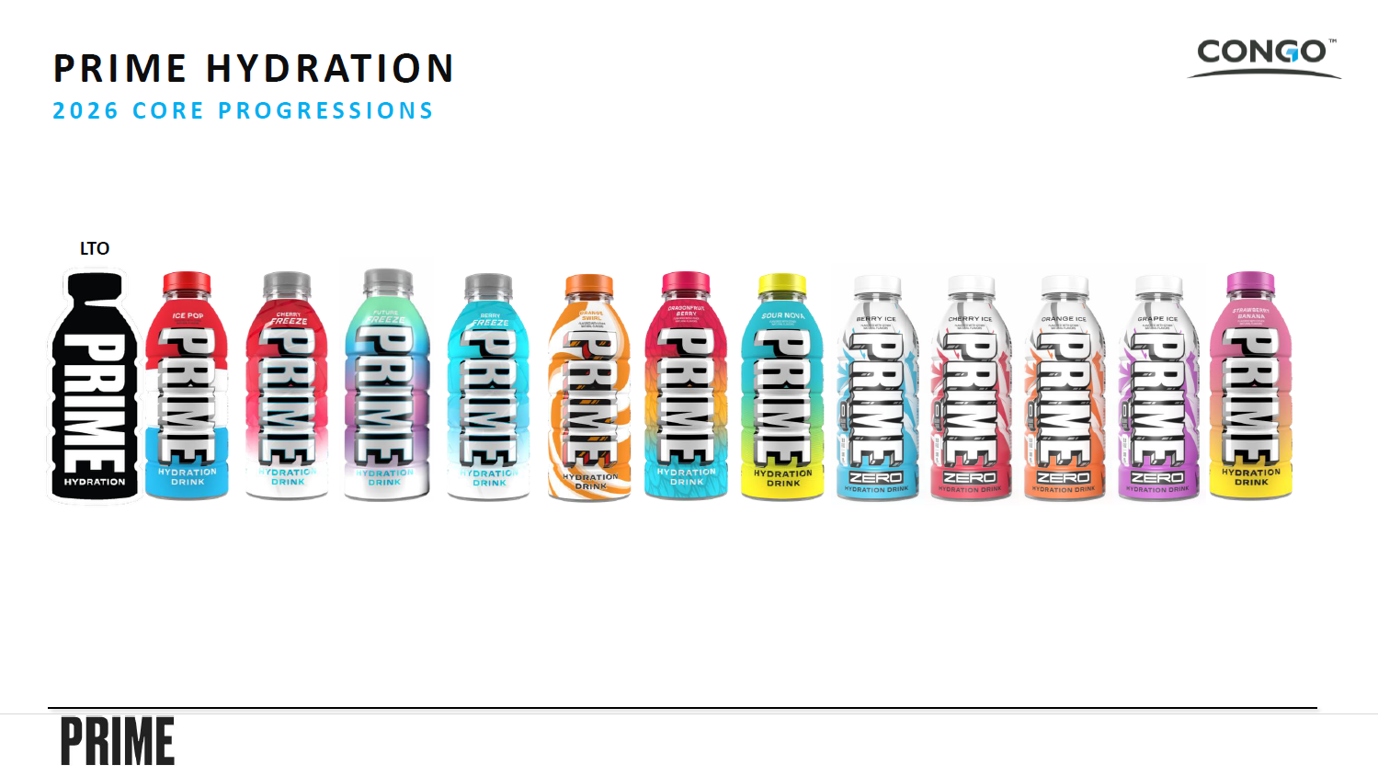
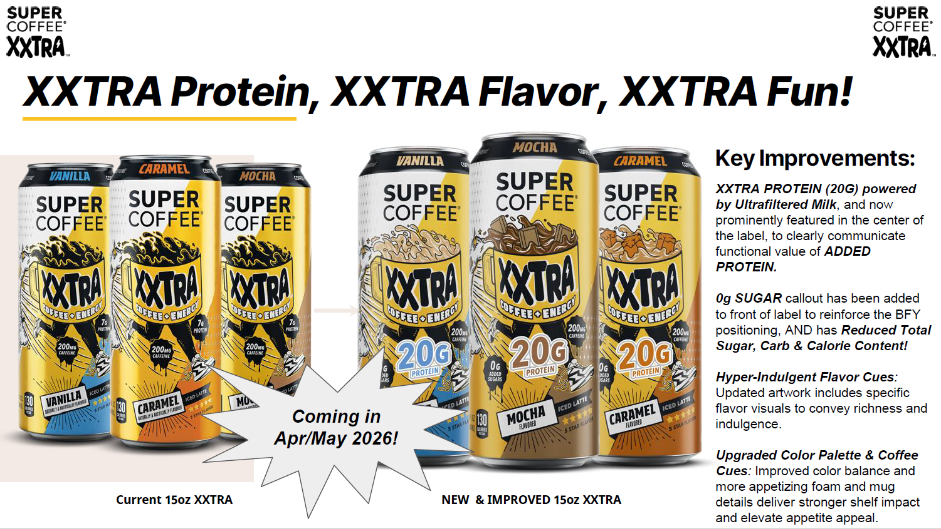
ENERGY & HYDRATION

Slide 15
