Slide 1
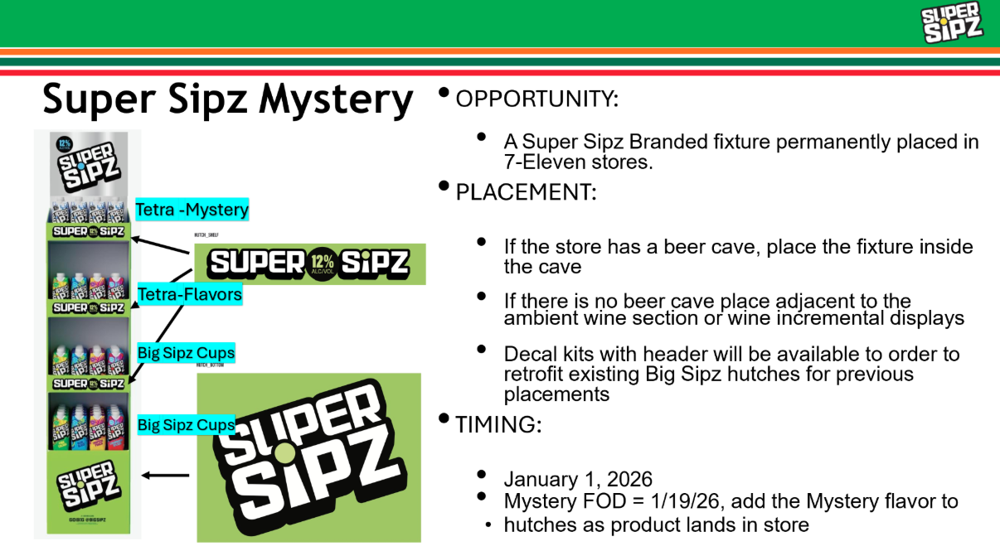

Slide 2





Super Sipz 500ml Tetra –2026 Program
National Program: Super Sipz Hutch Placement
PROGRAM DETAILS
BRAND | ITEM | SHIP DATE | START – END DATE | SRP / PROGRAM PRICING | 30 / 90 VOLUME EST.
Super Sipz | All 500ml tetras | On going | 1/1/26 - 12/31/26 | $3.49-$3.99 | 7000/10,000 cases
WHAT DOES SUCCESS LOOK LIKE
Follow 2025 recommended schematic for merchandising guidelines Ensure pricing tags are displayed on hutch Ensure Super Sipz SLINS are mark as ‘carried’
Super Sipz is a top private label driving strong incremental growth
Super Sipz is the #3 500ml tetra brand in Total US Convenience in all time periods
7E private brands +85% $ & +5.5M over prior year
INSIGHTS
LINK TO 7 Eleven P6 PLANNER: TBD
National Launch
Link to program information:
  Super Sipz Mystery-Hutch Information.pptx
Pricing dictated by regional managers
P6 program runs from 10/29/25 - 1/6/26
Program display location: Primary location is the Beer Cave, if store does not have a beer cave, place hutch adjacent to the ambient wine section or incremental wine displays
SUPPORTING DOCUMENTATION
STATE LEVEL INFO

Slide 3
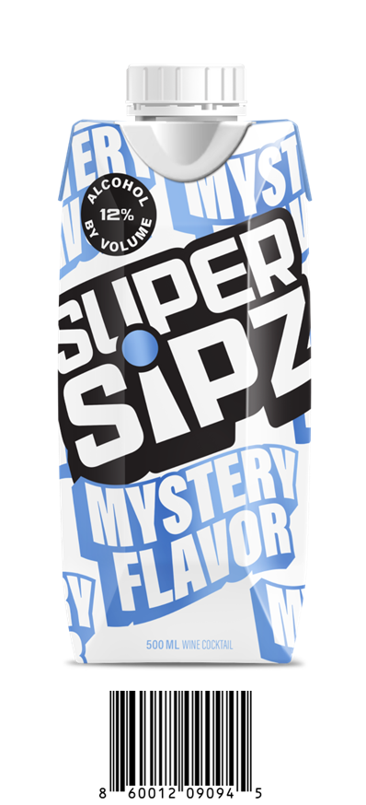



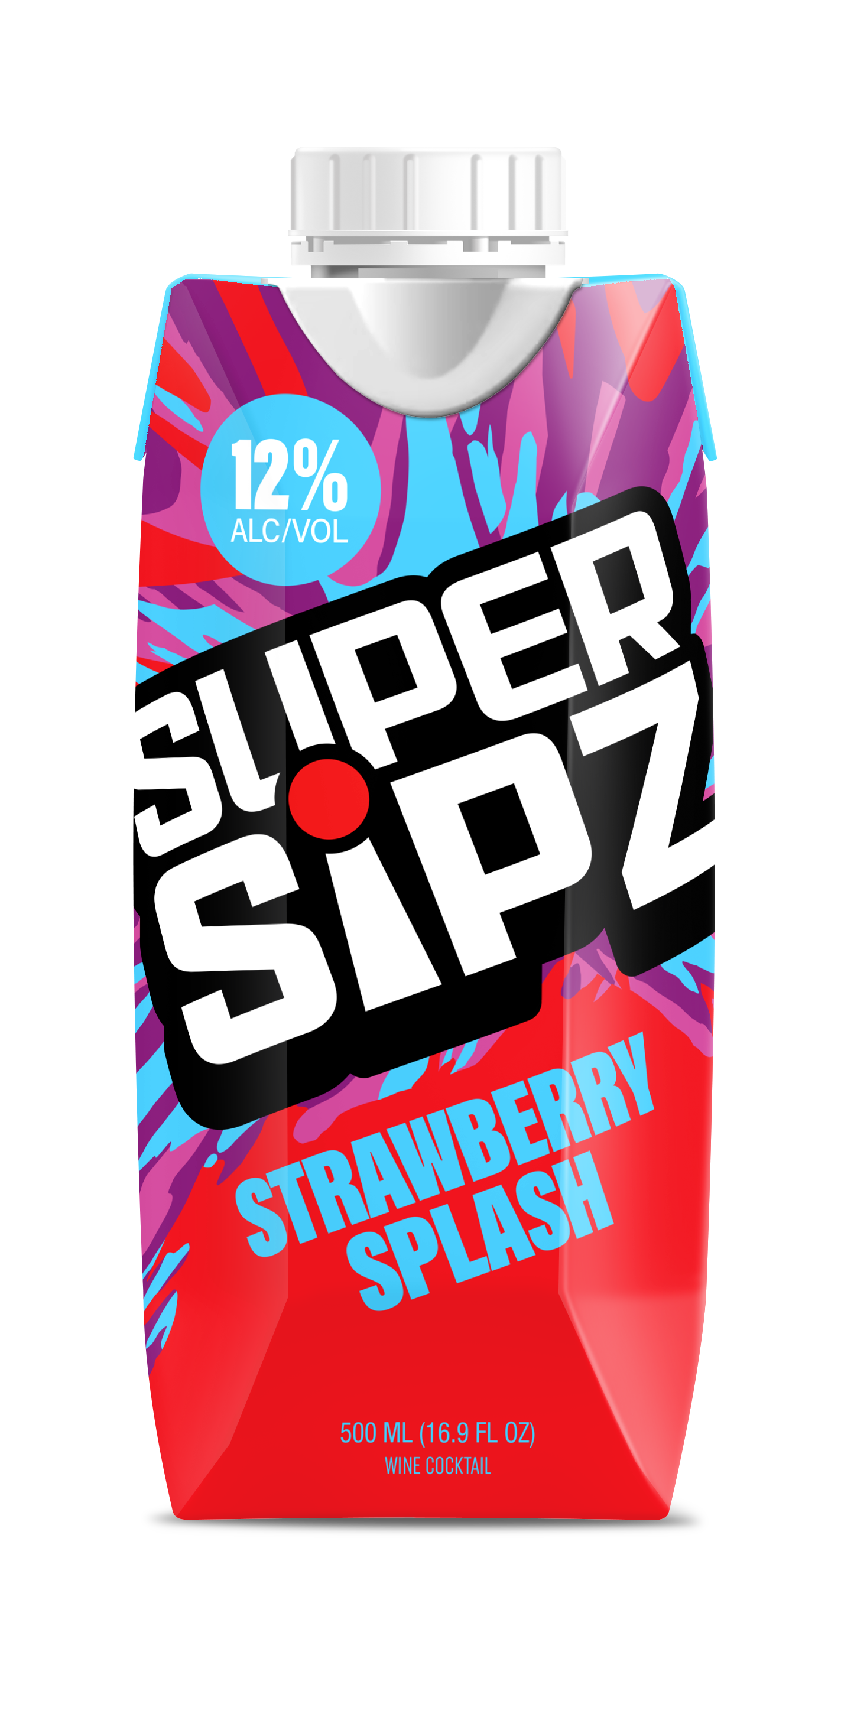
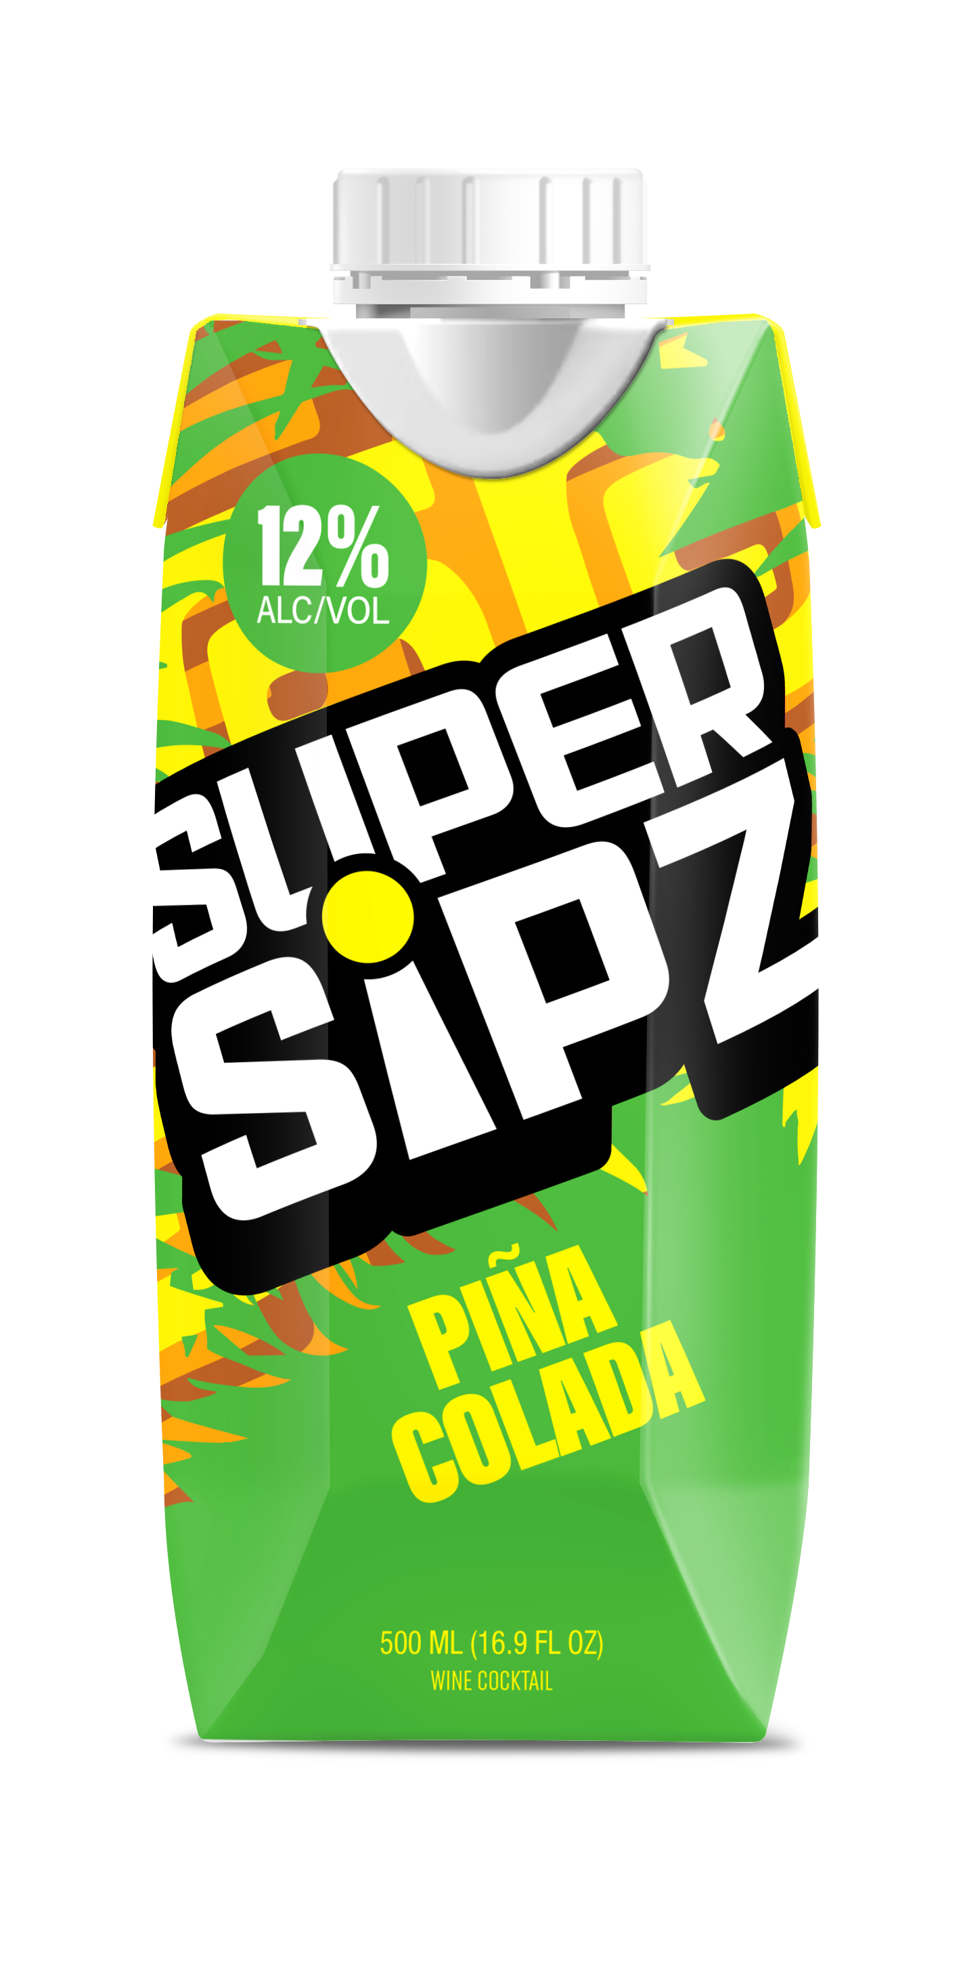
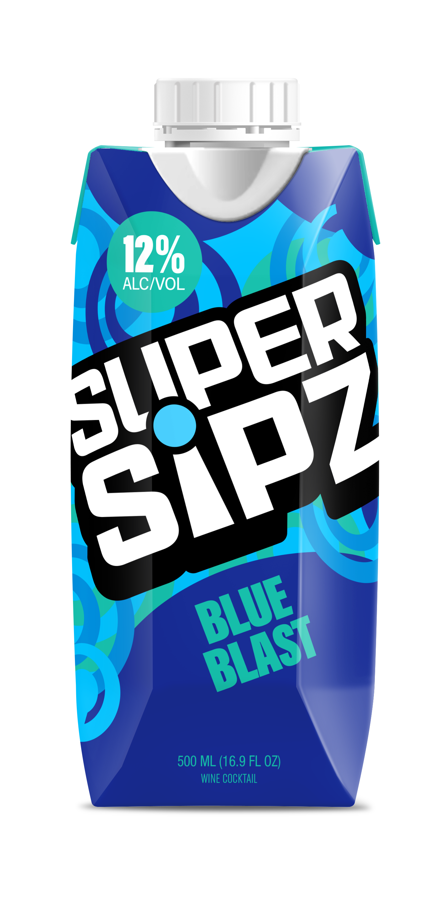
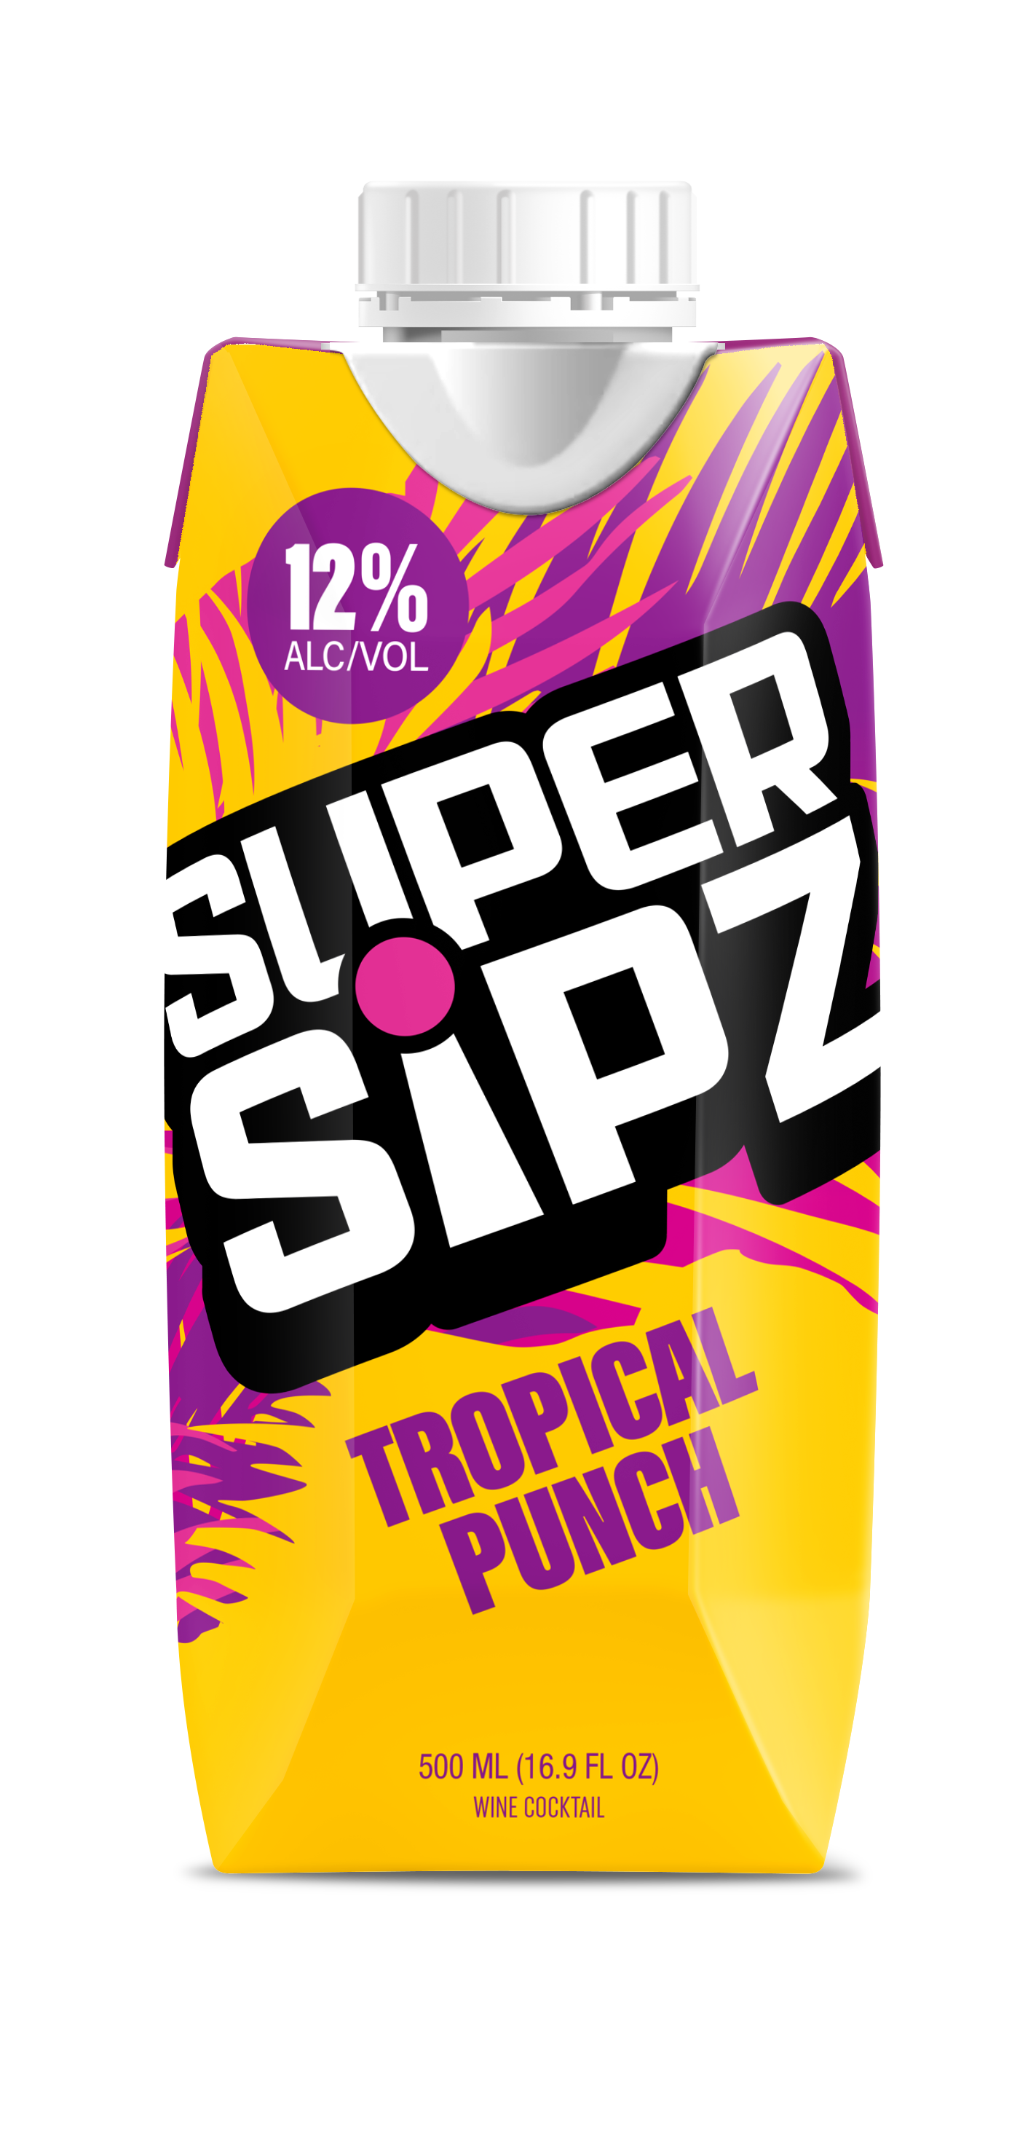




500 ML | 12% ABV WINE BASED TETRAS
Item | SLIN | PDI | SPDWY ID
Strawberry Splash 16.9oz | 105774 | 136536 | 1159297
Pina Colada 16.9oz | 105775 | 136538 | 1159296
Blue Blast 16.9oz | 105776 | 136537 | 1159295
Tropical Punch 16.9oz | 105778 | 136539 | 1159298
Mystery Flavor 16.9oz

Slide 4




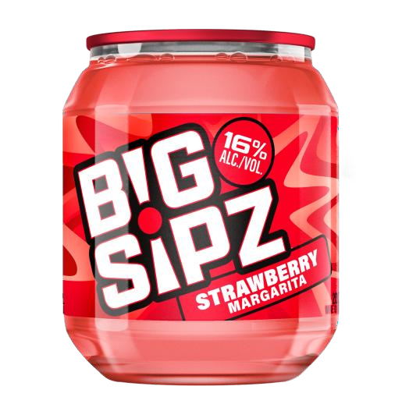
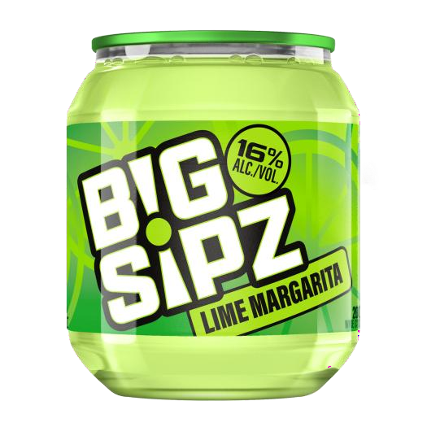
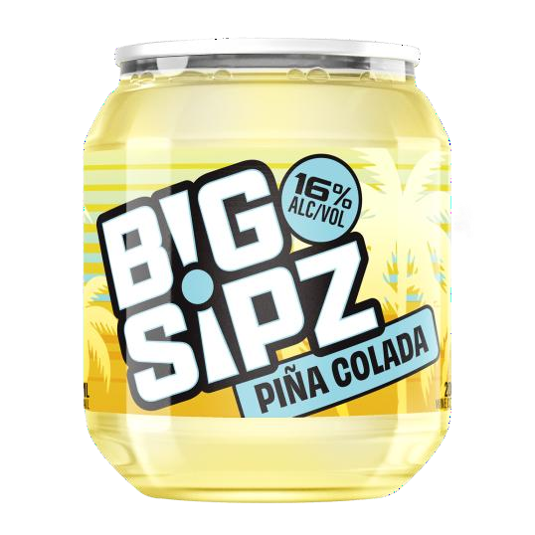









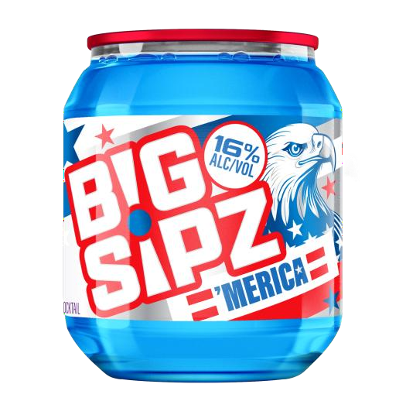



200 ML | 16% ABV WINE BASED CUPS
Item | SLIN | PDI | SPDWY ID
Strawberry Margarita | 109280 | 128948 | 1158005
Lime Margarita | 109281 | 128946 | 1158009
Chocolate Martini | 109282 | 128945 | 1158011
Piña Colada | 109283 | 128947 | 1158010
Diamond | 601664
Merica | 106554 | 137720 | 1159941
Purple Punch | 109290 | 135842 | 1160864

Slide 5




Big Sipz Cups Distribution Drive
“Operation Rising Tide Lifts All Boats” $8,000 Break the Bank GM & BULK
Who: Ohio Beverage Distributing
What: Increase Big Sipz Cups Overall PODs – All Cup SKUs
Where: GENERAL MARKET- 7 Eleven and Independent Off Premise Accounts
Timing: January-February 2026 For Distribution
January for 7-11 hutch portion with qualifier
Sales Reps. Payout: Earn $10 for each ‘NET NEW’ Big Sipz Cup POD by Route
      Additional $15 for each 7 Eleven Hutch display pic w/ both Super Sipz & Big Sipz Cups
        Qualifier: Account must purchase 5 Super Sipz SKUs + 5 Big Sipz Cups SKUs(including Diamond)
        7 Eleven KAM earn $10 for each Hutch display picture submitted w/ all SKUs
          Hutch Pictures required: Turned into SM/BM no later than 2/2/26
        The base line is 90 days back from 11/30/25
        50/50 co-op

Slide 6
Big Sipz Cups Distribution Drive
“Operation Rising Tide Lifts All Boats” $8,000 Break the Bank GM & BULK
Who: Ohio Beverage Distributing
What: Increase Big Sipz Cups & Jugz Overall PODs – All skus
Where: BULK Team
Timing: December – March 2026
Sales Reps. Payout: Earn $10 for each ‘NET NEW’ Big Sipz Cup & Jug Placement
        The base line is 90 days back from 11/30/25
        50/50 co-op

