Slide 1

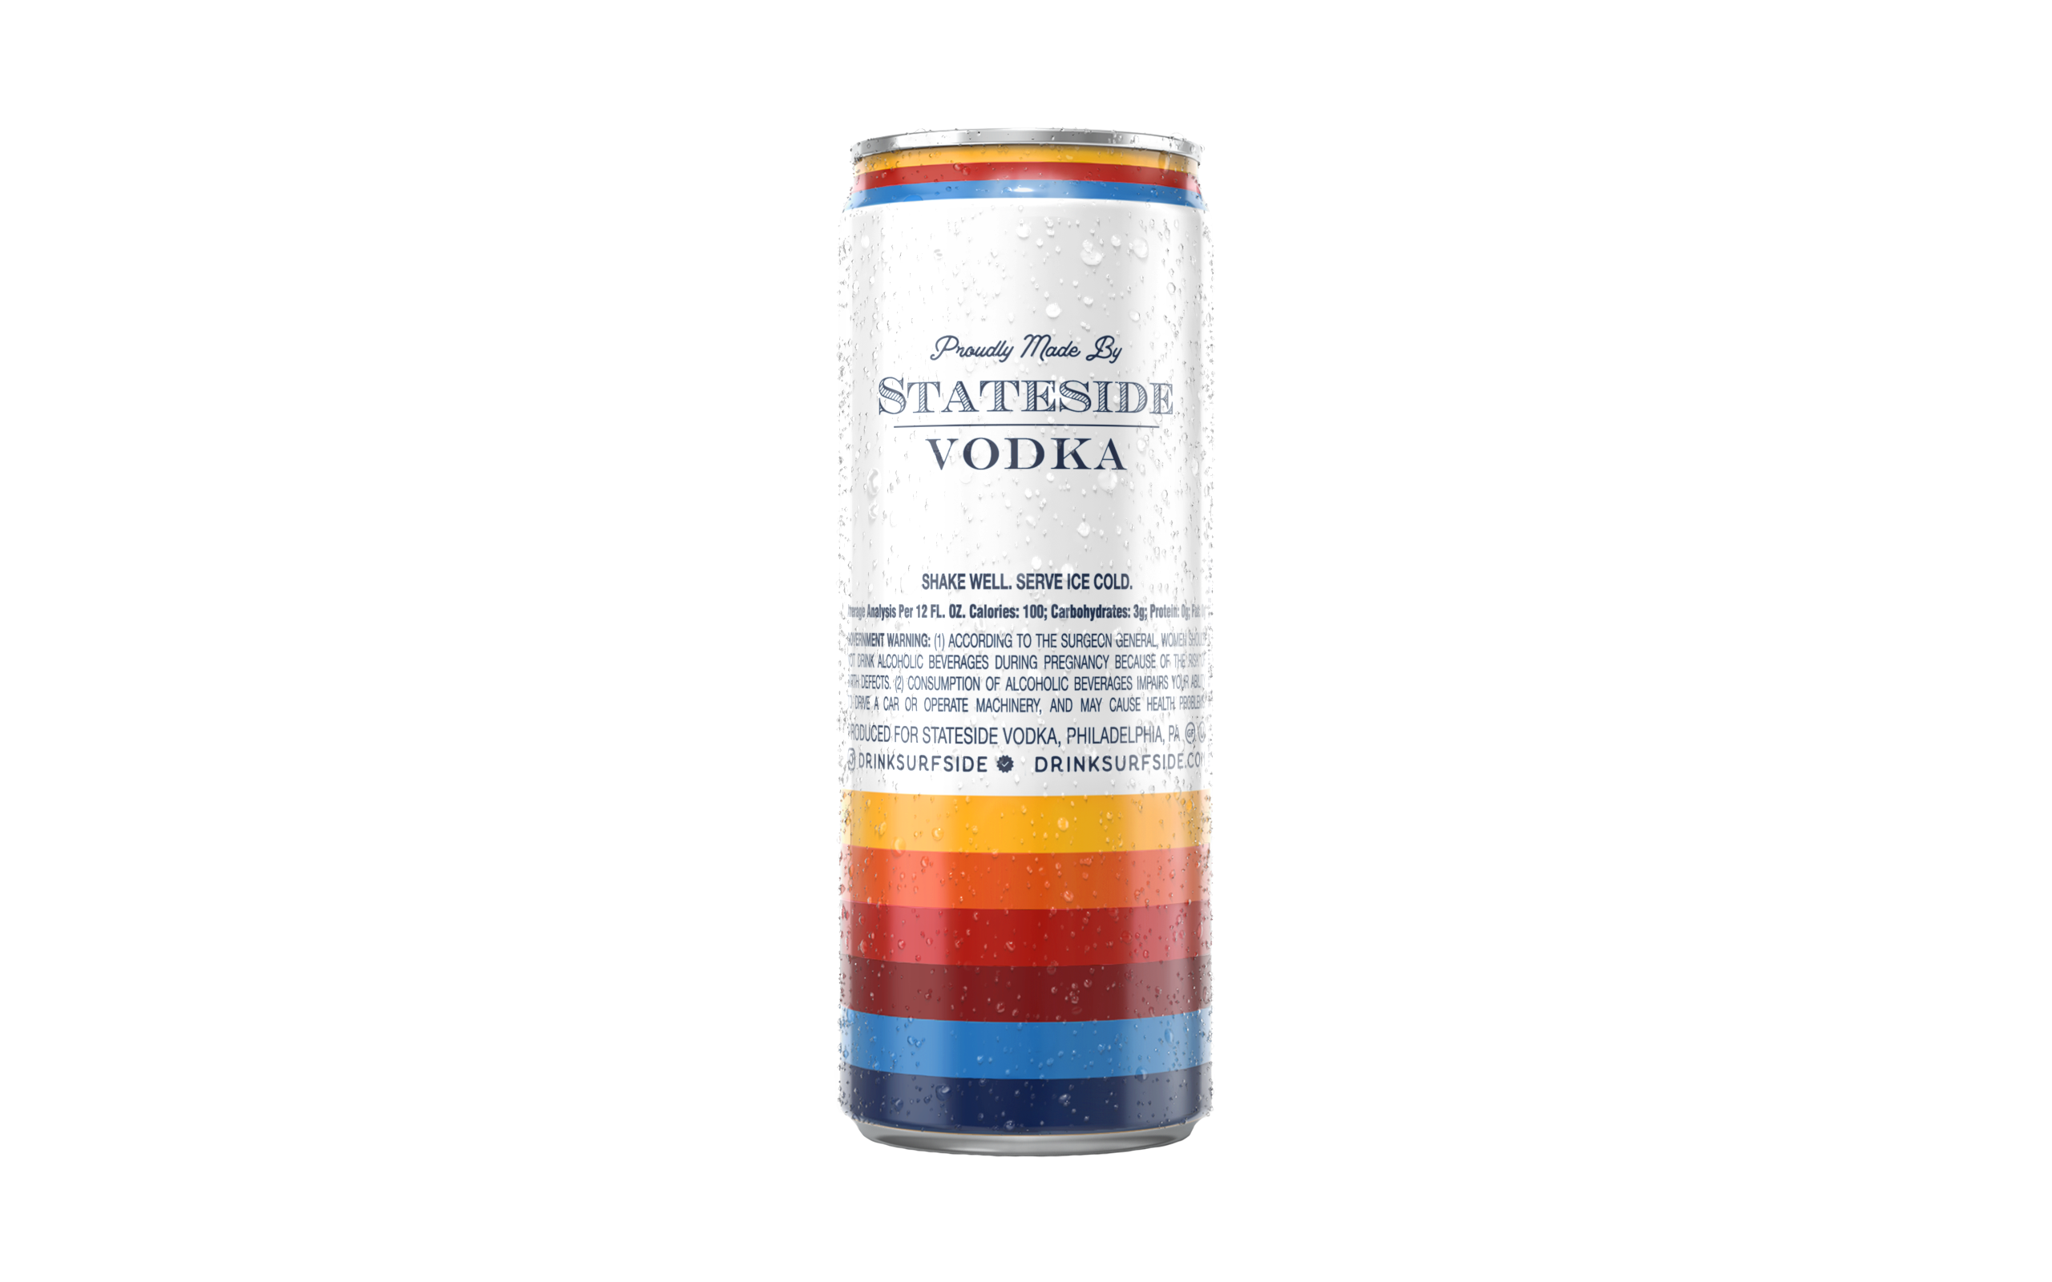
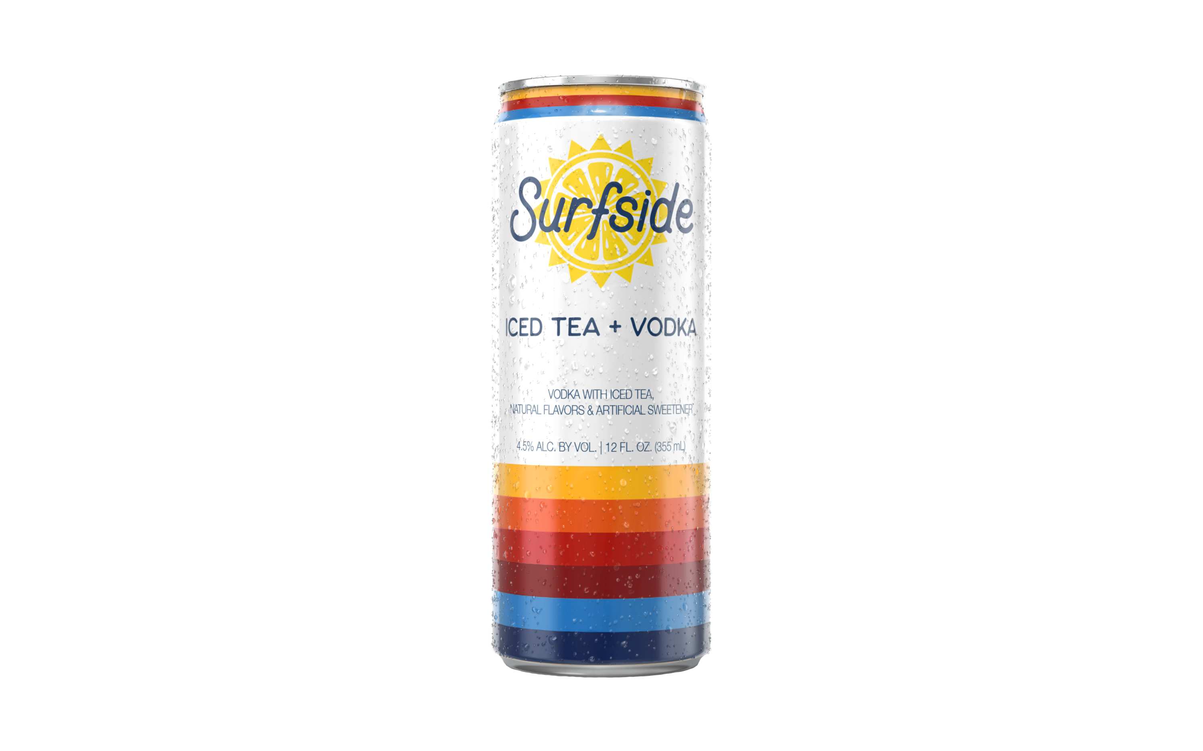
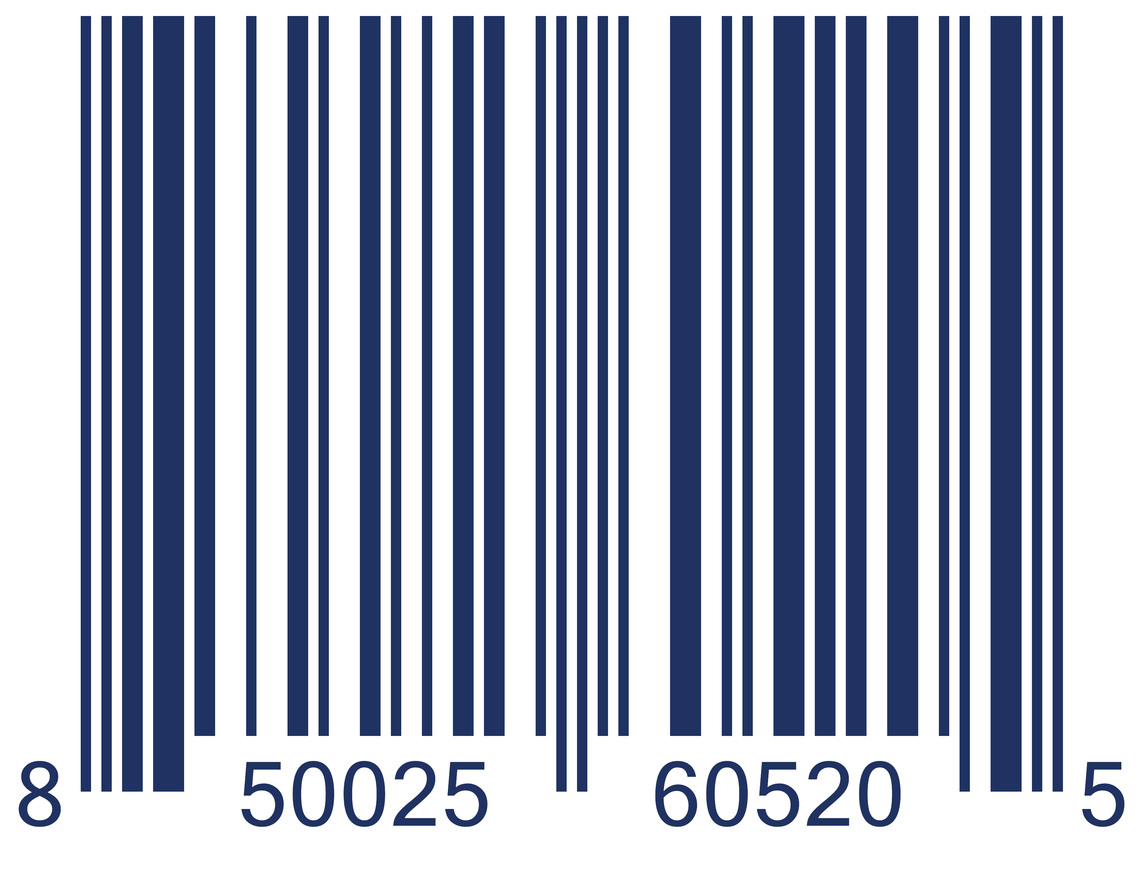
SURFSIDE ICED TEA + VODKA 12oz CANS LOOSE
Surfside Iced Tea + Vodka 12oz Cans Loose
Sunshine in a can! Vodka with Iced Tea.
No Bubbles, Only 100 Calories and 2g Sugar per can.
Gluten Free and OU Kosher Certified.
Case Quantity | 24 x 12oz Cans
Case Configuration | 24 Loose Cans
Pack Contents | N/A
Proof/ABV | 9/4.5% ABV
Can Dimensions | 2.3"W x 2.3"D x 6.1" H
Case Weight | 20.5 lb
Case Dimensions | 13.6" W x 9.1"L x 6.2" H
Can UPC | 850025605205
Case UPC | 850025605496
SCC Code | 20850025605209
Case Per Pallet | 104
Cases Per Layer | 13
Layers Per Pallet | 8
Can UPC
Can Front
Can Back

Slide 2
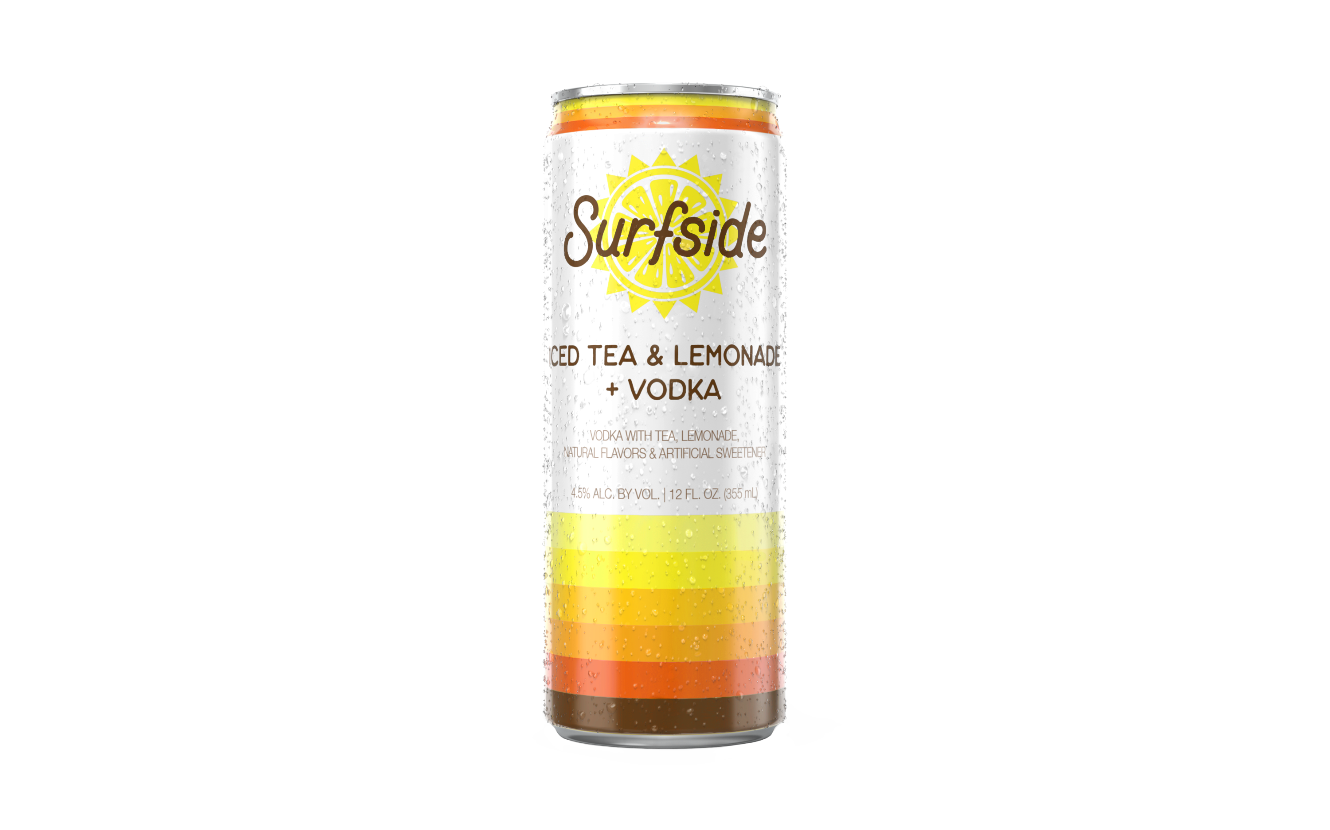
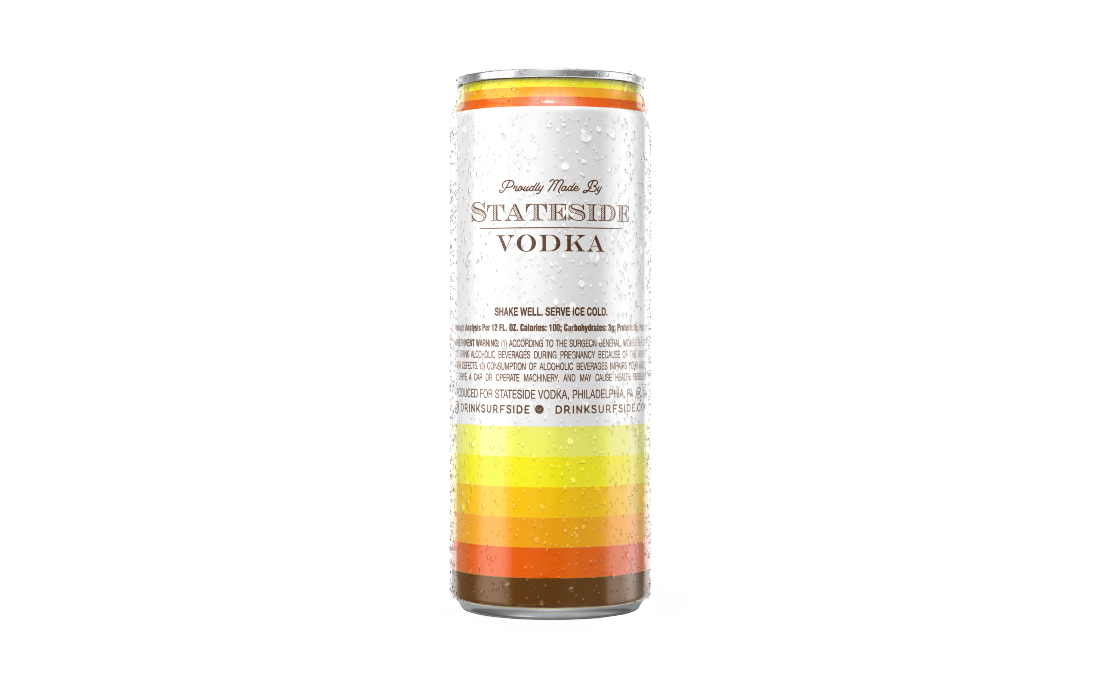

SURFSIDE ICED TEA & LEMONADE + VODKA 24 CANS LOOSE
Surfside Iced Tea & Lemonade + Vodka 24 Cans Loose
Sunshine in a can! Vodka with Iced Tea & Lemonade.
No Bubbles, Only 100 Calories and 2g Sugar per can.
Gluten Free and OU Kosher Certified.
Case Quantity | 24 x 12oz Cans
Case Configuration | 24 Loose Cans
Pack Contents | N/A
Proof/ABV | 9/4.5% ABV
Can Dimensions | 2.3"W x 2.3"D x 6.1" H
Case Weight | 20.5 lb
Case Dimensions | 13.6" W x 9.1"L x 6.2" H
Can UPC | 850025605427
Case UPC | 850025605458
SCC Code | 10850025605424
Case Per Pallet | 104
Cases Per Layer | 13
Layers Per Pallet | 8
Can UPC
Can Front
Can Back

Slide 3
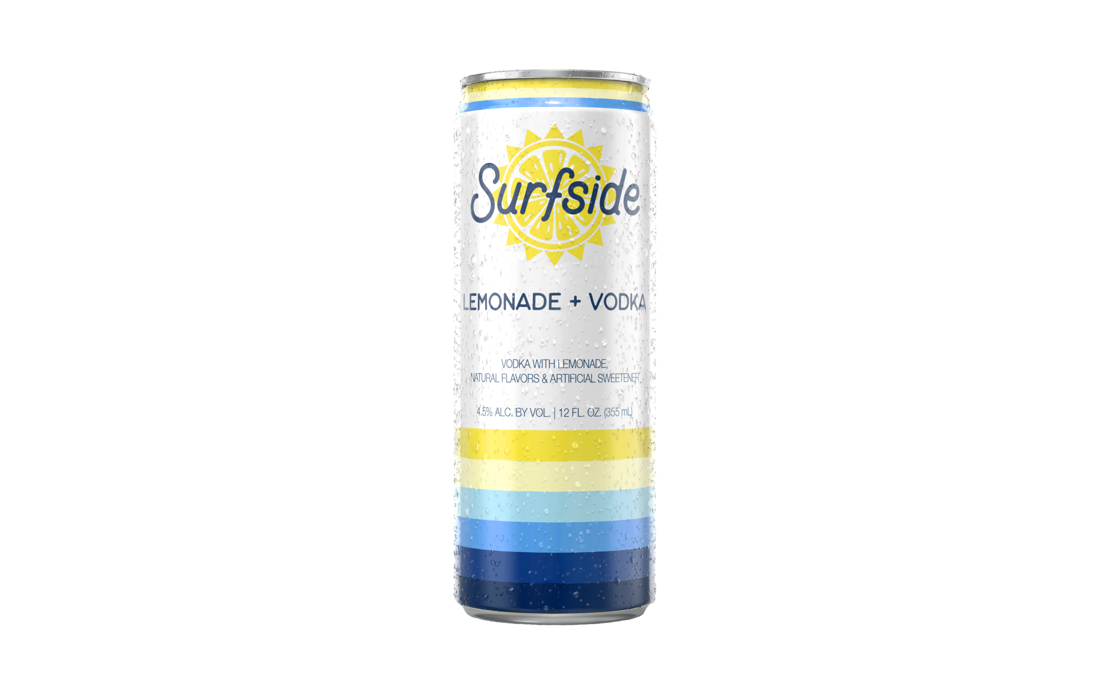
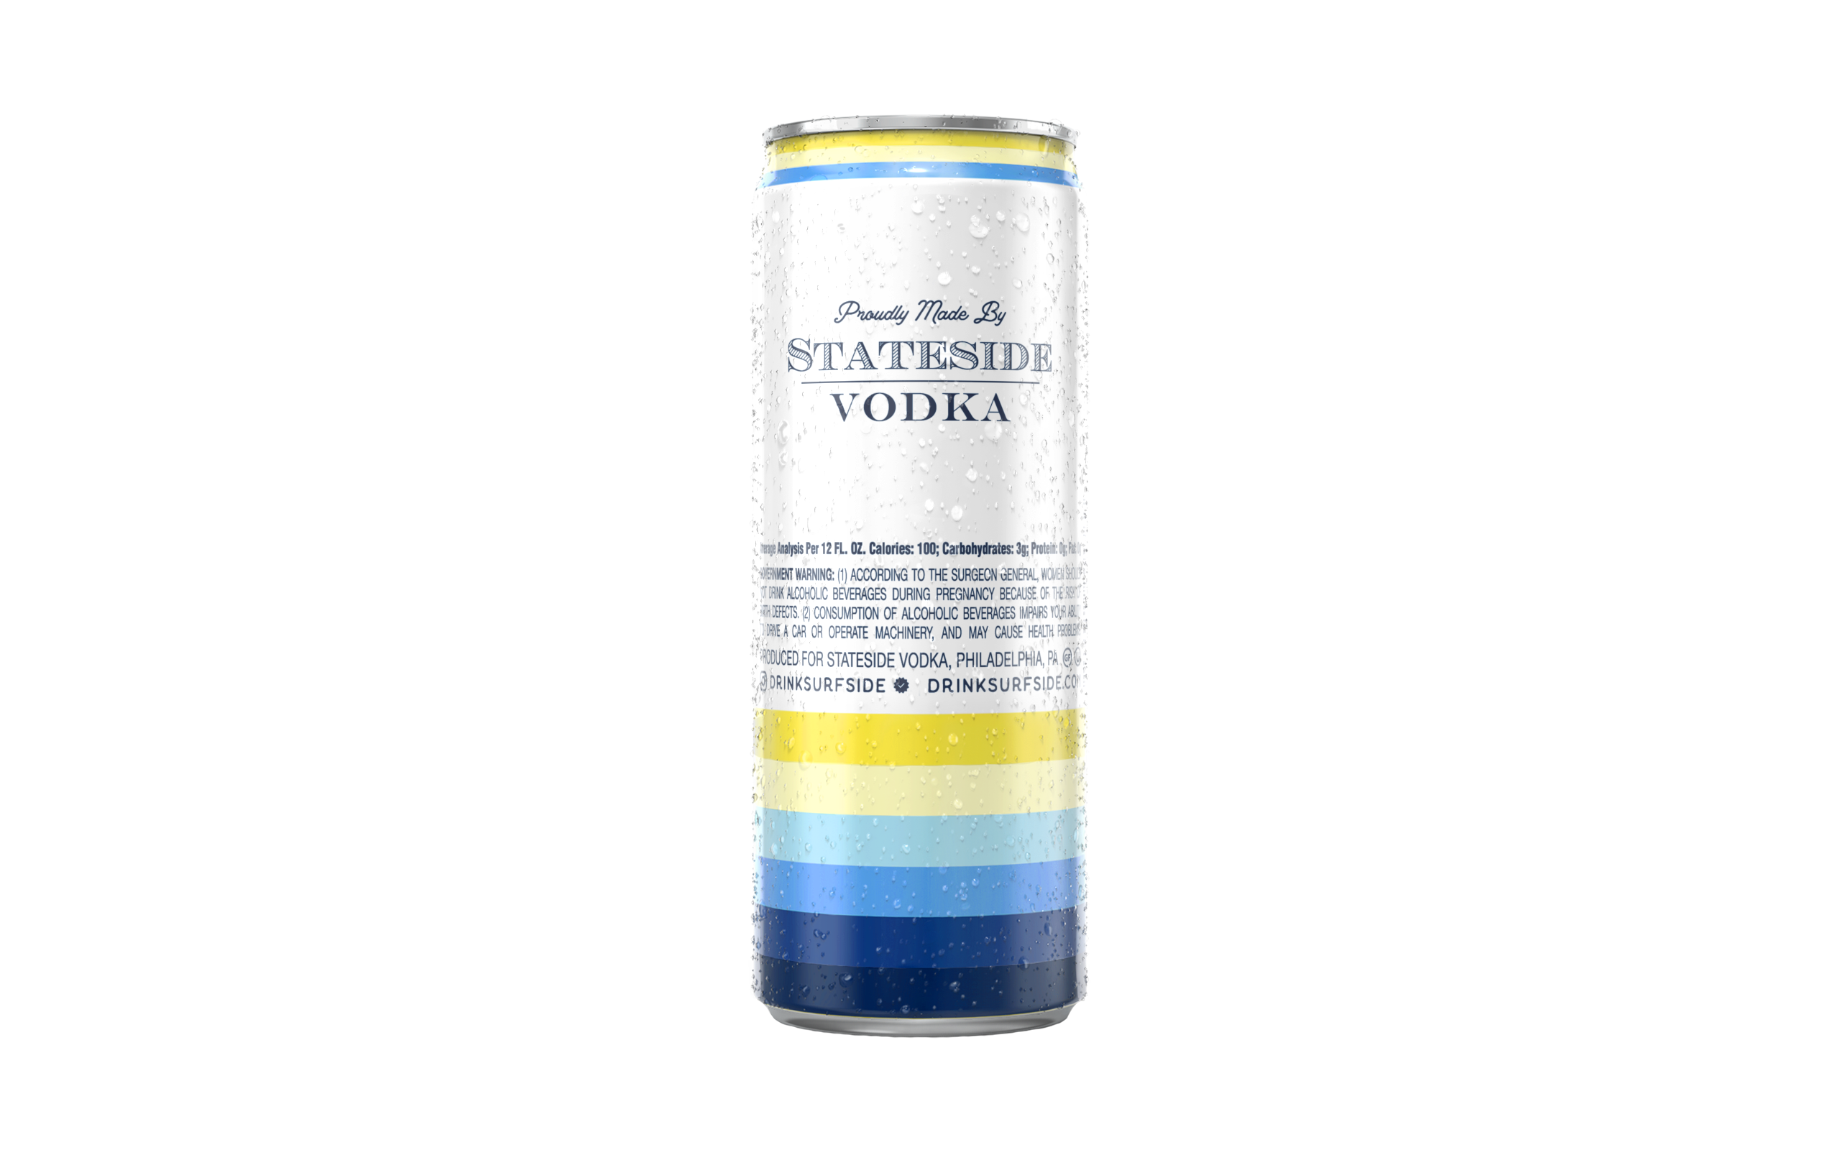

SURFSIDE LEMONADE + VODKA 12oz CANS LOOSE
Surfside Lemonade + Vodka 24 Cans Loose
Sunshine in a can! Vodka with Lemonade.
No Bubbles, Only 100 Calories and 2g Sugar per can.
Gluten Free and OU Kosher Certified.
Case Quantity | 24 x 12oz Cans
Case Configuration | 24 Loose Cans
Pack Contents | N/A
Proof/ABV | 9/4.5% ABV
Can Dimensions | 2.3"W x 2.3"D x 6.1" H
Case Weight | 20.5 lb
Case Dimensions | 13.6" W x 9.1"L x 6.2" H
Can UPC | 850025605366
Case UPC | 850025605403
SCC Code | 10850025605363
Case Per Pallet | 104
Cases Per Layer | 13
Layers Per Pallet | 8
Can UPC
Can Front
Can Back

Slide 4
