Slide 1
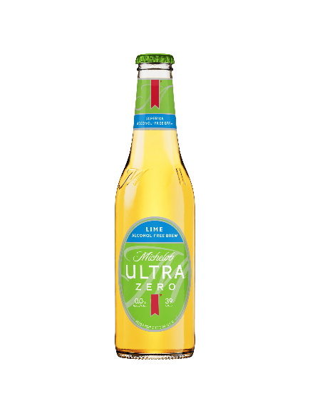
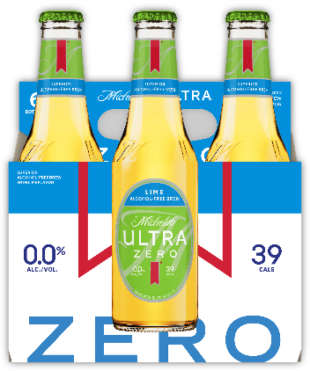
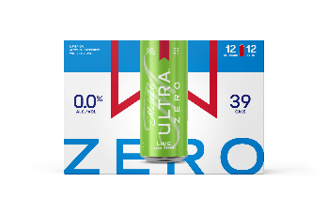



Michelob ULTRA Zero Lime
IGNITE JOB
TARGET CONSUMER
  Trade Up
35+ Co-ed
Introducing Michelob ULTRA Zero Lime – a refreshing alcohol-free brew with a citrus twist and just 39 calories
GROWTH DRIVER
OCCASION
  Meaningfully Premium
  Expanding active lifestyle occasions
Beer Style | Color | Flavor Profile | ABV | Calories
0.0% alc/vol Light Lager | Light Amber | A light 0.0% ABV light lager with lime and a refreshingly crisp finish | 0.0% | 39
Features | An easy-drinking alcohol-free brew inspired by the great taste of Michelob ULTRA that consumers love and brewed with real lime.
REASONS TO BELIEVE
Non-Alcoholic Beer is the fastest growing segment in Beer (+26% CAGR), and
premiumizing faster than beer overall
SOURCE: Circana TUS MULC+ W/E 7/27/25
Michelob ULTRA Zero is now the #2 NAB Beer in the category by dollars (L12W) during first year of launch and the 12pk Can is the #2 Share SKU in NAB
SOURCE: Circana TUS MULC+ W/E 7/27/25
Flavored Non-Alcoholic Beer tripled in dollar sales in the past 3 years.
Lime flavored beers +9% volume trend L52W vs. YA
SOURCE: Circana TUS MULC+ W/E 7/27/25
SKU(s) | National: 6pk glass TX/FL/OH/GA: 12pk can
Str | 1/5/2026
Reco’d pricing | Core plus, line with ultra zero
Channel focus | Large format
Logistics | Begin as low, transition to forecast
MARKETING SUPPORT
MEDIA & TRADE SUPPORT: CREATIVE COHESION
INTEGRATION INTO OUR EXCITING BRAND MEGA-PLATFORMS
This is a big bet for Michelob ULTRA! Expect to see Michelob ULTRA Zero seamlessly integrated into our industry-leading Brand programming across Golf, Soccer, Active Living, and MORE.
Enjoy Responsibly
The alcohol beverage laws of individual states vary regarding the merchandising and promotion of beers. You should be guided accordingly.
© 2026 Anheuser-Busch InBev Michelob ULTRA ® Beer, St. Louis, MO.

Slide 2






Michelob ULTRA Zero Lime
IGNITE JOB
TARGET CONSUMER
  Trade Up
35+ Co-ed
Introducing Michelob ULTRA Zero Lime – a refreshing alcohol-free brew with a citrus twist and just 39 calories
GROWTH DRIVER
OCCASION
  Meaningfully Premium
  Expanding active lifestyle occasions
Pack | CASE UPC | UNIT UPC | CARRIER UPC
6pk Bottle
12pk Can
SKU(s) | National: 6pk glass TX/FL/OH/GA: 12pk can
Str | 1/5/2026
Reco’d pricing | Core plus, line with ultra zero
Channel focus | Large format
Logistics | Begin as low, transition to forecast
Enjoy Responsibly
The alcohol beverage laws of individual states vary regarding the merchandising and promotion of beers. You should be guided accordingly.
© 2026 Anheuser-Busch InBev Michelob ULTRA ® Beer, St. Louis, MO.

