Slide 1


Slide 4


Slide 5
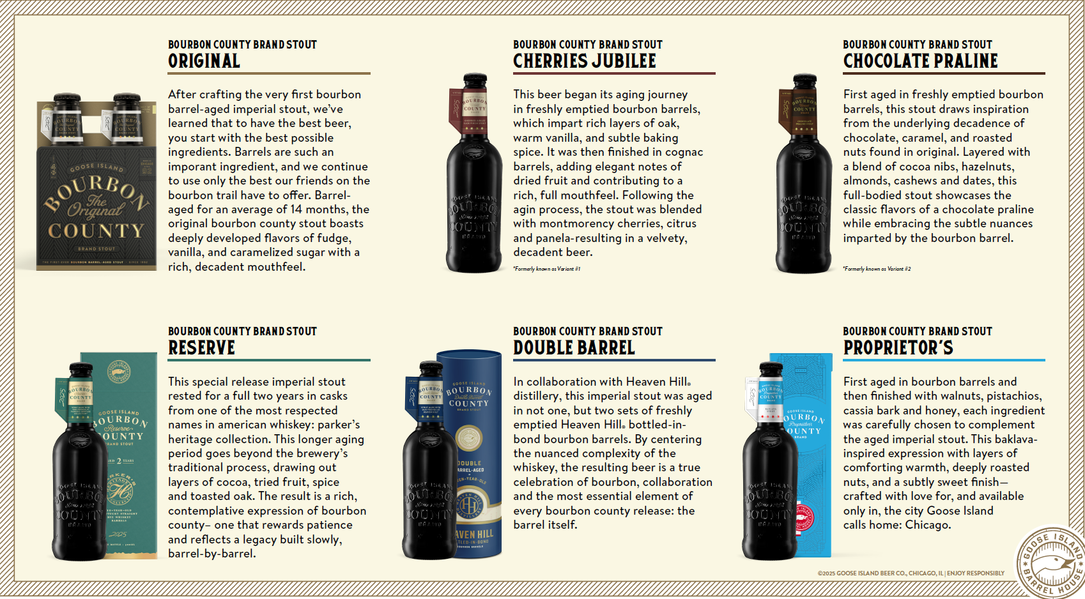
VERY LIMITED!!!
VERY LIMITED!!!
CHICAGO ONLY

Slide 6
