Slide 1
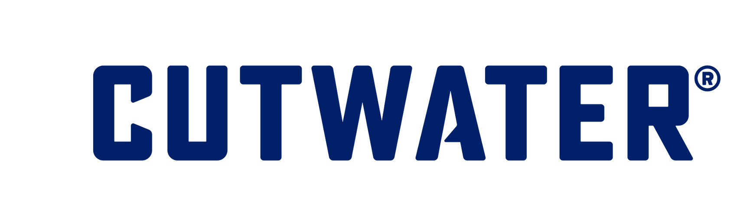
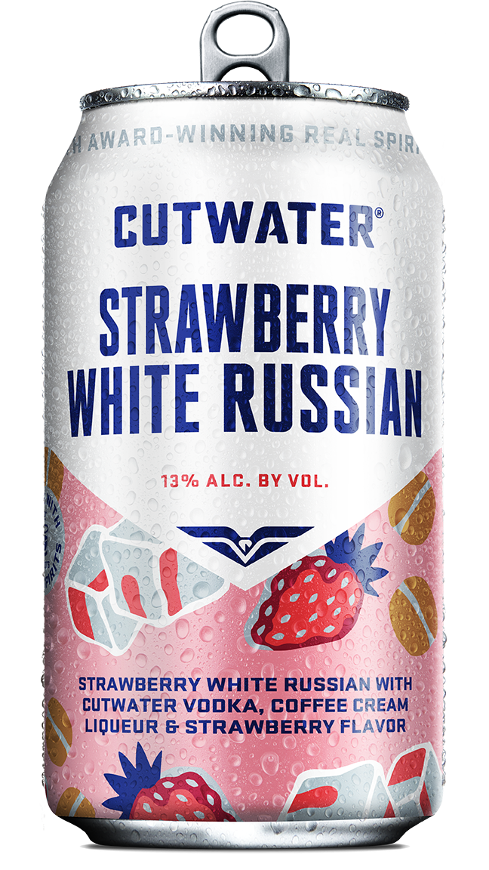
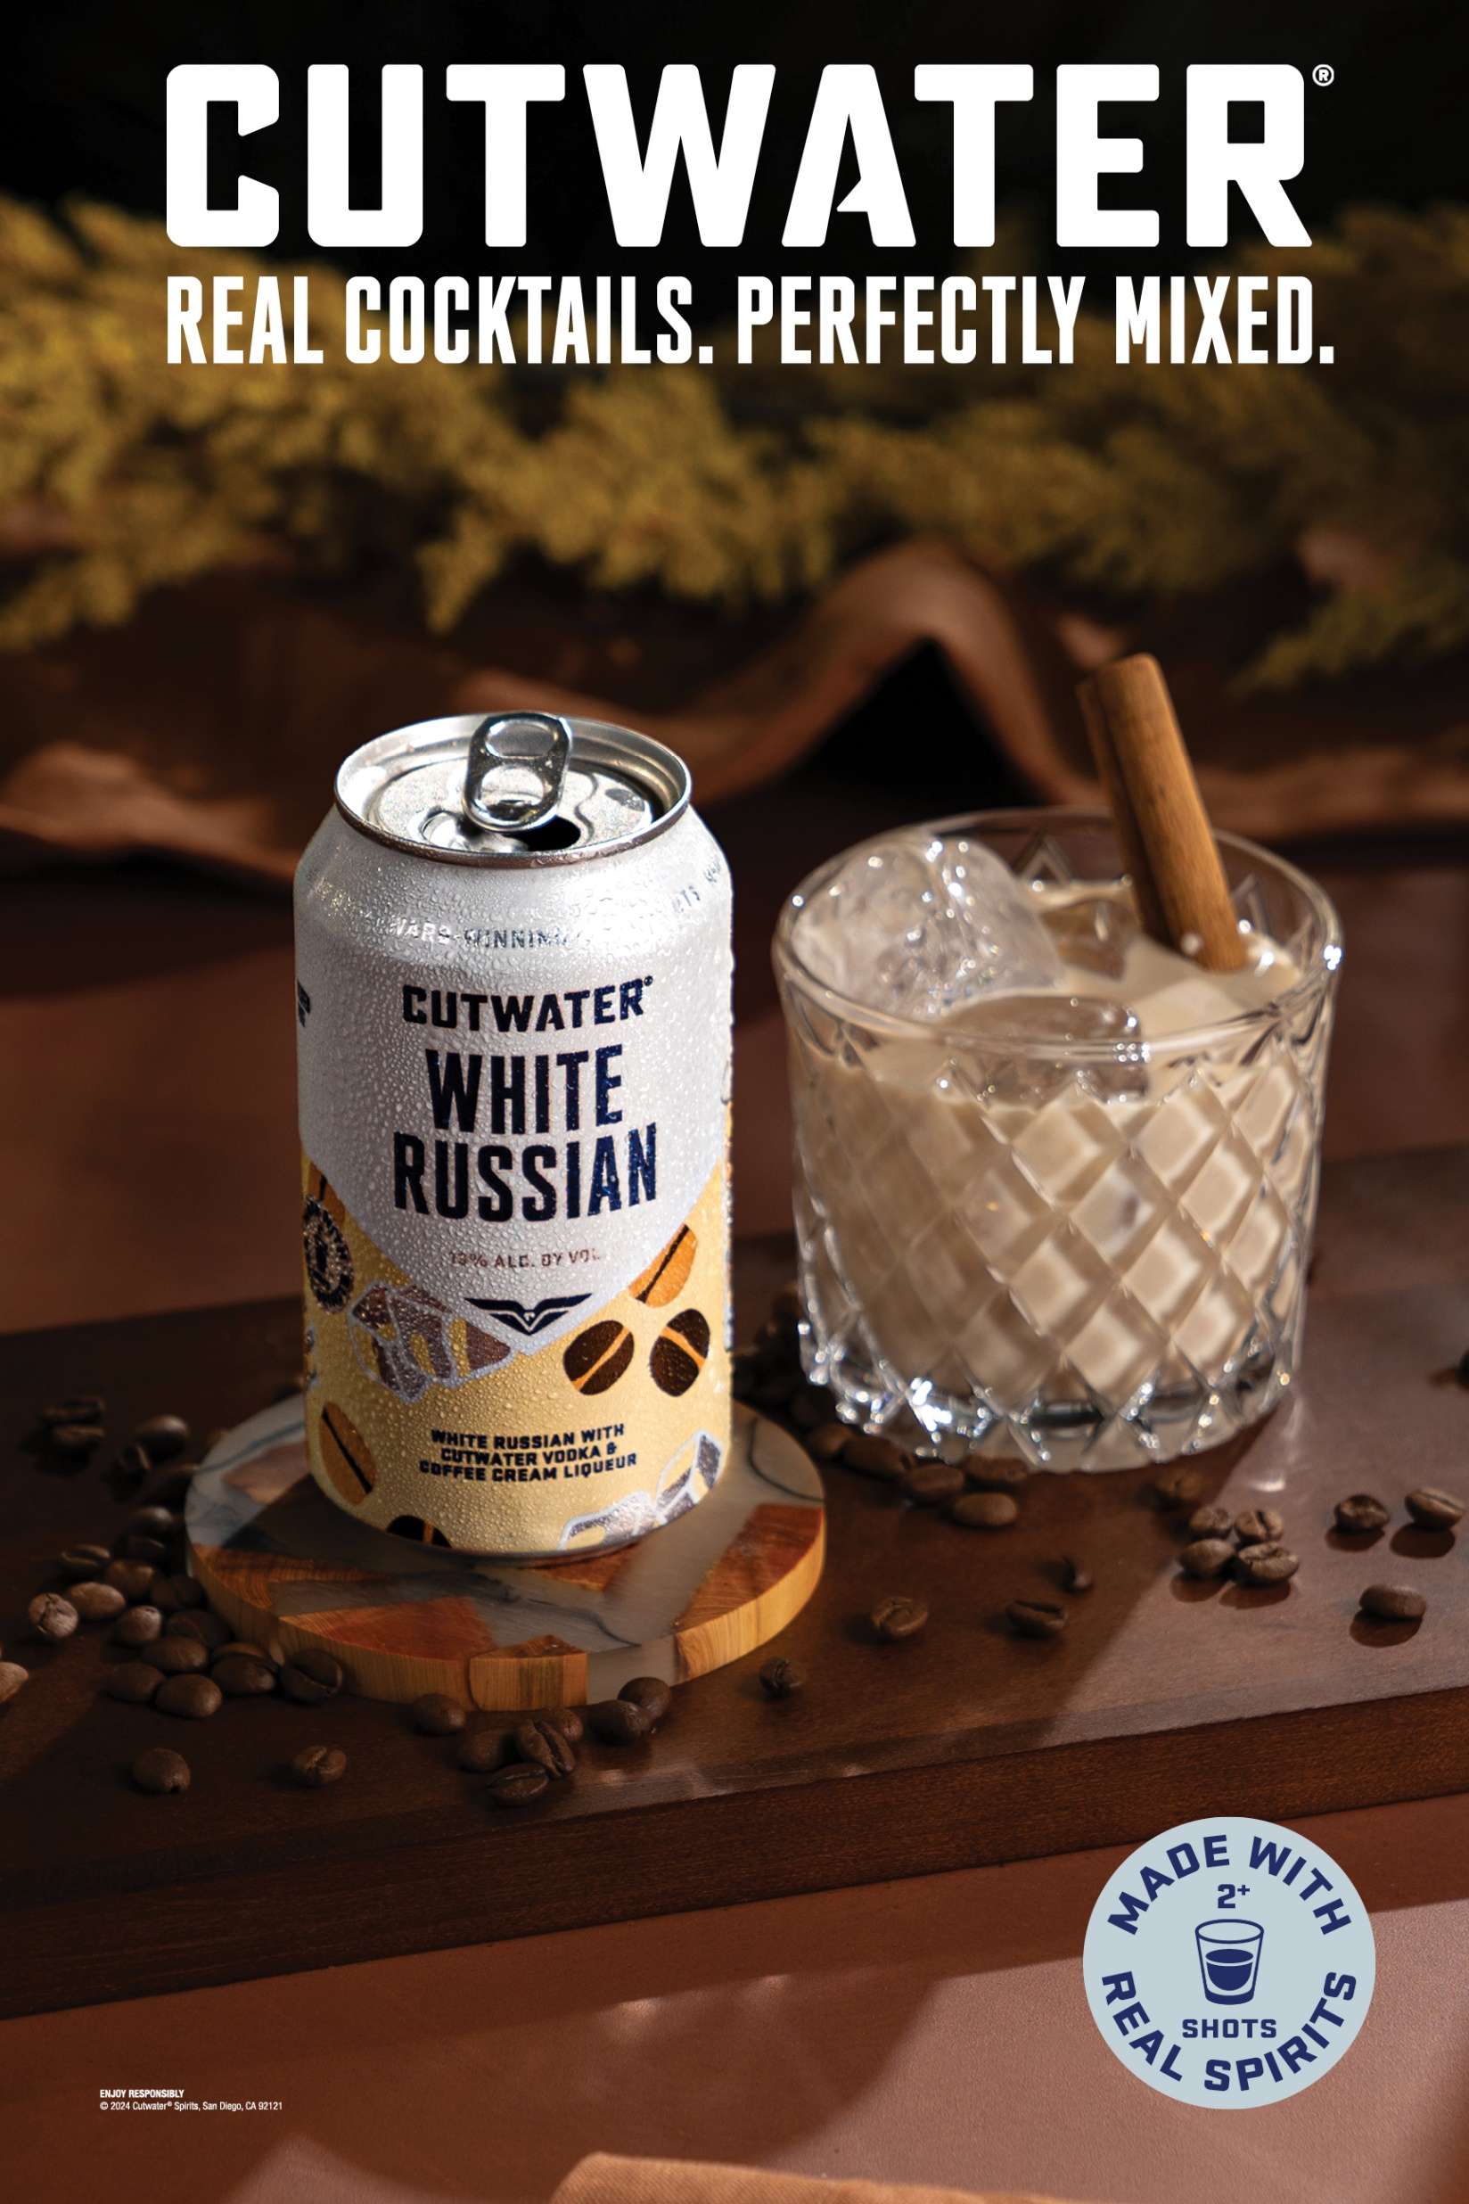
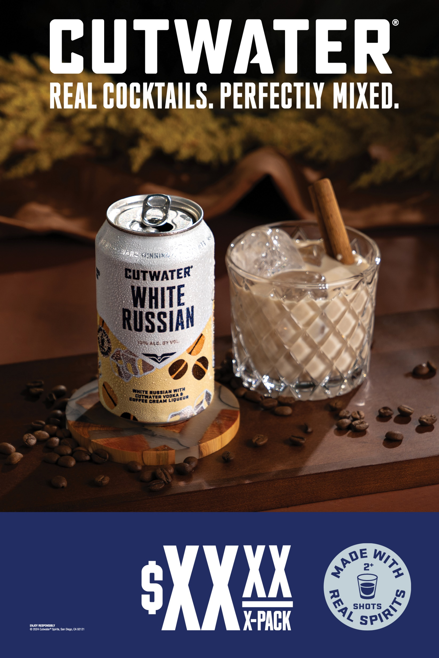
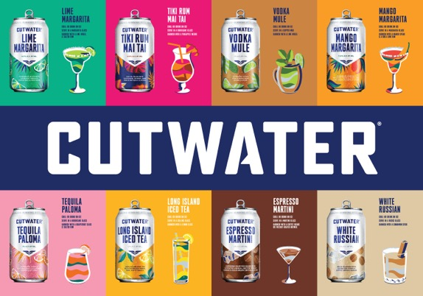
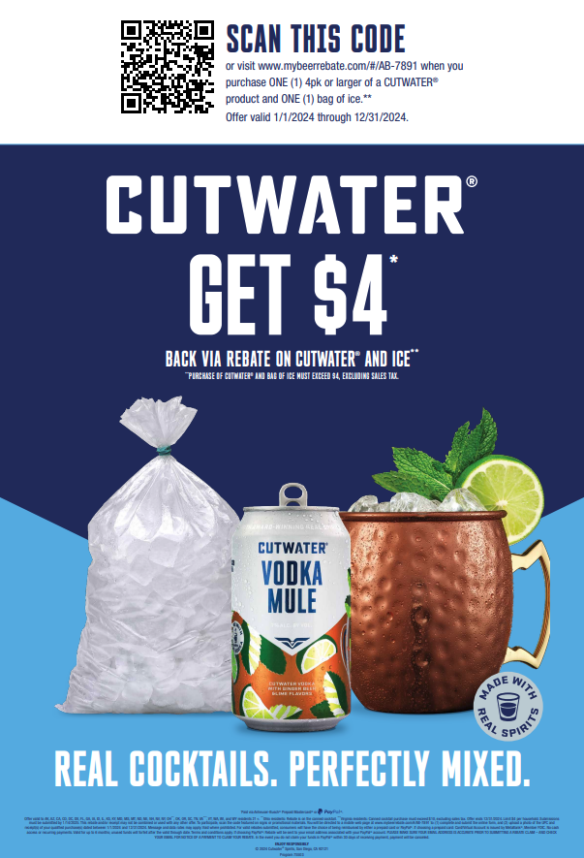
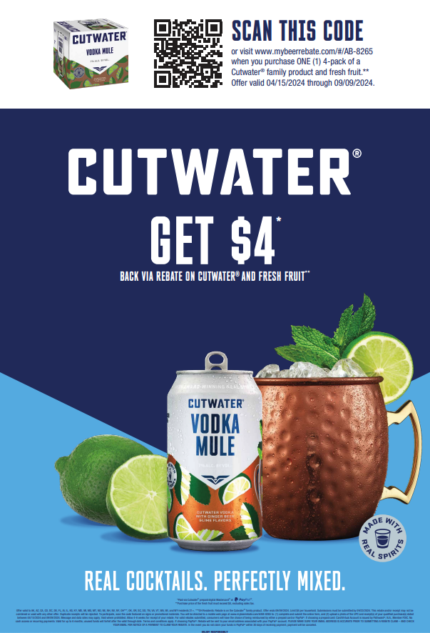

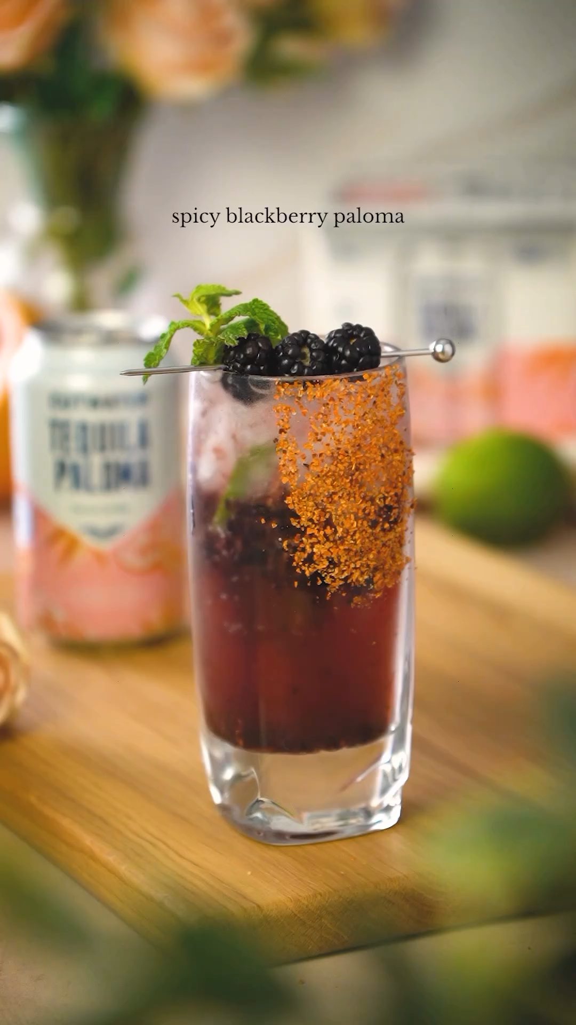
Ignite Job
Target Consumer
Invite New Consumers
GENDER | AGE
Co-Ed | 25-34
 | 35-54
Macro Trends
Strawberry
White Russian
120z 4pk
  Meaningfully Premium Flavor Variety
Reasons To Believe
REASONS TO BELIEVE
RTB #1
RTB #2
RTB #3
Cutwater White Russian is the #4 vodka-based cocktail in $ sales and Highest Purchase Frequency in portfolio
Peppermint White Russian was the #1 4PK in $ ROS in Q4 2023
Made with Cutwater’s Award-Winning Vodka; only Strawberry White Russian canned cocktail
(SOURCE: Circana L52Wk Data thru 3/30/24.)
(SOURCE: Givaudan Secondary Research, Datassential 2022,
Trade & Marketing Support
Trade & Marketing Support
Trade POCM & SMT
Retail Sampling
XM
& Merch
Social
WIP
Alcohol Style | Color
Spirit Based Cocktails | Pink
Flavor Profile | Featuring our award-winning vodka, coffee cream liqueur and strawberry flavor. Enjoy with a strawberry garnish over ice or straight from our can.
Features/Benefits | Made with our award-winning vodka and natural flavors.
Alcohol Base | ABV
Vodka | 13%

Slide 2
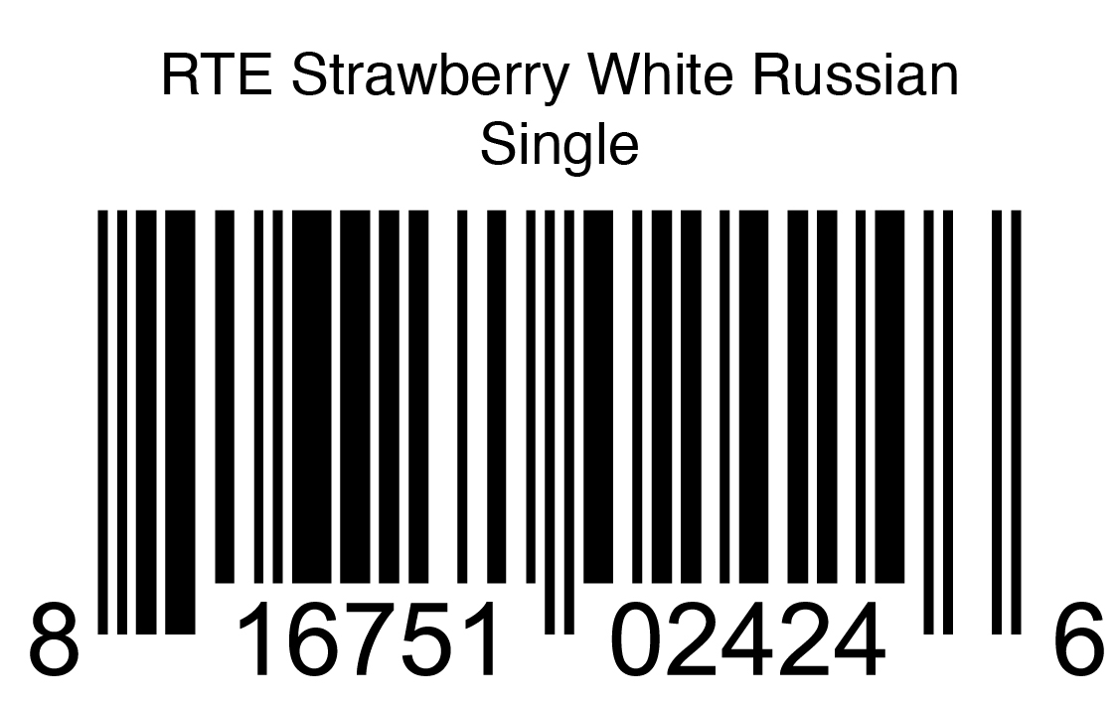
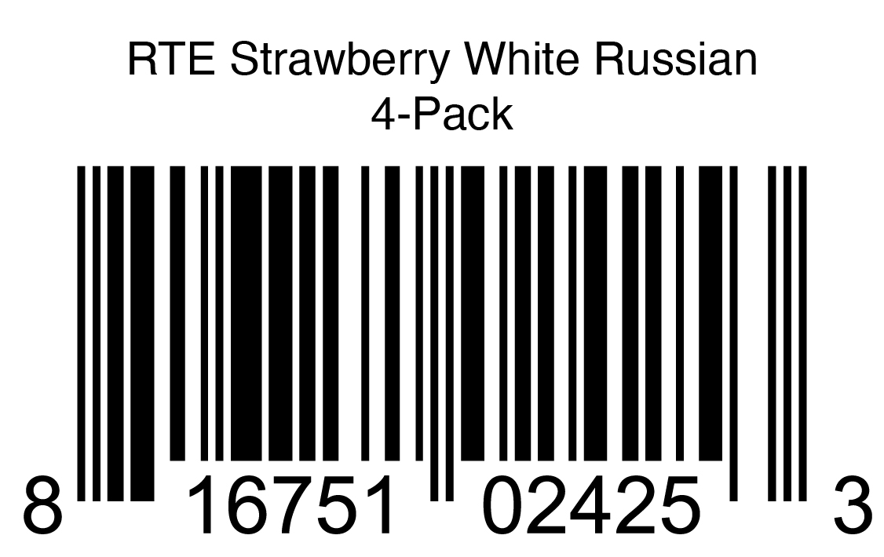
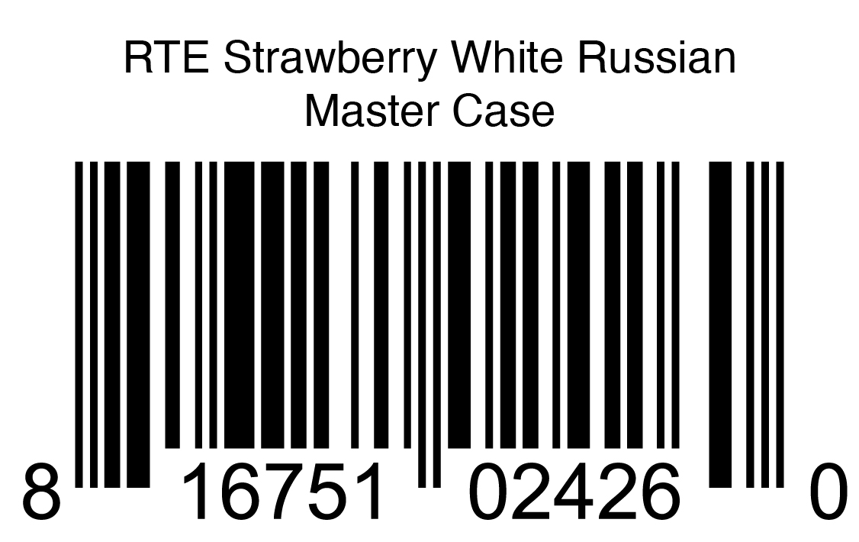
STR | Price | UPC Code | Case Code | Case Dimensions w” x h” x d” | Focused Channels | State Availability
1/1/25 | Line-priced with existing 4pks | 816751024253 | 816751024260 | 16.13 x 10.88 x 5 | Large Format, Small Format, & Package Liquor | Pilot is Select Markets (Mamba States + CA/NV)
Strawberry
White Russian
12oz 4pk
Merchandising
To be merchandised on Spirit-based Cocktails warm shelf
Brand blocked with other Cutwater items

