Slide 1
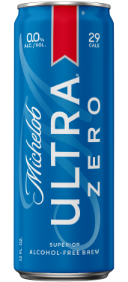
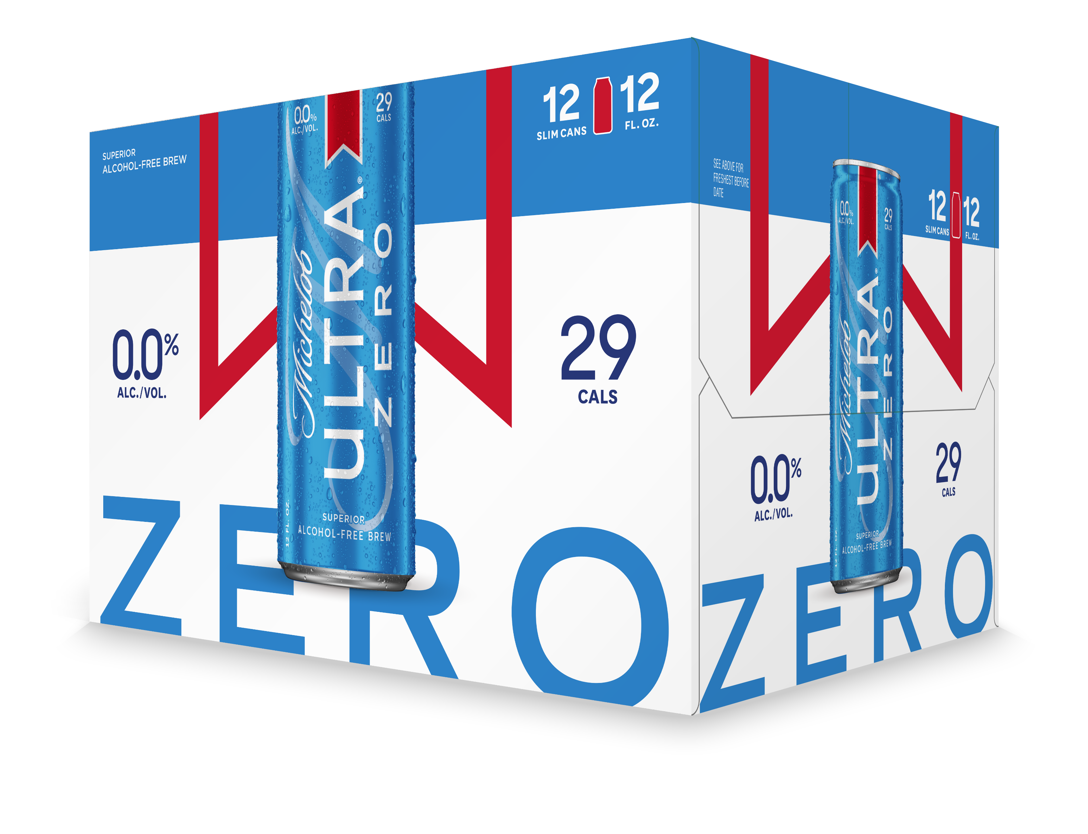


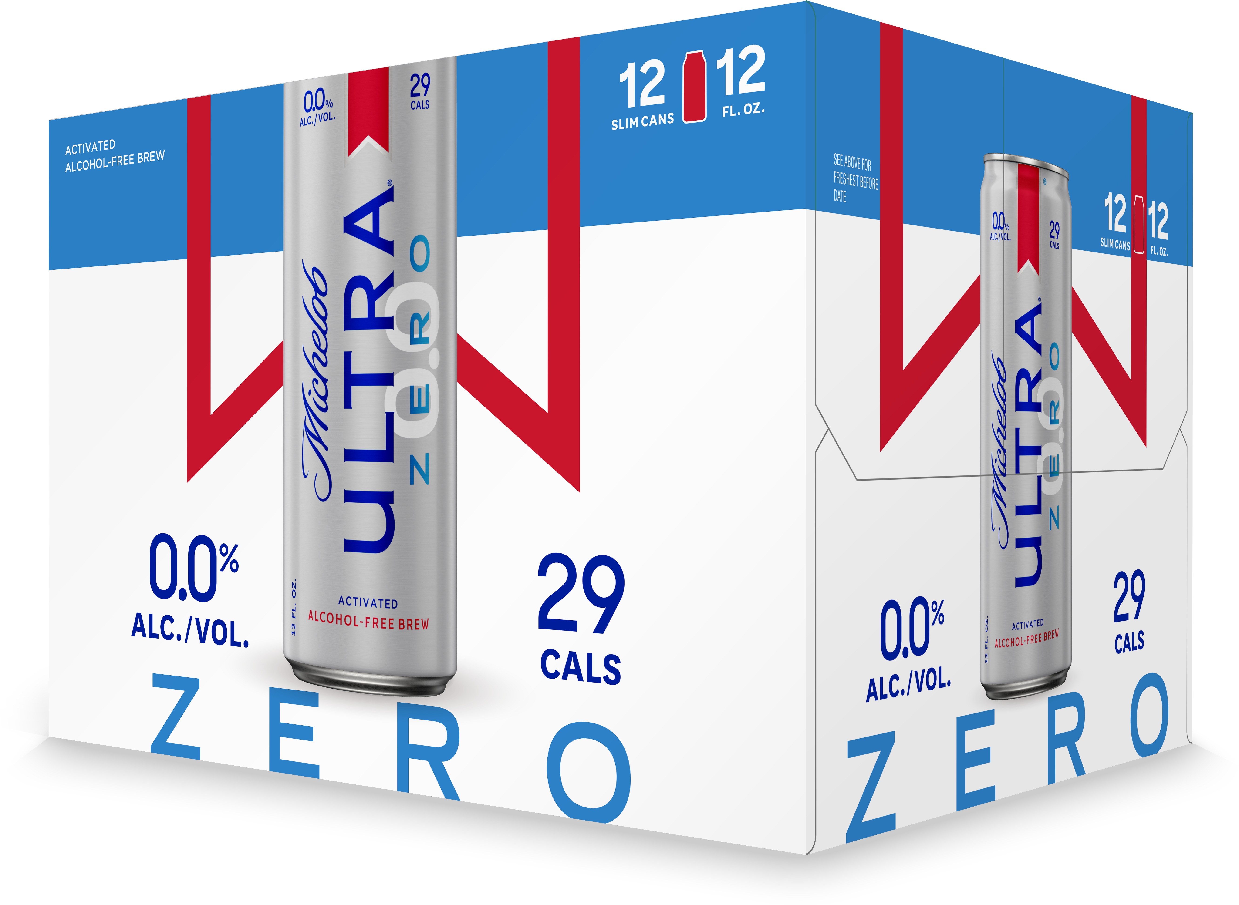

Slide 2

Introducing Michelob ultra zero
Superior alcohol-free brew
NAB INDUSTRY PROJECTED TO DOUBLE TO $2 BILLION INDUSTRY IN NEXT 5 YEARS
MICHELOB ULTRA WELL-POSITIONED IN HEALTH & Wellness, a top driving consideration with nab shoppers
Superior stats, roughly half the calories & carbs of leading industry na beers
360 support for full march 2025 launch

Slide 3
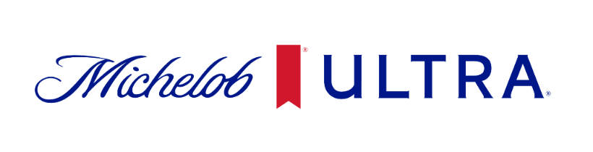
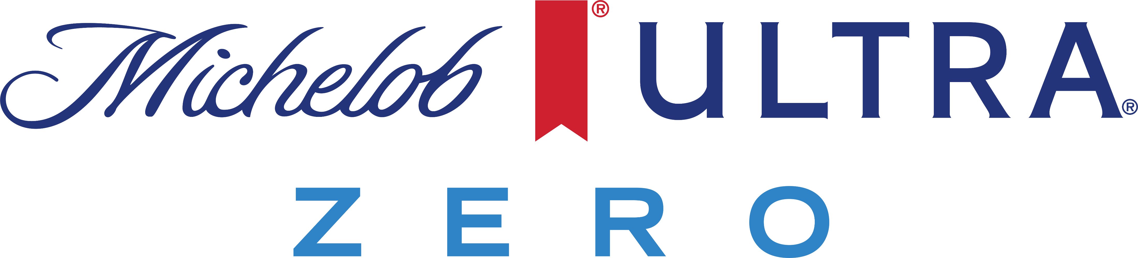
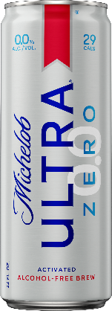
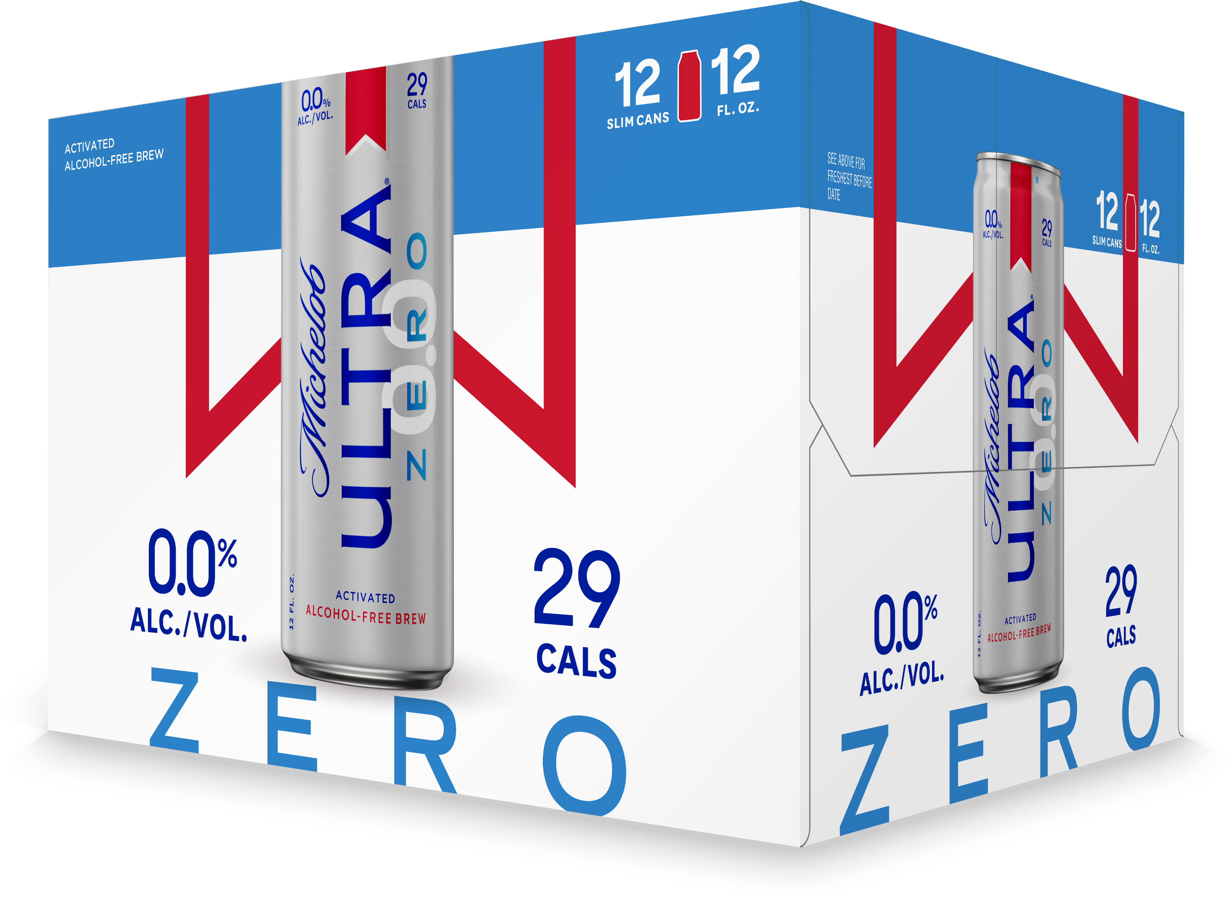
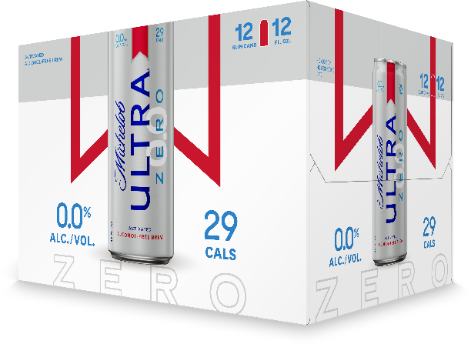

Michelob ULTRA Zero
IGNITE JOB
TARGET CONSUMER
  Trade Up
35+ Co-ed, Caucasian & Hispanic
Introducing Michelob ULTRA Zero – a refreshing alcohol-free brew with 29 Calories and 6.5 Carbs
GROWTH DRIVER
OCCASION
  Meaningfully Premium
  Non-drinking occasions and supplemental to existing drinking occasions
Beer Style | Color | Ingredients | Shelf Life | ABV | Calories
0.0% ABV Light Lager | Light Amber | Barley, Hops, Rice, Water, Natural Flavor | 180 days | 0.0% | 29
Flavor Profile | A light 0.0% ABV light lager with a subtle citrus aroma and a refreshingly crisp finish
Features | An easy-drinking zero-alcohol light lager, with the great taste of Michelob ULTRA that consumers love…and with roughly half the calories and carbs of most leading Non-Alcoholic Beers
REASONS TO BELIEVE
Non-Alcoholic Beer is the fastest growing segment in Beer (+28% CAGR), and premiumizing faster than beer overall.
SOURCE: Circana Non-Alc WAMP through Dec 2023
Michelob ULTRA is the #3 Brand in Beer, with a five-year CAGR of 7.19% - growing 41% in volume over the past five years.
SOURCE: Total US – MULO WE 12/31/2023 (Dollar Share), HERO Analytics thru 2023
Michelob ULTRA Zero will offer consumers superior stats (29 Cals / 6.3g Carbs) and build upon Michelob ULTRA’s equity in Active Lifestyle and Health & Wellness
STR | 12/30/2024 (12pk 12oz Can) 3/10/2025 (6pk 12oz Bottle)
Recommended Pricing | Core +
Pack Launch Strategy | 12/30/24: 12pk Can STR via LOW (9/23- 10/18) 3/10/25: 12pk Can converts to Forecast 6pk Bottle STR via Forecast
MARKETING SUPPORT
MEDIA & TRADE SUPPORT: CREATIVE COHESION
INTEGRATION INTO OUR EXCITING BRAND MEGA-PLATFORMS
This is a big bet for Michelob ULTRA! Expect to see Michelob ULTRA Zero seamlessly integrated into our industry-leading Brand programming across Golf, Soccer, Active Living, and MORE.
Enjoy Responsibly
The alcohol beverage laws of individual states vary regarding the merchandising and promotion of beers. You should be guided accordingly.
© 2024 Anheuser-Busch InBev Michelob ULTRA ® Beer, St. Louis, MO.

Slide 4
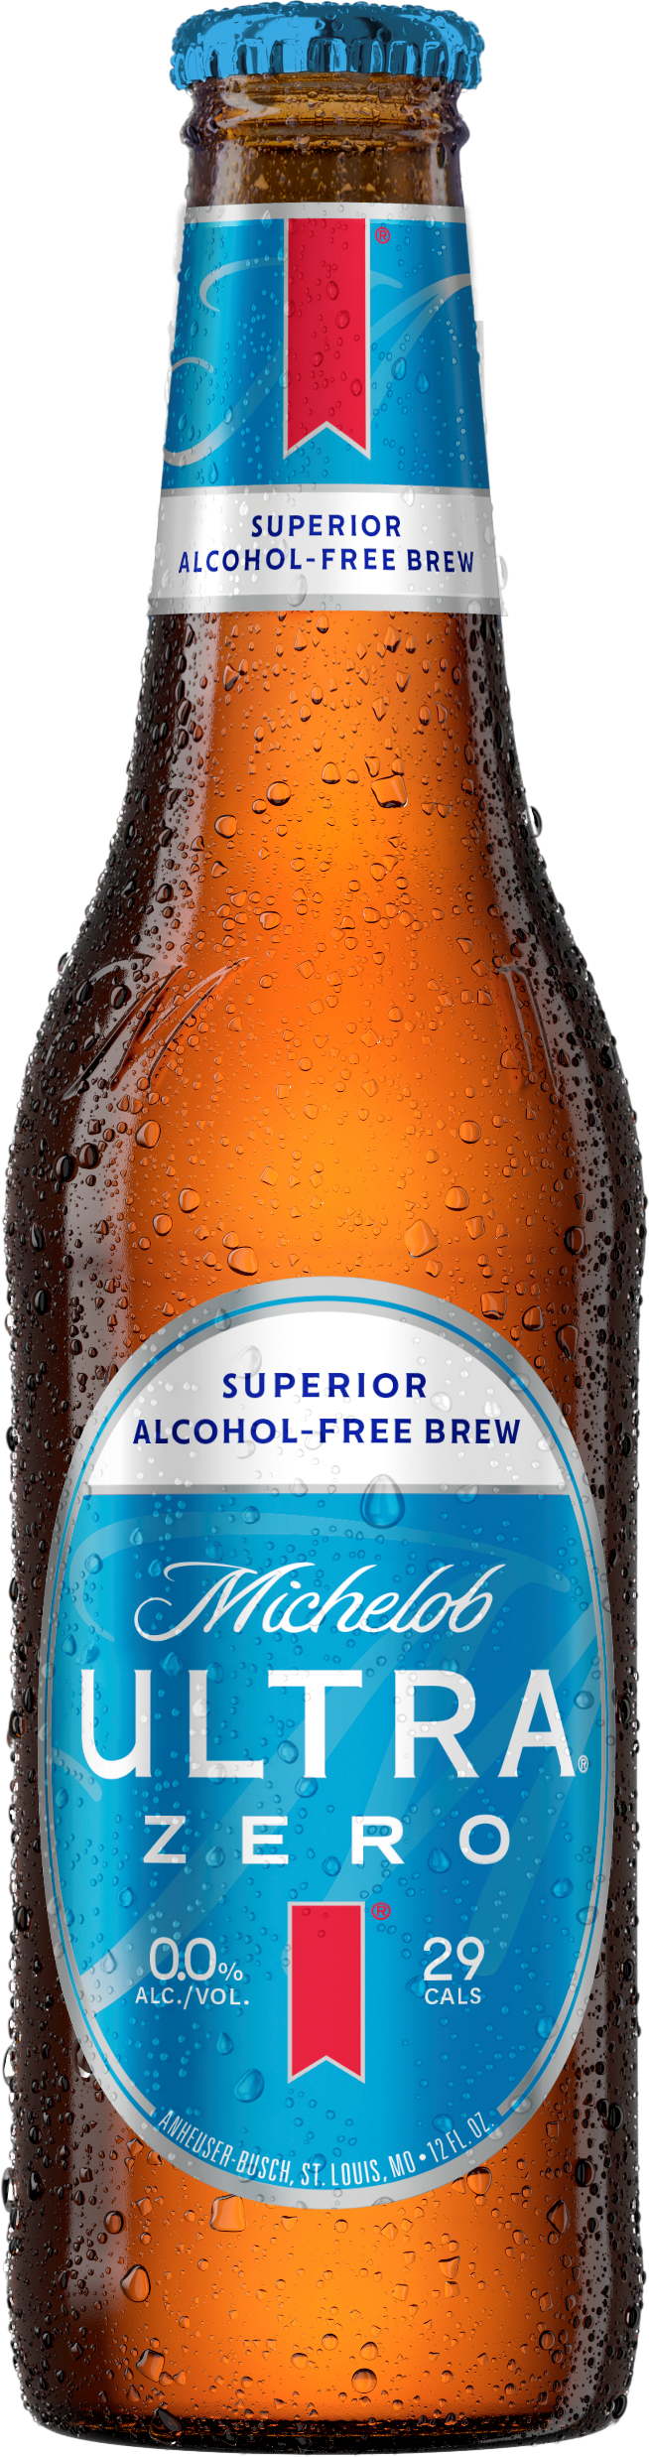
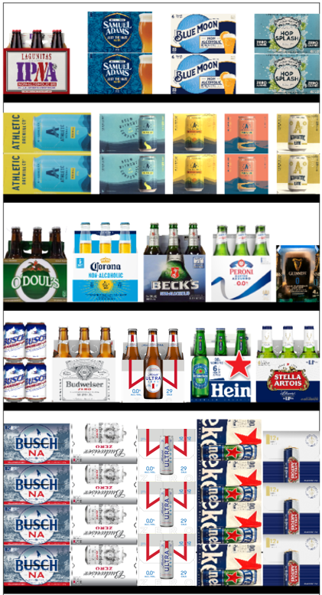
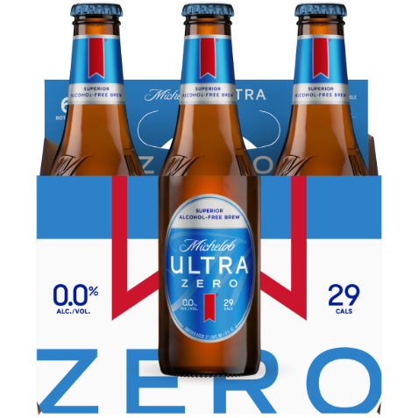
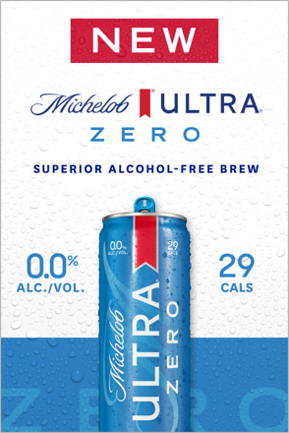
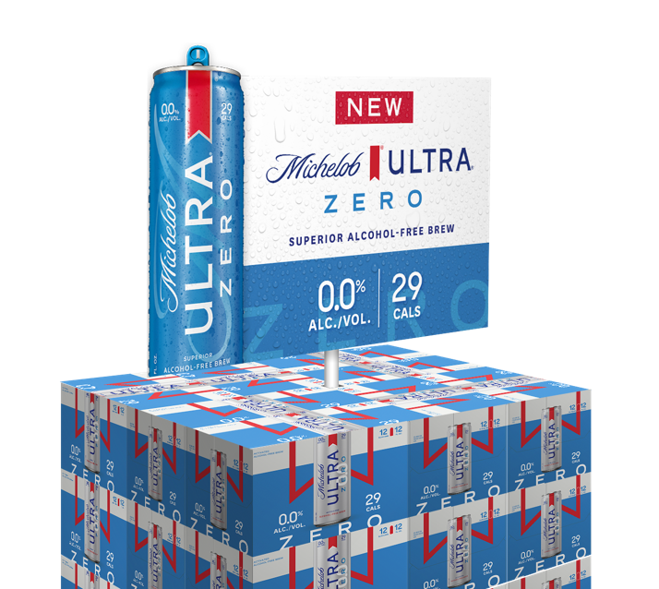


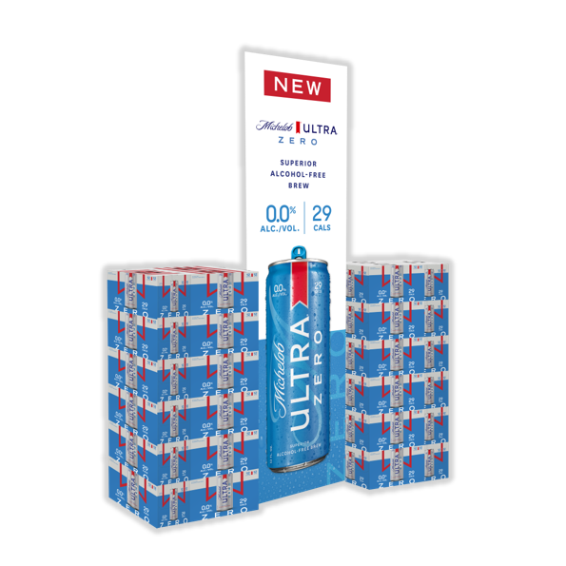




Michelob ULTRA Zero
IGNITE JOB
TARGET CONSUMER
  Trade Up
35+ Co-ed, Caucasian & Hispanic
Introducing Michelob ULTRA Zero – a refreshing alcohol-free brew with 29 Calories and 6.5 Carbs
GROWTH DRIVER
OCCASION
  Meaningfully Premium
  Non-drinking occasions and supplemental to existing drinking occasions
UPCs
TRADE ASSETS
OFF-PREMISE SHELF RECO
12pk Can
6pk Bottle
All Assets WIP
FPO
FPO
12pk Can Case 018200292378
12pk Can Carrier 018200204241
12pk Can Unit 018200002373
6pk Bottle Case 018200292842
6pk Bottle Carrier 018200204456
6pk Bottle Unit 018200264559
FPO
Enjoy Responsibly
The alcohol beverage laws of individual states vary regarding the merchandising and promotion of beers. You should be guided accordingly.
© 2024 Anheuser-Busch InBev Michelob ULTRA ® Beer, St. Louis, MO.

Slide 5
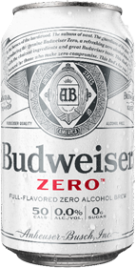
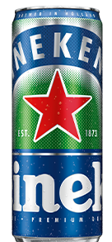
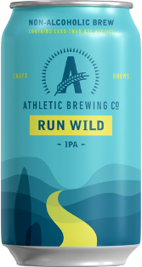
MICHELOB ULTRA ZERO WILL HAVE ~HALF THE CALORIES AND CARBS AS THE CURRENT INDUSTRY LEADERS
50
CALORIES
12
CARBS
69
CALORIES
16
CARBS
29
CALORIES
6.5
CARBS
65
CALORIES
14
CARBS
Enjoy Responsibly
The alcohol beverage laws of individual states vary regarding the merchandising and promotion of beers. You should be guided accordingly.
© 2024 Anheuser-Busch InBev Michelob ULTRA ® Beer, St. Louis, MO.

