Slide 1


Start / End Visit in M360: What counts for Call Frequency? AB & HOL will be tracking
M360 Primary Calls Call Frequency
Call Frequency is tracked utilizing Start/End Visit in M360.
The following ABWP Roles receive credit for primary sales calls: Sales Reps, Team Leaders, & Sales Managers
Please Note: An account can only receive credit for one visit per day.

Slide 2
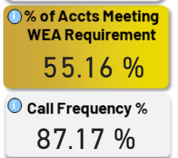
Call Frequency:
- Required in person visits to accounts
-We will send out requirement by Route/Month
Star visit as soon as you pull into the account
- WEA Requirement – (Wholesaler Equity Agreement)
% of accounts that have received their minimum required visits for the selected time period.
- Call Frequency
Total Sales rep visits (Actual) / Total visits required

Slide 3

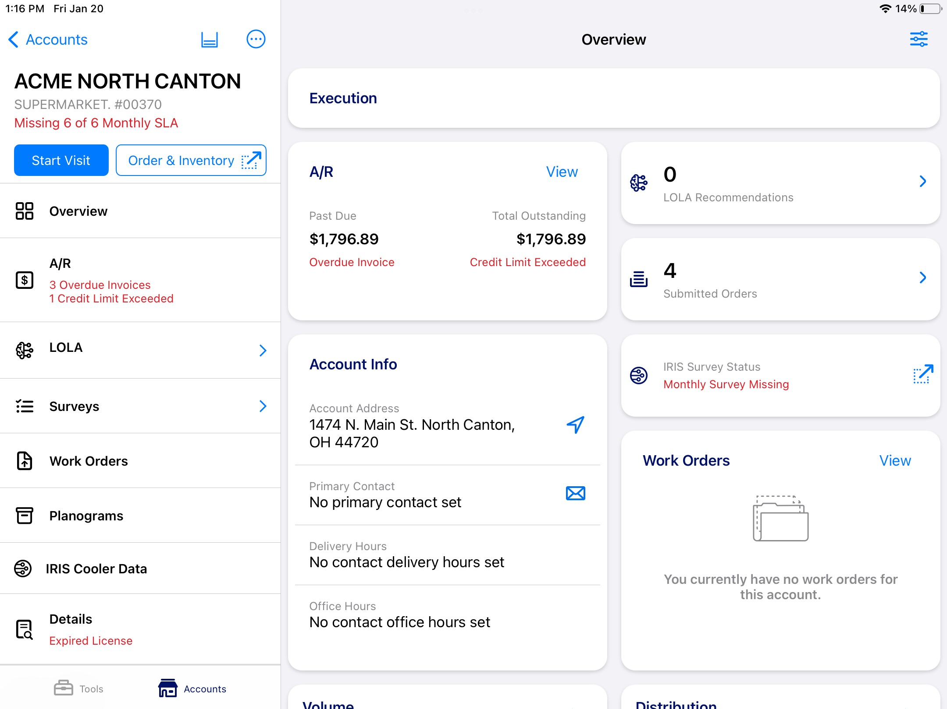
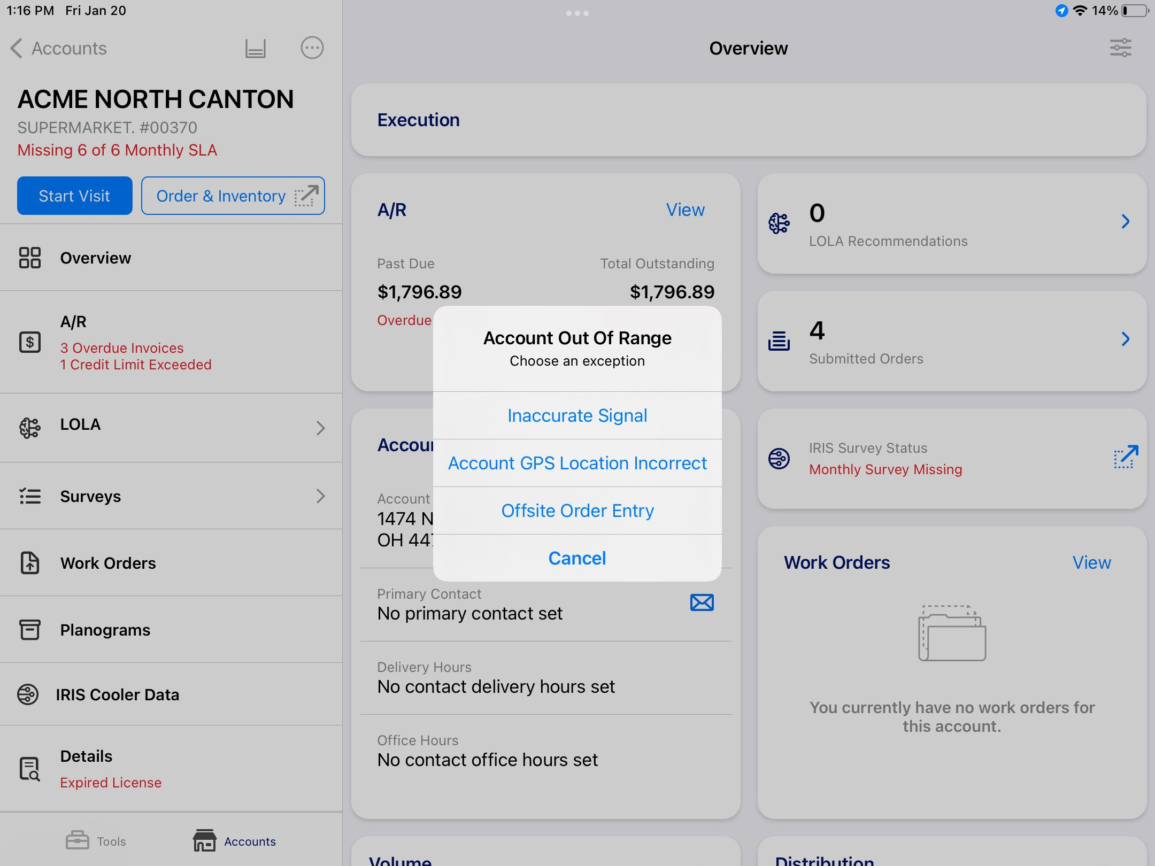
Start / End Visit in M360: In Range vs. Out of Range
In Range
Out of Range
Successful “Start Visit” is “In Range.” The blue “Start Visit” changes to a red “End Visit”
Successful “Start Visit” is ”Out of Range.” When GPS is out of range >1000m when starting visit, user must choose an exception.

Slide 4



Start / End Visit “Out of Range” Scenarios
Inaccurate Signal: User is physically at the account, but Cellular connectivity on the iPad is out of service or very low.
Account GPS Location Incorrect: User is getting an accurate signal and is physically at the account, but the GPS coordinates that M360 has for the account are inaccurate and need to be updated.
Offsite Order Entry: User is not physically at the account. They are putting in an order elsewhere or could be adjusting an existing order. This scenario does not receive credit for a call frequency visit.

Slide 5
Start / End Visit in M360 – What Visits Count?
Start Visit | End Visit | Call Frequency Scenario Description Credit
In Range | In Range | YES | Standard visit, sales rep starts and ends visit while in range.
In Range | Out of Range | YES | Sales rep starts visit in range but ends visit out of range.
Out of Range: Inaccurate Signal | In Range | YES | Sales rep starts visit out of range but ends visit in range – i.e. rep has inaccurate signal at account, but ends visit once they get back into service.
Out of Range: GPS Location | In Range | YES | Sales rep starts visit out of range but ends visit in range – i.e. M360 has wrong GPS location for account, but ends visit once within range (unlikely event).
Out of Range: Offsite Order Entry | In Range | YES | Sales rep starts visit out of range but ends visit in range – i.e. rep needs to punch in an order out of range, but then gets to the account and closes out their visit.
Out of Range: Inaccurate Signal | Out of Range | YES | Sales rep starts visit out of range AND ends visit out range due to inaccurate signal at the account – i.e. rep has inaccurate signal at account and starts and ends visit.
Out of Range: GPS Location | Out of Range | YES | Sales rep starts visit out of range AND ends visit out range due to inaccurate GPS Location for the account in M360 – i.e. GPS location is off and rep starts and ends visit.
Out of Range: Offsite Order Entry | Out of Range | NO | Sales rep starts visit out of range AND ends visit out range due to necessity of submitting an order – i.e. Sales rep starts and ends visit to submit order without visiting the account.

