Slide 1




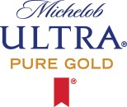
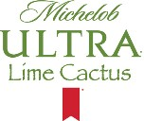


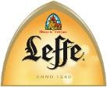










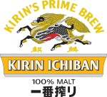
























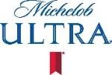



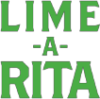



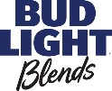




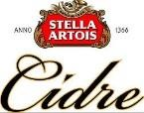

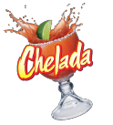


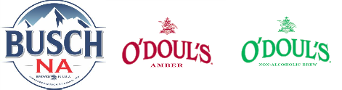







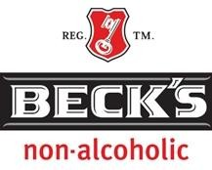




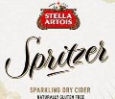




Market Partitions
Value
Core
Premium
Super Premium
Core +
Notes:
Natural Light Naturdays is included in Value.
Bud Light Extensions (Lemon Tea, Orange, Lime, Platinum) are included in Core +.
Budweiser Extensions (Reserve Series) are included in Core +.
Michelob Ultra Extensions are included in Premium.
Ziegenbock included in Core +
Other Future Innovation Market Partitions are TBD.
Only Busch NA, O’Doul’s, Beck’s NA & St. Pauli NA are included in the non-alc volume budget.
Natural Light Seltzers included in Beyond Beer
Non-Alcohol
Beyond Beer
ANHEUSER-BUSCH

