Slide 1


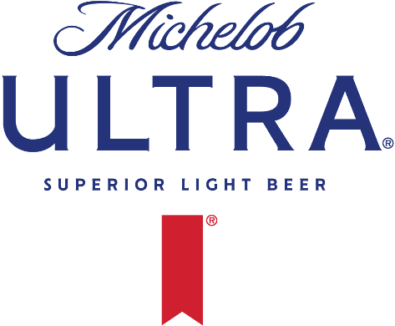
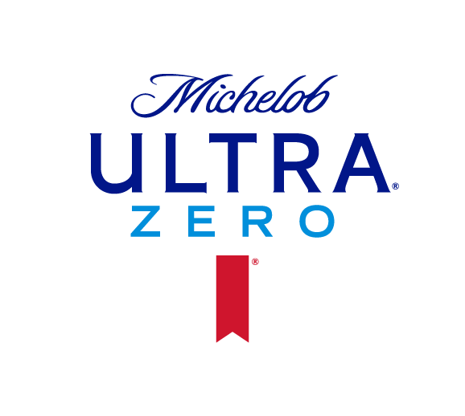
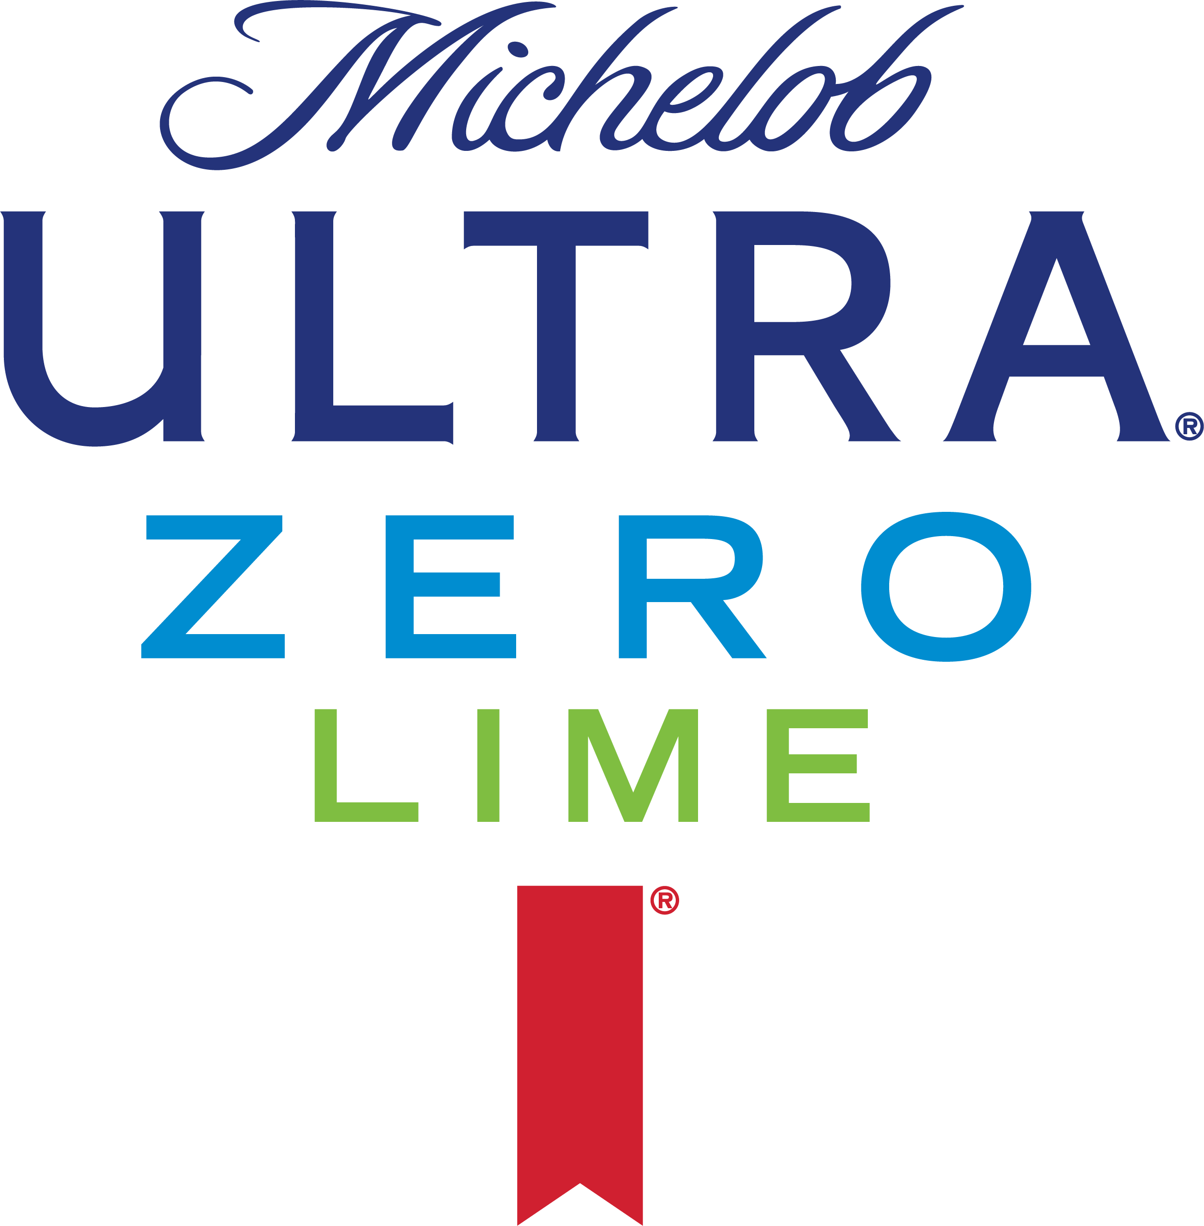
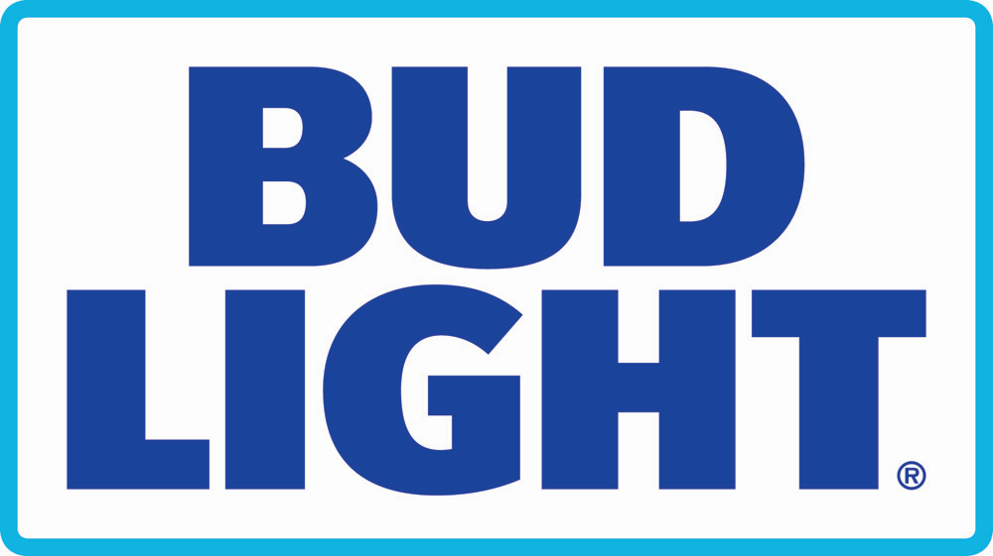
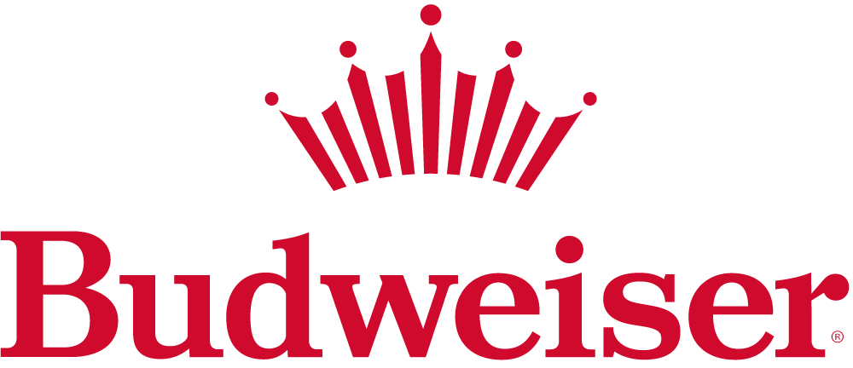
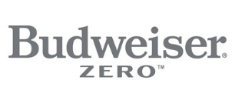

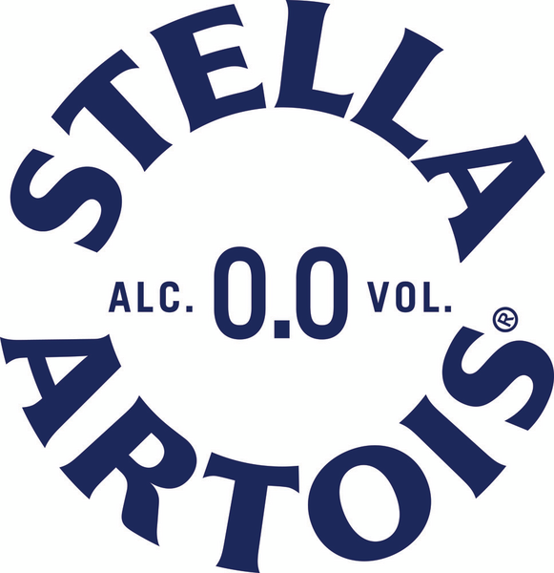
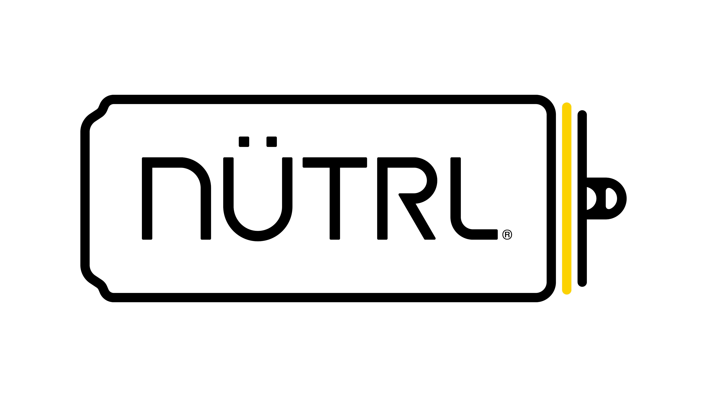
Seize the Summer Part 1 National Incentive
Time: May 1st – June 30th
Baseline: L90 Days 4/30
EXECUTION – $6.5M BREAK THE BANK (CO-OP)
$3.5M ULTRA BANK + $3.0M ALL OTHER BRANDS BANK
CHANNEL | OFF PREMISE | ON PREMISE |  |  | DISPLAYS
BRANDS | PODs​ | Buy / Rebuy (1/6 BBL)​ | Buy / Rebuy (1/2 BBL) | Package (3 C/E total) | Small (10+ C/E)​ | Medium (20+ C/E) | Large (35+ C/E) | Extra-Large (50+ C/E)
ULTRA | $10 | $25 / $75 | $75 / $150 | $75 | $15 | $30 | $45 | $75
ULTRA ZERO | $10 | - | - | $75 | $15 | $25 | $35
ULTRA ZERO LIME | $10 | - | - | $75
BUD LIGHT | $5 | $25 / $75 | $75 / $150 | $50 | $10 | $20 | $30 | $50
BUDWEISER | $5 | $25 / $75 | $75 / $150 | $50 | $10 | $20 | $30 | $50
BUDWEISER ZERO | $5 | - | - | $50
STELLA ARTOIS | $10 | $25 / $75 | $75 / $150 | $75 | $15 | $30 | $45 | $75
STELLA 0.0 | $10 | - | - | $75
NUTRL | $10 | - | - | $75 | $20 | $40 | $60 | $100
PART 1
BRANDS:
$3.5M
$3.0M
*All incentive payments are made to wholesalers only in cash only, which cash wholesalers can use at their sole discretion. All incentives exclude MI
**For Seize the Summer Pt 1, Ultra displays can be comprised of any combination of Ultra (motherbrand), Ultra Zero, and Ultra Zero Lime to hit the STR C/E and IRIS product count minimum requirements. The same mechanics apply for Budweiser and Stella displays with their non-alcohol counterparts.
***States that are not able to sell Bud Light 1/6 bbls will get credit for 1/4 bbl sales.

Slide 2

2026 National Incentives – Account Scope & Execution Validation
OFF-PREMISE PODS
ON-PREMISE PODS
DISPLAYS
Brand Group | Account Eligibility
Malt | All Distribution Eligible Independent + 7-11 Parent
Non – Malt | All VIP Open & Active Independent & 7-11 Parent
Brand Group | Account Eligibility
Malt | All VIP Open & Active Independent & Chains
Non – Malt | All VIP Open & Active Independent & Chains
Brand Group | Account Eligibility
Malt | All Display Eligible
Non – Malt | All VIP Open & Active Display Eligible
Account Scope
MPD +1 L90 Days STR Check
New SKU vs. L90
MPD +1 within the specific account
MPD +1 L90 Days STR Check
Malt:
  Draft initial buy and rebuy
  Package included for all megabrands, including non-alc brands (Ultra Zero, Ultra Zero Lime, Stella 0.0, Budweiser Zero, Busch NA); 3 C/E cumulative minimum on a single or multiple invoices +1 New Brand (simple distribution, account baseline = 0)
Non-Malt:
  Package Only
  3 C/E cumulative minimum on a single or multiple invoices +1 New Brand (simple distribution, account baseline = 0)
IRIS Product Count (Display Survey) + STR Invoice Check
Display payout is 1 per brand per period
Malt:
  Display Survey completed at Brand level for IRIS validation of product count
  Account has STRs that meet C/E minimum on a single invoice
  Brand level STR Invoice*
Non-Malt:
  Display Survey completed at Brand Family level for IRIS validation of product count
  Account has STRs that meet C/E minimum on a single invoice
  Brand Family level STR Invoice
Execution Validation
**For Seize the Summer Pt 1, Ultra displays can be comprised of any combination of Ultra (motherbrand), Ultra Zero, and Ultra Zero Lime to hit the STR C/E and IRIS product count minimum requirements. The same mechanics apply for Budweiser and Stella displays with their non-alcohol counterparts.

Slide 3


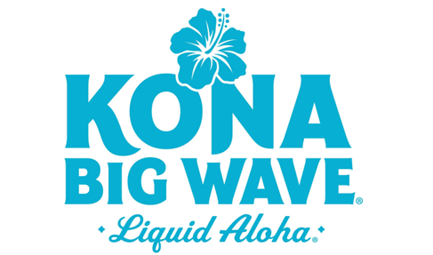
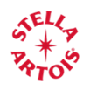
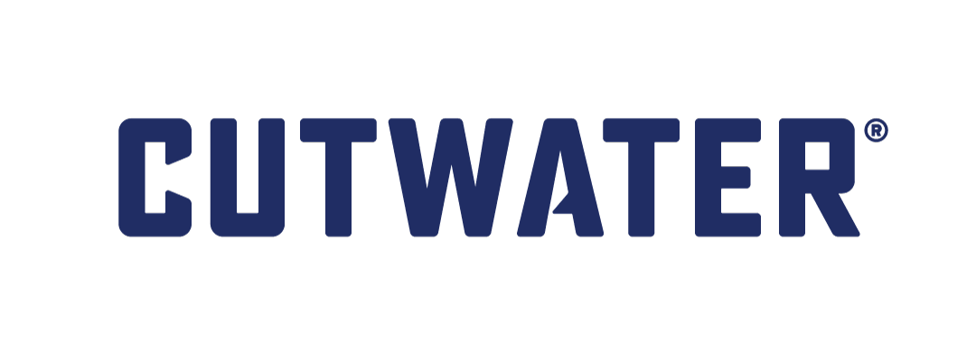
2026 National Incentives – Payouts
Brand | Displays |  |  |  | ONP Draught PODs |  |  |  | ONP Package PODs | OFFP PODs
 | Small | Medium | Large | Extra-Large | Initial Buy |  | Rebuy
Brand | 10+ C/E 5+ product count | 20+ C/E 10+ product count | 35+ C/E 18+ product count | 50+ C/E 25+ product count | 1/2 bbl | 1/6 bbl | 1/2 bbl | 1/6 bbl | 3+ C/E | Off-Premise PODs
 | $10 | $20 | $30 | $50 | $75 | $25 | $150 | $75 | $50 | $5
 | $10 | $20 |  | $30 | $75 | $25 | $75 | $25 | $30 | $5
 | $10 | $20 |  | $30 | $75 | $25 | $75 | $25 | $30 | $5
 | $15 | $30 | $45 | $75 | $75 | $25 | $75 | $25 | $75 | $10
 | $15 | $25 |  | $35 | $75 | $25 | $75 | $25 | $35 | $10
 | $15 | $25 |  | $35 | $75 | $25 | $75 | $25 | $35 | $10
 | $20 | $40 | $60 | $100 | - | - | - | - | $100 | $10
 | $20 | $40 |  | $60 | - | - | - | - | - | $10
*Co-Op Values
**Non-Alcohol Brands (Ultra Zero, Ultra Zero Lime, Budweiser Zero, Stella 0.0, and Busch NA) will be included in execution mechanics and be eligible for the above payout values when their respective mother brands are on the calendar.

Slide 4
National Incentive FAQs
How will National Incentives be structured?
2026 National Incentives will only be execution-based. The execution payout will be structured as a “Break the Bank” execution incentive supporting the communicated incentive brands. Wholesalers will receive execution payouts based on gained PODs and displays. Additionally, during each period Michelob Ultra is on the calendar, it will have its own bank, separate from the “All Other” brands bank. Each bank will reduce independently of the other as payouts are earned each period.
How will “Break the Bank” execution be measured?
On Premise PODS
Off Premise PODS
Displays
What is the eligible account universe for National Incentive Execution Wholesaler payouts?
Off Premise PODS
  MALT – All Distribution Eligible Independent & 7/11 Parent
  NON-MALT - All VIP Open & Active Independent & 7-11 Parent
Off Premise Displays
  MALT – All Display eligible within any MAL during the Incentive (if account is display eligible Y in either May or Jun MAL you will receive a display payout)
  NON-MALT – All VIP Open & Active + Display eligible during the Incentive (if account is display eligible Y in either May or Jun MAL you will receive a display payout)
On Premise
  MALT – All VIP Open & Active Independent & Chains
  NON-MALT – All VIP Open & Active Independent & Chains
*For wholesalers to earn a POD payout it must be a new SKU and increase the baseline MPD (L90 4/30/26) at that account +1
All incentive payments are made to wholesalers only in cash only, which cash wholesalers can use at their sole discretion. All incentives exclude MI.

Slide 5
National Incentive FAQs
What non-alcohol brands are included in National Incentives?
Michelob Ultra Zero, Michelob Ultra Zero Lime, Stella Artois 0.0, Budweiser Zero, and Busch NA will all be included in execution mechanics in 2026 and eligible for payouts for ONP package PODs, OFFP PODs, and displays. (These brands will be grouped with their mother brands for display tracking and payouts.)
How are ONP package payouts earned?
ONP package mechanics have been updated for 2026. Payouts will be based on hitting a cumulative 3 C/Es during the incentive period, rather than on initial buy and rebuy mechanics. For validation, STRs can be contained on a single invoice or across multiple. The account base will also be expanded to include all VIP open and active accounts, and all brands will be eligible.
How many display payouts can wholesalers earn?
Display payouts will be based on the largest display built per brand at an account during the period rather than the first display built per brand at an account each month. A wholesaler can earn 1 payout per brand per account during the incentive window.
How is display eligible determined?
Display eligible is flagged within the Wholesaler RAS, please refer to the respective MAL window to understand when you need to have your Displayable flag adjusted.
How do displays with NA brands work?
During New Year Knockout, Michelob Ultra displays can be comprised of any combination of Michelob Ultra (mother brand), Ultra Zero, and Ultra Zero Lime to hit the C/E minimum STR validation requirement and the IRIS product count minimum requirement. With updated mechanics for 2026, Michelob Ultra, Ultra Zero, and Ultra Zero Lime will not be limited to a single SKU and will instead be based on the brand level. The same mechanics will apply for displays with Budweiser and Stella and their non-alcohol counterparts during this period.
What are the requirements around IRIS validation of displays?
IRIS validation of displays will be based on the total product count of the brand recognized. IRIS product count thresholds will be 50% of the STR invoice C/E minimums for each display size tier in order to offset potential under-recognition. (As an example, small displays will require a 5+ product count to be recognized for IRIS validation credit, in addition to 10+ C/Es for STR invoice validation credit to unlock the corresponding small display payout.)
Is there still a volume component to National Incentives?
For 2026 incentives, volume budget has been moved to the execution bank and there are no volume payouts.
All incentive payments are made to wholesalers only in cash only, which cash wholesalers can use at their sole discretion. All incentives exclude MI.

