Slide 1
Cutwater Space Incentive | May 2026
Details
Payouts
WHAT | $5,000 Break the Bank
WHEN | May
WHERE | Independent, off-premise IRIS surveyed accounts
HOW | Gain incremental space in May vs March
Type | March | May | Payout
2 Full Shelves | NO | YES | $50
Half Door 4 Shelves (30+ Facings) | NO | YES | $150
Full Door 7 Shelves (70+ Facings) | NO | YES | $250
Qualifier | Account must have full shelf of singles!
All rewards must be paid via cash or EFT to the wholesaler entity directly and not to individual wholesaler employees. All incentive programs exclude Michigan.

Slide 2
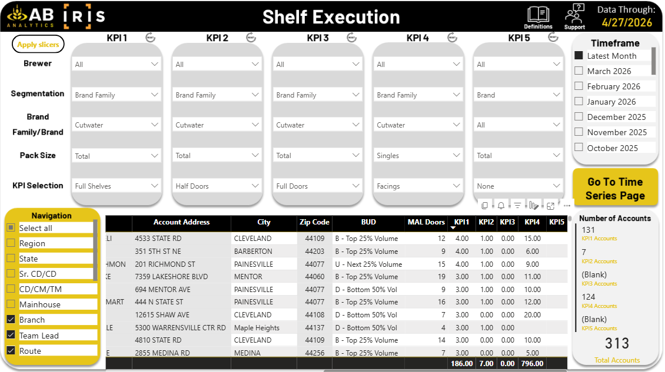
Cutwater Space Incentive | Tracking
How are we tracking Execution?
Using IRIS Shelf Execution in ABA
March surveys will be used as the baseline
We will compare space gains May vs March
  You will only receive payouts for 2 full shelves, 1 half door OR 1 full door – not for a combination within the same account
  The account must have singles facings 8+ to qualify
June & July eligibility is established by May execution
The goal of this incentive is to gain incremental Cutwater space in the main cooler doors
With such a high payout per account, we are requiring high level of execution.
All rewards must be paid via cash or EFT to the wholesaler entity directly and not to individual wholesaler employees. All incentive programs exclude Michigan.

Slide 3
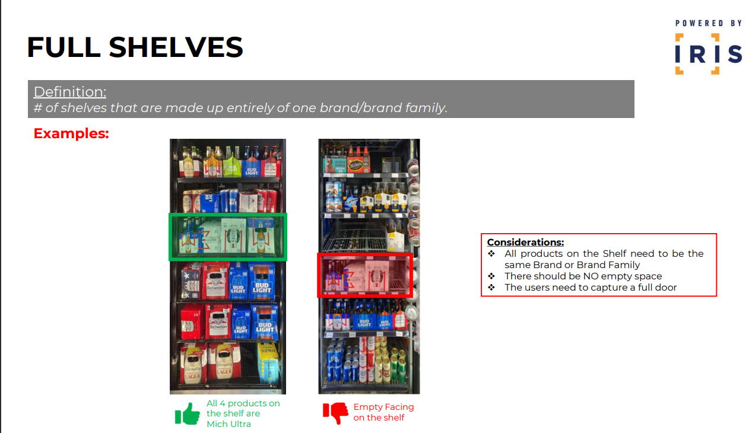
All rewards must be paid via cash or EFT to the wholesaler entity directly and not to individual wholesaler employees. All incentive programs exclude Michigan.

Slide 4
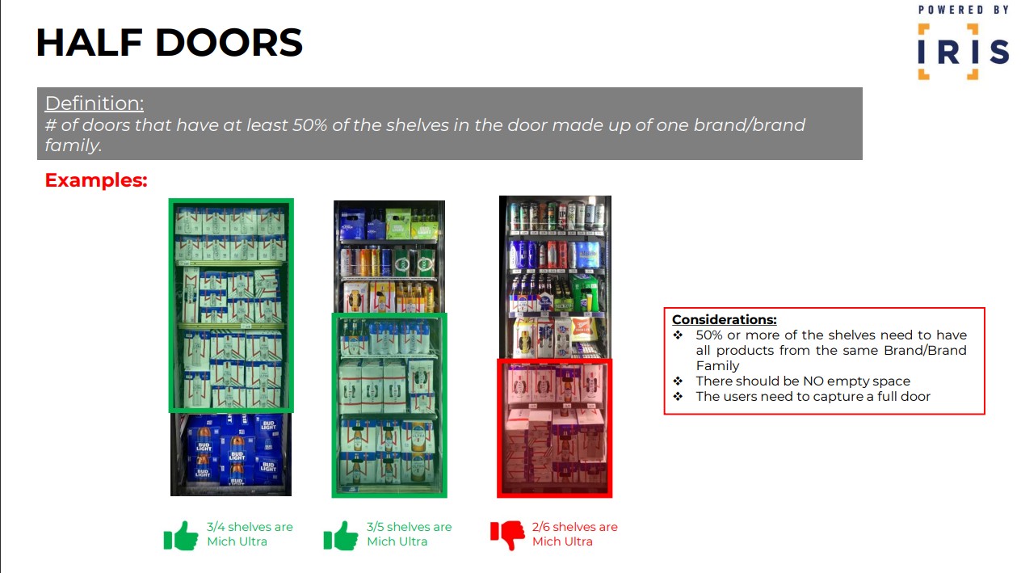
All rewards must be paid via cash or EFT to the wholesaler entity directly and not to individual wholesaler employees. All incentive programs exclude Michigan.

Slide 5
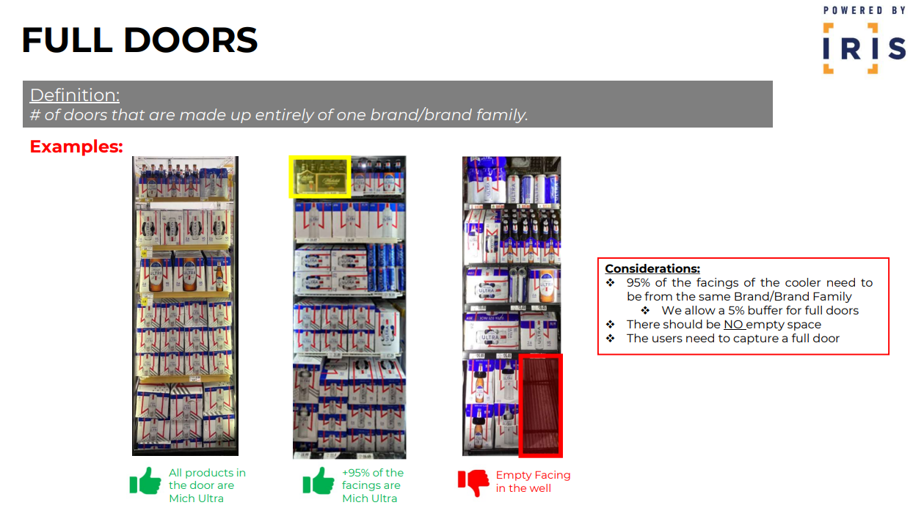
All rewards must be paid via cash or EFT to the wholesaler entity directly and not to individual wholesaler employees. All incentive programs exclude Michigan.

Slide 6
Cutwater Space Incentive | June 2026
Details
Payouts
WHAT | Accounts that gained space in May are eligible for additional payout
WHEN | June
WHERE | Independent, off-premise IRIS surveyed accounts
HOW | Hold incremental space gained in May through June, get paid
Type | May | June | Payout
2 Full Shelves | YES | YES | $50
Half Door | YES | YES | $150
Full Door | YES | YES | $250
Qualifier | Account must have full shelf of singles!
All rewards must be paid via cash or EFT to the wholesaler entity directly and not to individual wholesaler employees. All incentive programs exclude Michigan.

Slide 7
Cutwater Space Incentive | July 2026
Details
Payouts
WHAT | Accounts that gained space in May are eligible for additional payout
WHEN | June
WHERE | Independent, off-premise IRIS surveyed accounts
HOW | Hold incremental space gained in May through June & July, get paid
Type | June | July | Payout
2 Full Shelves | YES | YES | $100
Half Door | YES | YES | $300
Full Door | YES | YES | $500
Qualifier | Account must have full shelf of singles!
All rewards must be paid via cash or EFT to the wholesaler entity directly and not to individual wholesaler employees. All incentive programs exclude Michigan.

Slide 8


Cutwater Space Incentive | May to July 2026 – Example #1
March
May
June
July
IRIS Surveyed Account
8+ Singles Facings
Full Door
Payout:
Baseline
IRIS Surveyed Account
8+ Singles Facings
Full Door
Payout:
$250
IRIS Surveyed Account
8+ Singles Facings
Full Door
Payout:
$250
IRIS Surveyed Account
8+ Singles Facings
Full Door
Payout:
$500
Incremental vs Baseline
Total Payout: $1,000
All rewards must be paid via cash or EFT to the wholesaler entity directly and not to individual wholesaler employees. All incentive programs exclude Michigan.

Slide 9
Cutwater Space Incentive | May to July 2026 – Example #2
March
May
June
July
IRIS Surveyed Account
Singles
Full Door
Payout:
Baseline
IRIS Surveyed Account
Singles
Full Door
Payout:
$250
IRIS Surveyed Account
Singles
Full Door
Payout:
$0
IRIS Surveyed Account
Singles
Full Door
Payout:
$250
Incremental vs Baseline
Total Payout: $500
All rewards must be paid via cash or EFT to the wholesaler entity directly and not to individual wholesaler employees. All incentive programs exclude Michigan.

Slide 10
Cutwater Space Incentive | May to July 2026 – Example #3
March
May
June
July
IRIS Surveyed Account
Singles
Full Door
Payout:
Baseline
IRIS Surveyed Account
Singles
Full Door
Payout:
$0
IRIS Surveyed Account
Singles
Full Door
Payout:
$0
IRIS Surveyed Account
Singles
Full Door
Payout:
$0
Incremental vs Baseline
Total Payout: $0
All rewards must be paid via cash or EFT to the wholesaler entity directly and not to individual wholesaler employees. All incentive programs exclude Michigan.

