Slide 1
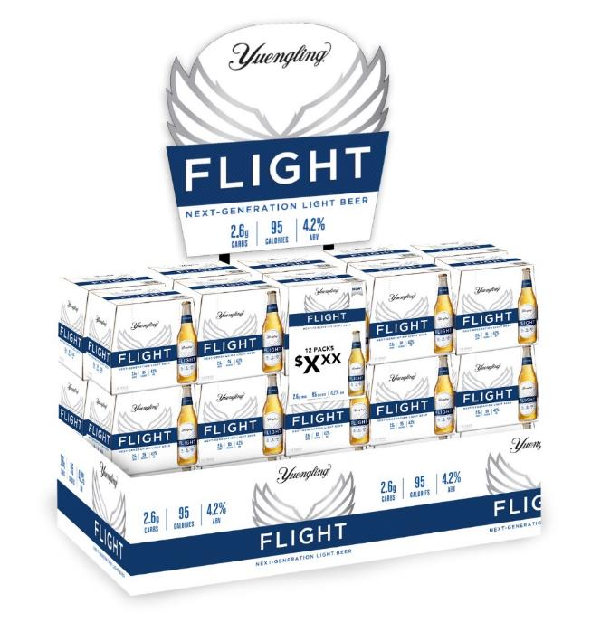
FLIGHT: HOLR General Market
Timeframe Sept 1st-Dec 31st
Incentive Details:
You will be ranked amongst your peers in the following categories
  Flight (Brand) POD’s in your Off Premise independent accounts
  Flight (Brand) % of distribution in your Off Premise independent accounts
  Flight (Brand) % of distribution in your On Premise accounts
  Flight Features in On Premise Accounts Max 2 features per account
  Flight (Brand) volume growth in On/Off premise (all accounts) vs 2020
  Flight (Brand) % increase in On/Off premise (all accounts) vs 2020
    Features Must be submitted to graphics by Dec 1st
    Must have a photo to count
    Photos of features must be turned into me by 12/29
    Tiebreaker will be volume increase

Slide 2

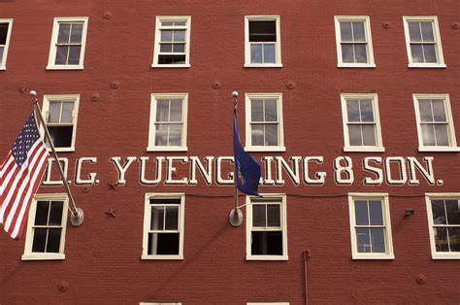
FLIGHT: HOLR General Market
Timeframe Sept 1st-Dec 31st
Prizes:
There will be prizes you will pick prize by the order in which you finish
Brewery Trips (1) $ 500, $ 300
HOLR must hit ALL distribution goals and be positive in volume to Qualify
Goals are at bottom of scorecard

