Slide 1
Innovation Meeting 2025

Slide 2

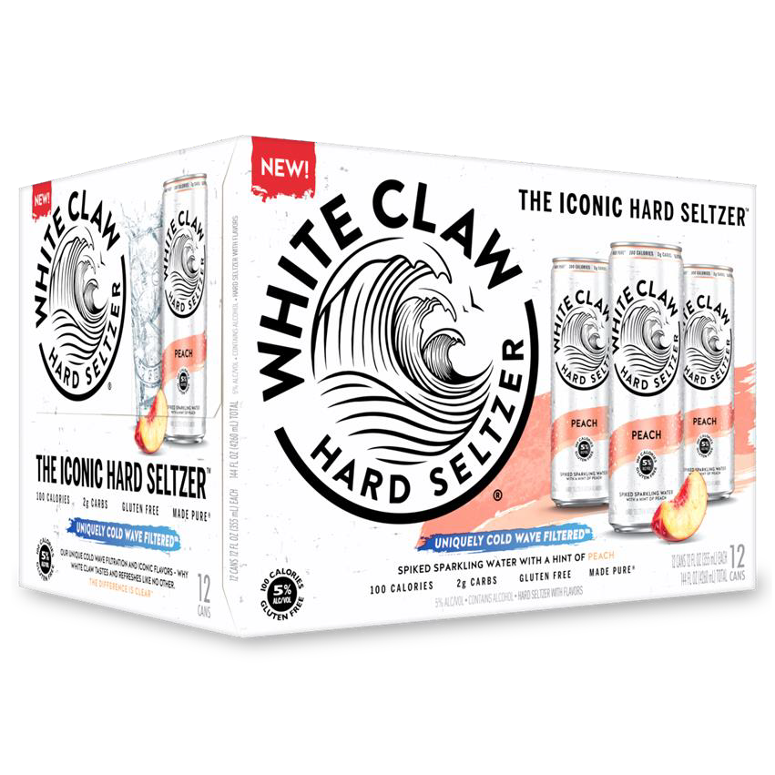
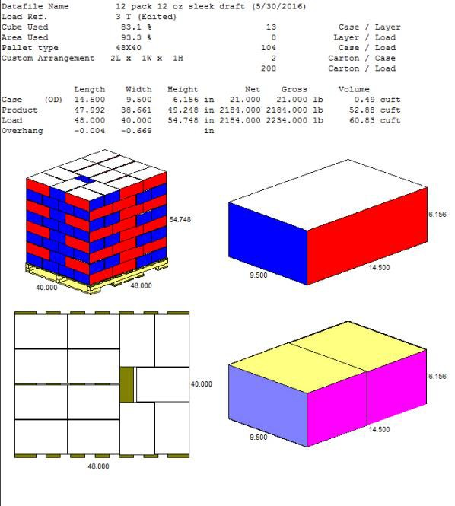


WHITE CLAW® PEACH 12PK VP2 UPC AND PALLET SPECS
VIP Code:
12130
Carrier
Shipper
Shipping February 2025

Slide 3
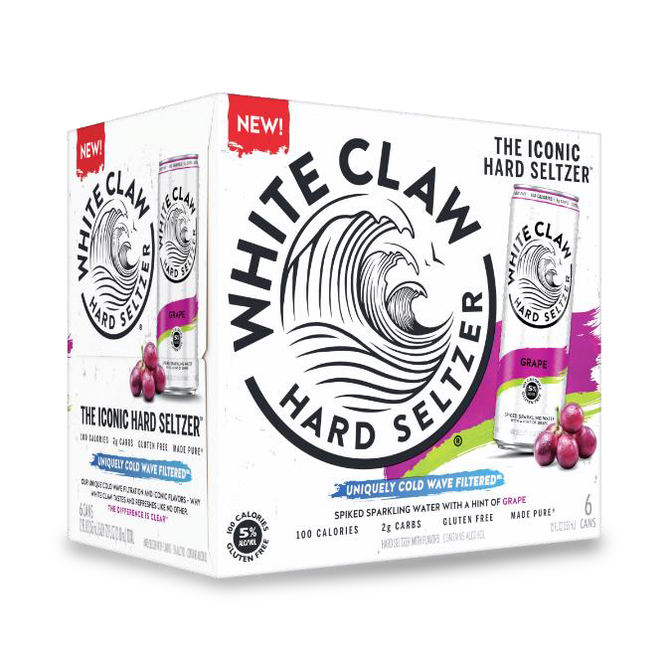
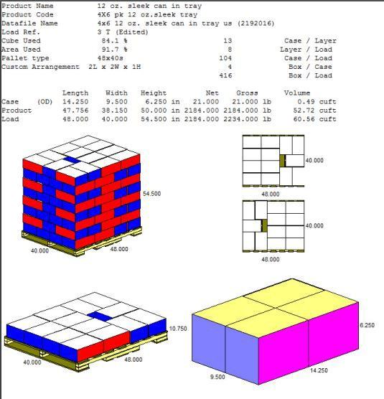



WHITE CLAW® GRAPE 6PK UPCS AND PALLET SPECS
VIP Code: 12024
Can
Carrier
Shipper
Shipping February 2025

Slide 4
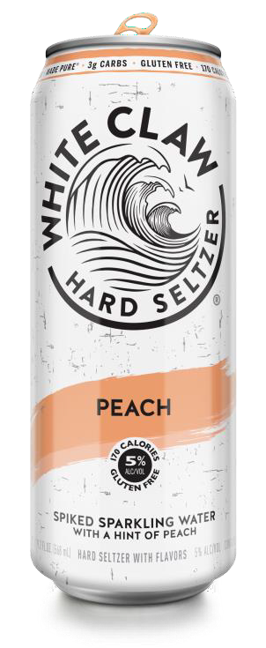
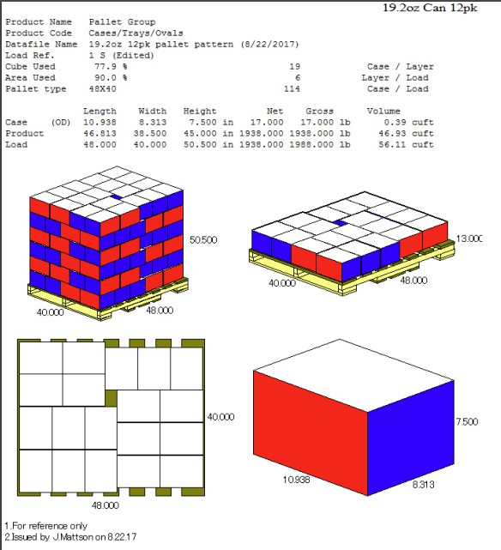


WHITE CLAW® PEACH 19.2OZ UPCS AND PALLET SPECS
VIP Code: 12047
Can
Shipper
Shipping December 2024

Slide 5
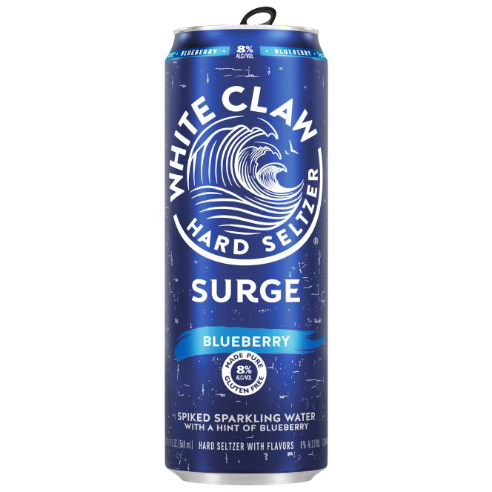


WHITE CLAW® SURGE BLUEBERRY 19.2OZ UPCS AND PALLET SPECS
VIP Code: 12118
Can
Shipper
Shipping December 2024

Slide 6
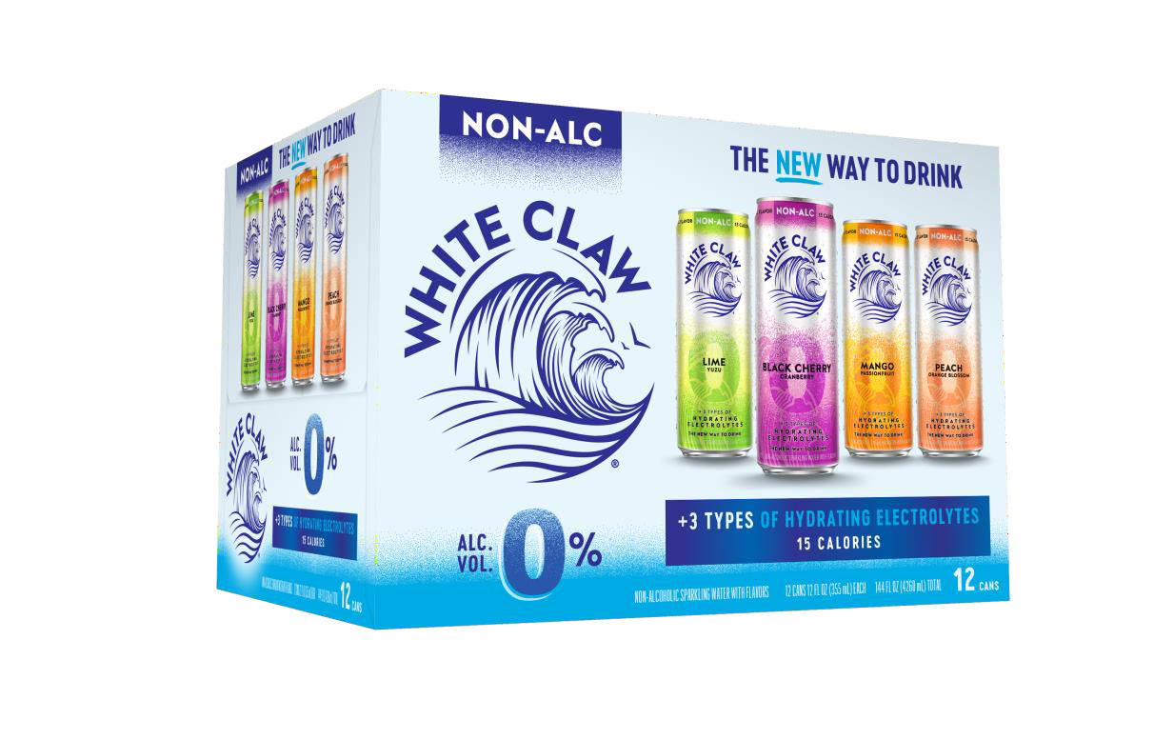


WHITE CLAW® 0% 12PK PACKAGE CHANGES UPC AND PALLET SPECS
VIP Code: 15200
Carrier
Shipper
UPCs AND VIP CODES NOT CHANGING

Slide 7
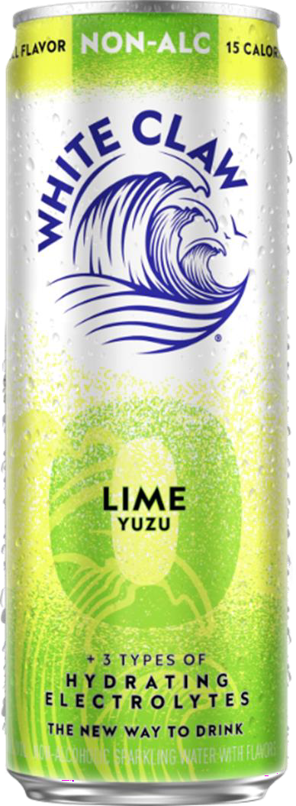
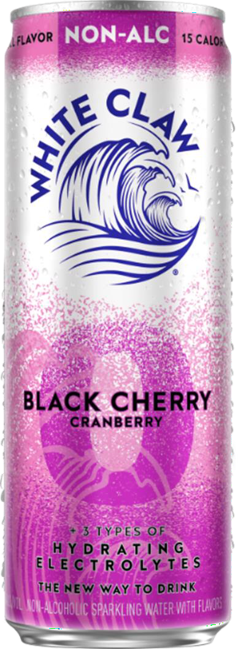






WHITE CLAW® 0% PACKAGING UPDATE CAN UPCs
FPO
FPO
FPO
FPO
Can
Lime Yuzu
Black Cherry Cranberry
Mango Passion Fruit
Peach Orange Blossom
UPCs AND VIP CODES NOT CHANGING

Slide 8
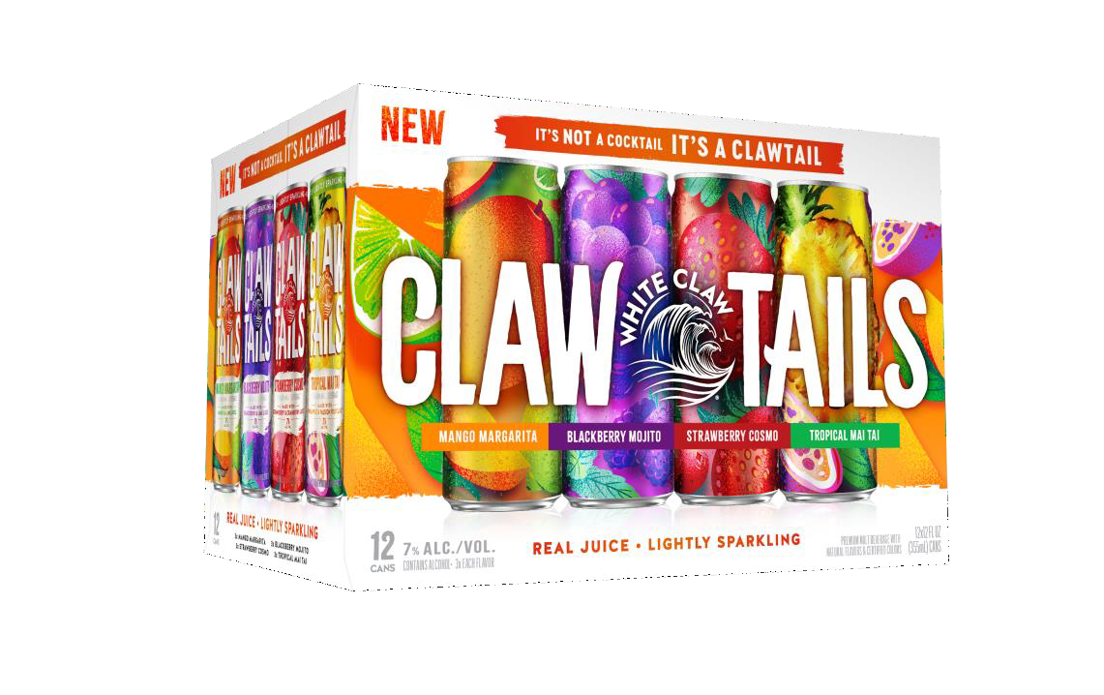


WHITE CLAW® CLAWTAILS 12PK UPCS AND PALLET SPECS
VIP Code: 15300
Carrier
Shipper
Shipping February 2025

Slide 9
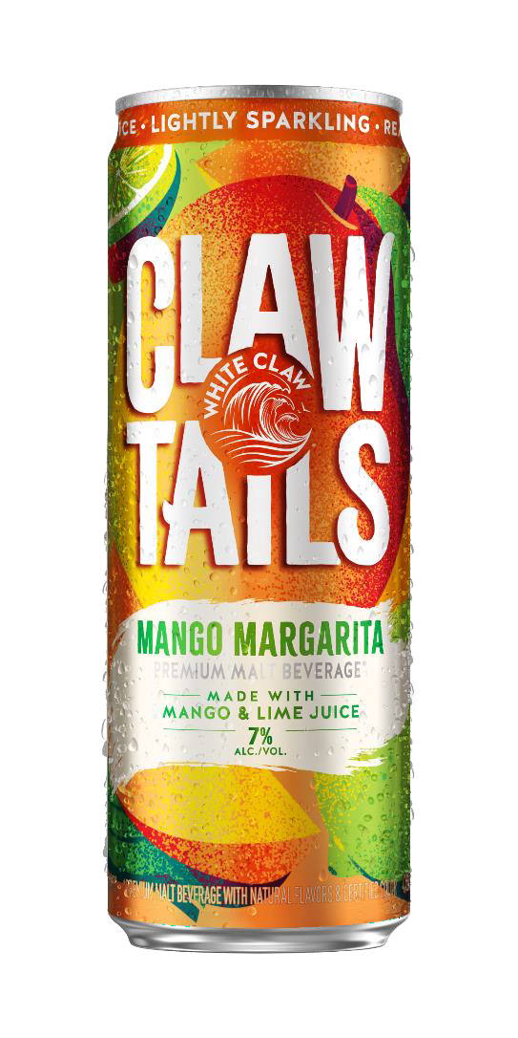
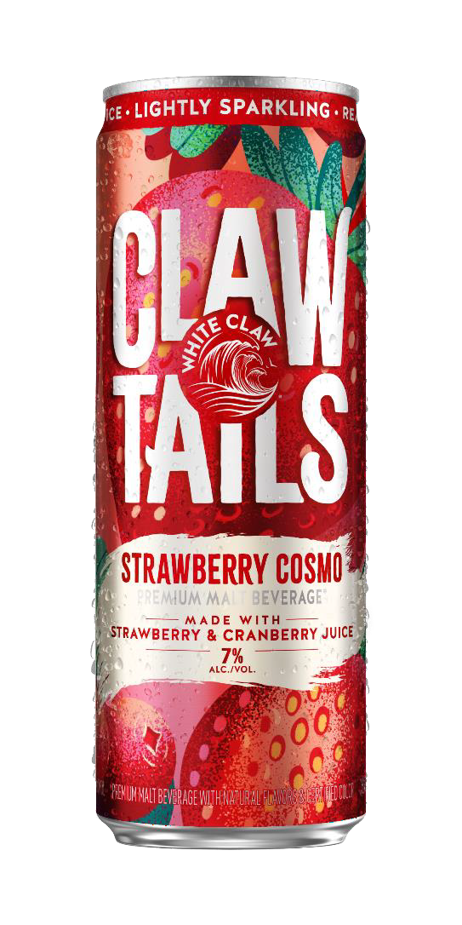
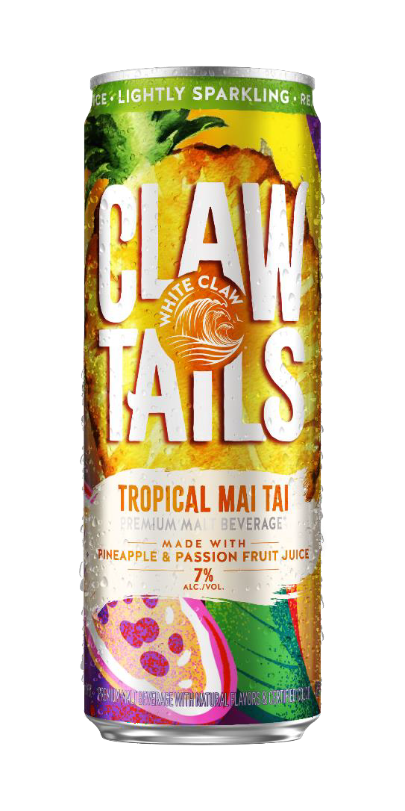
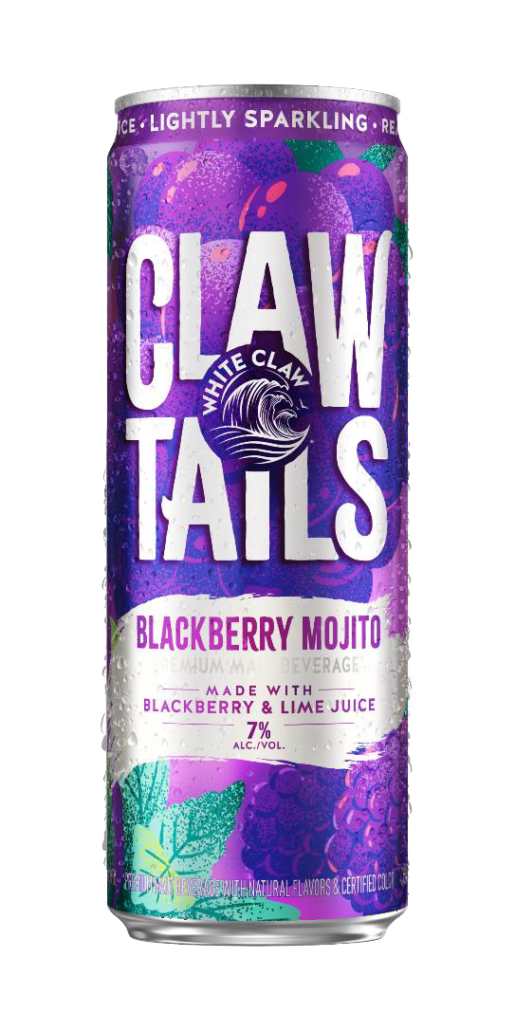




WHITE CLAW® CLAWTAILS 12OZ CANS UPCS AND PALLET SPECS
Mango Margarita
Strawberry Cosmo
Tropical Mai Tai
Blackberry Mojito
Can
Can
Can
Can
Shipping February 2025

Slide 10


F26 UPCs &
Pallet Specs

Slide 11

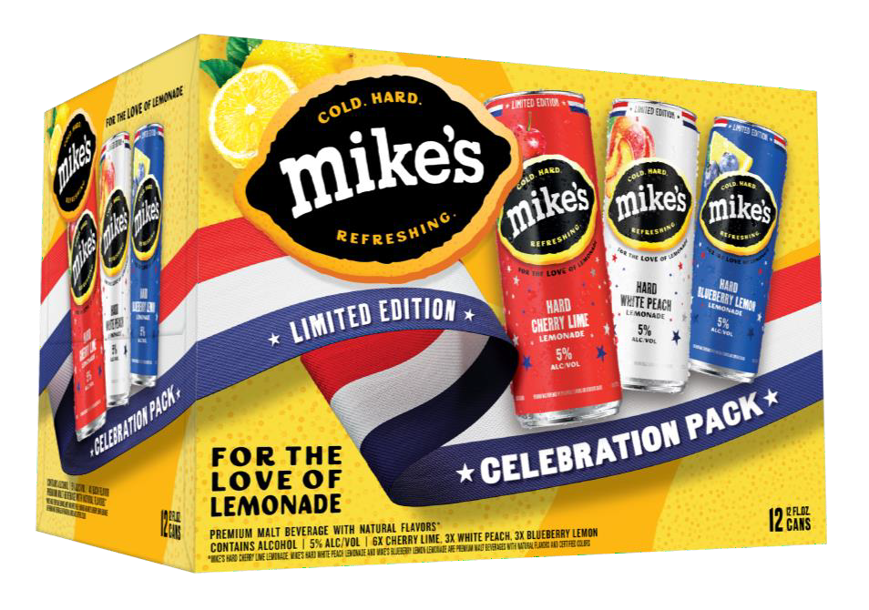
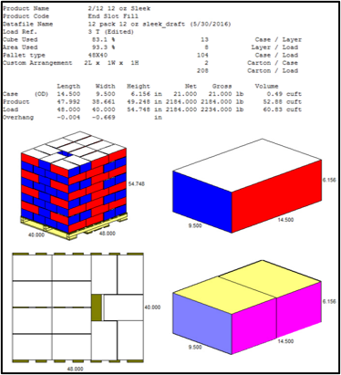


MHL SUMMER LTO CELEBRATION PACK 12PK
VIP: 33033
CARRIER
SHIPPER
SHIPPING FEBRUARY 2025

Slide 12
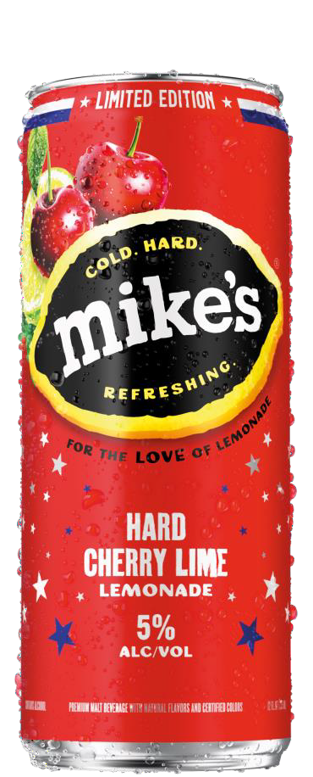
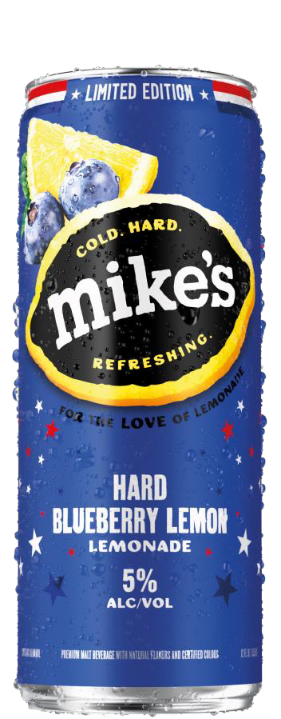
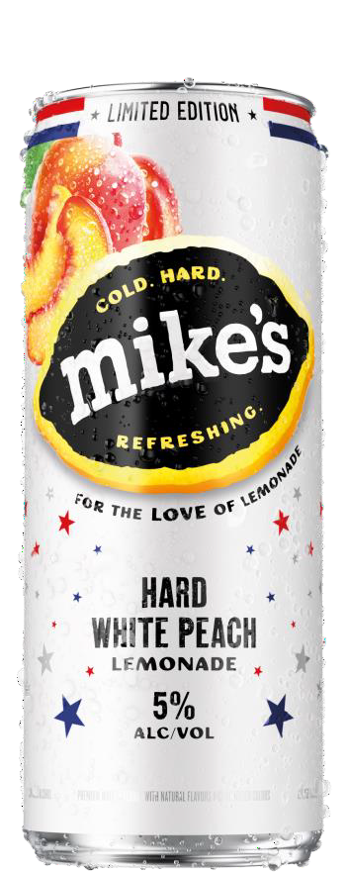



MHL SUMMER LTO CELEBRATION PACK 12PK CANS
SHIPPING FEBRUARY 2025

Slide 13
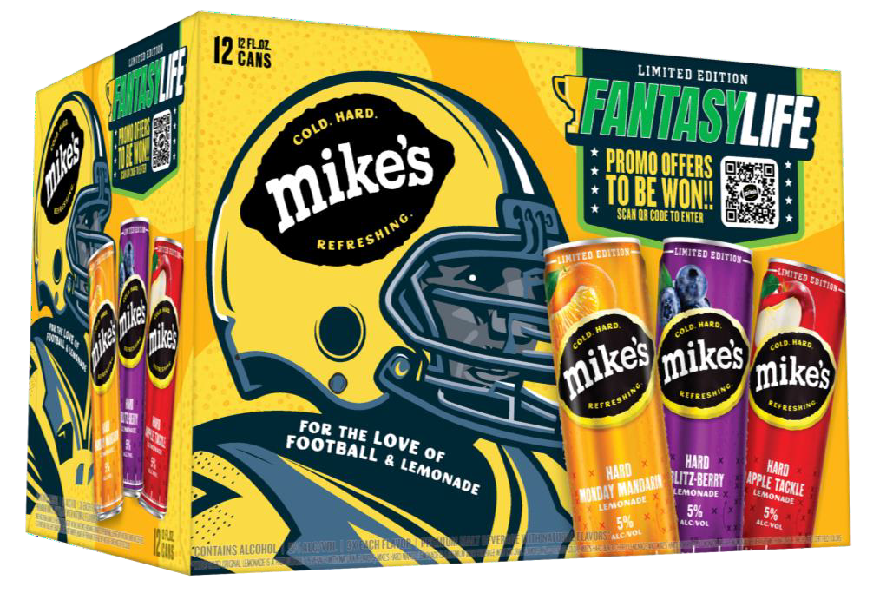

MHL FALL FANTASYLIFE LTO 12PK
VIP: TBD (SKU WILL HAVE UNIQUE ITEM #
CARRIER
SHIPPER
SHIPPING SEPT 2025

Slide 14

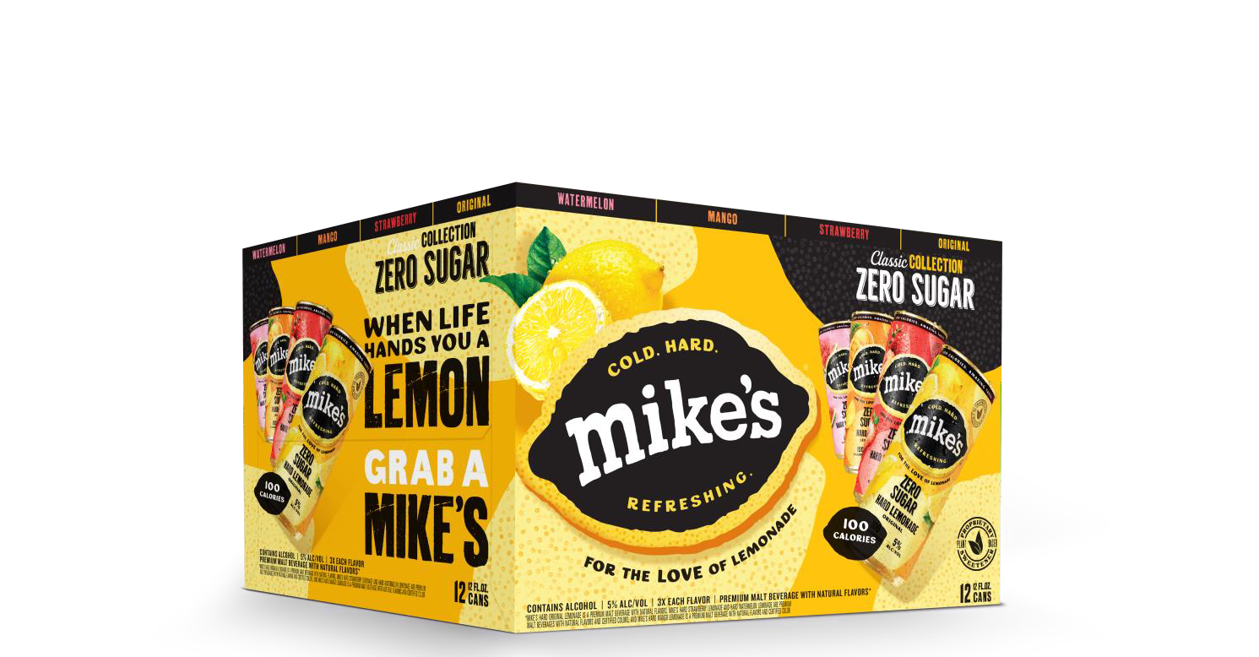


MHL ZERO SUGAR VARIETY PACK 12PK
VIP: 11654
CARRIER
SHIPPER
SHIPPING FEBRUARY 2025

Slide 15
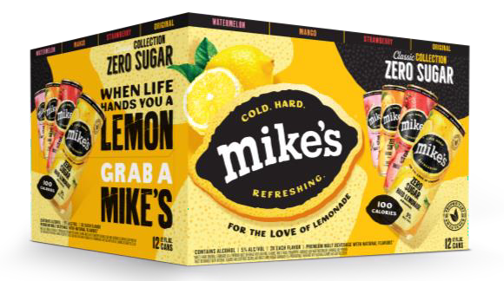
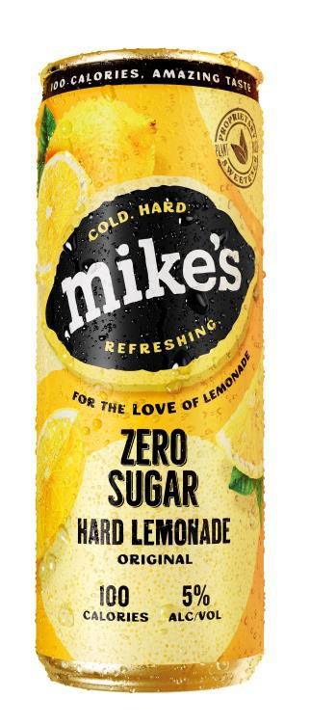
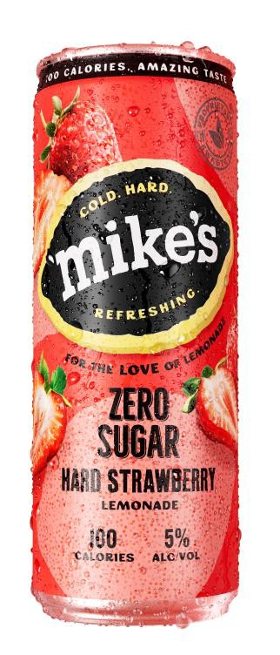
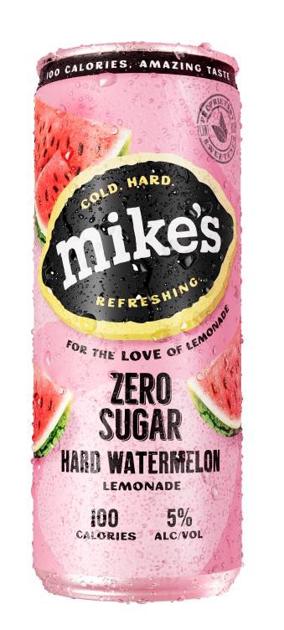
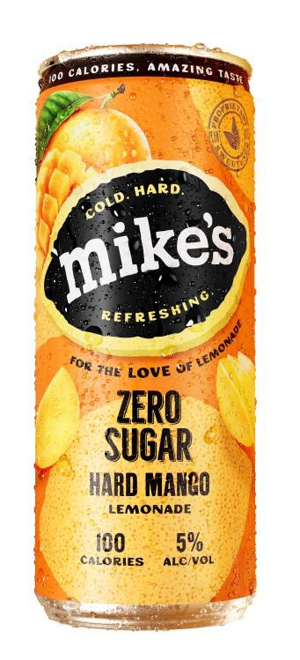




MHL ZERO SUGAR VP 12PK CANS
SHIPPING FEBRUARY 2025

Slide 16
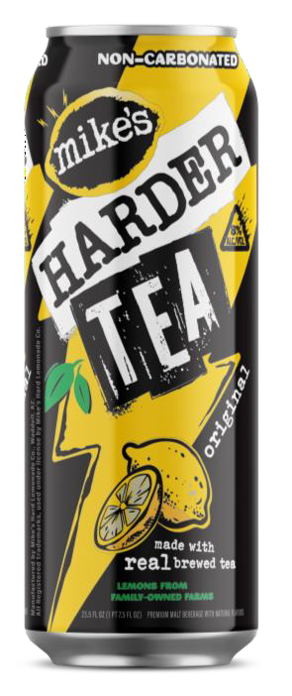

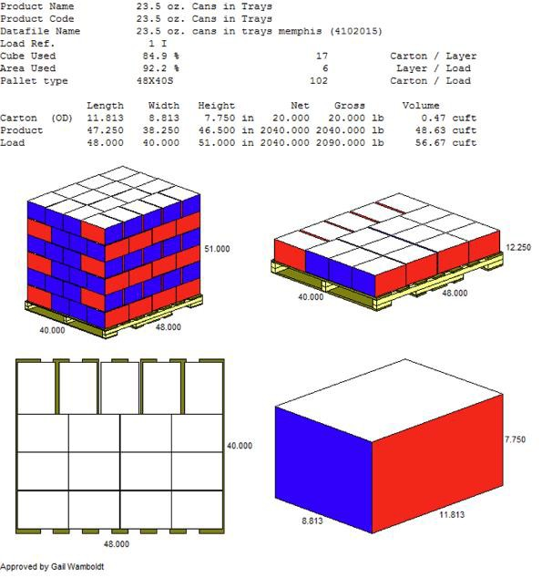




MIKES HARDER TEA
CAN
CAN
TRAY
TRAY
VIP: 28512
VIP: 28510
SHIPPING DECEMBER 2024 TENTATIVE

Slide 17

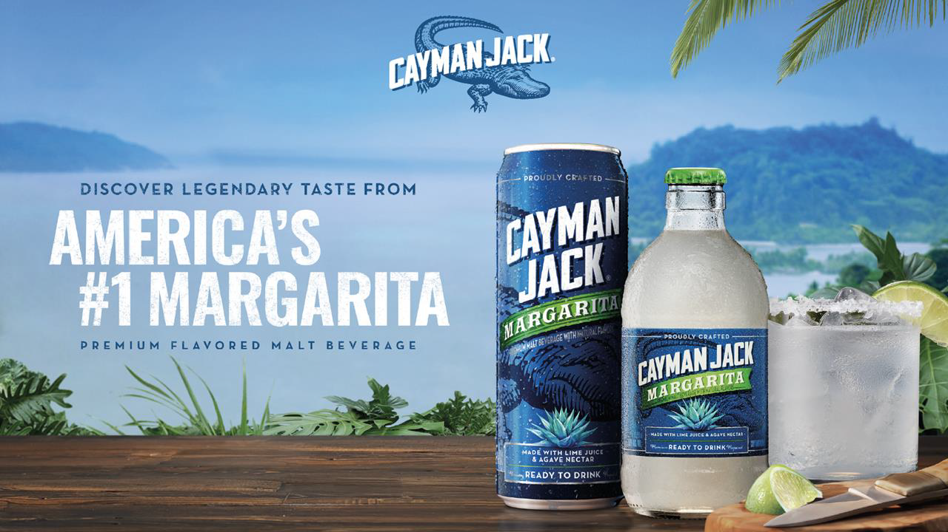
F26 UPCs & PALLET SPECS
*

Slide 18
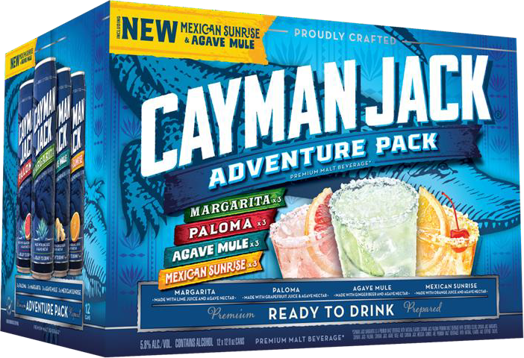


CAYMAN JACK ADVENTURE PACK VP 12PK RENO
VIP: 10801
CARRIER
TRAY
SHIPPING JANUARY 2025
Notes:
Replacing cayman jack variety

Slide 19
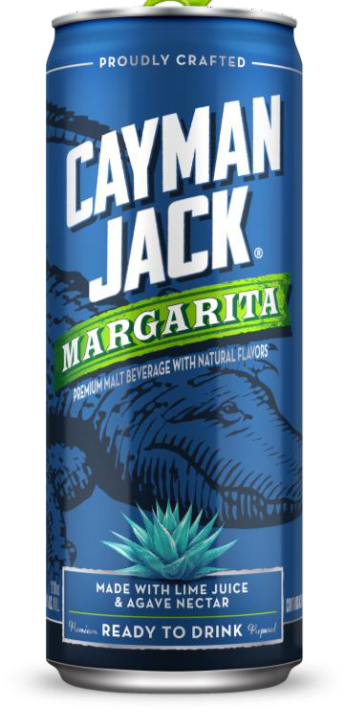
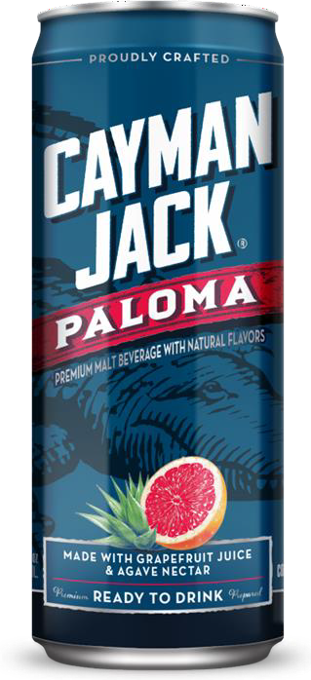
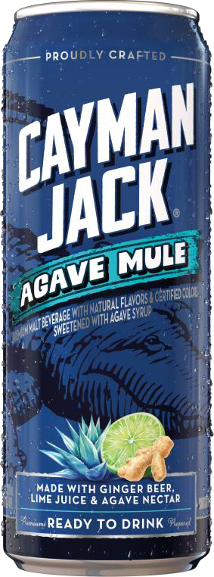
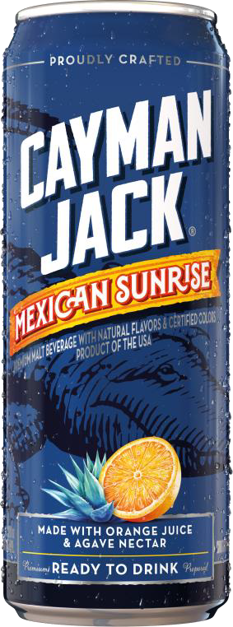




CAYMAN JACK ADVENTURE PACK VP 12PK CANS
SHIPPING FEBRUARY 2025

Slide 20
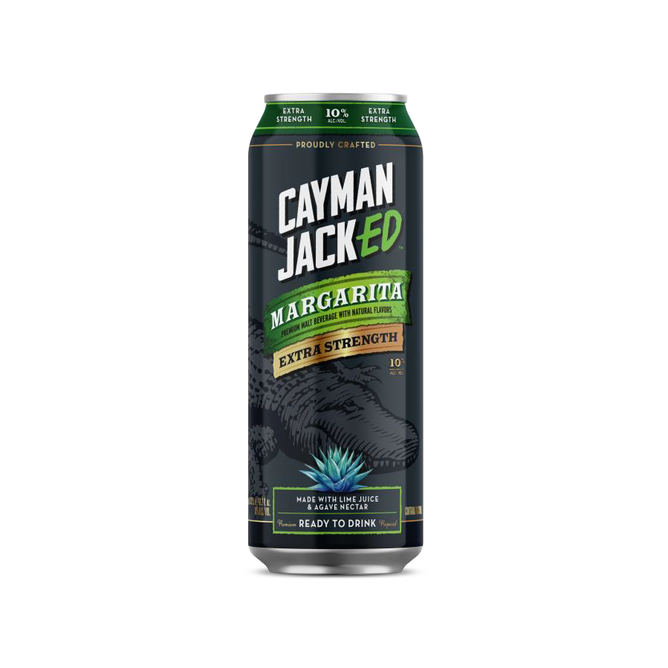
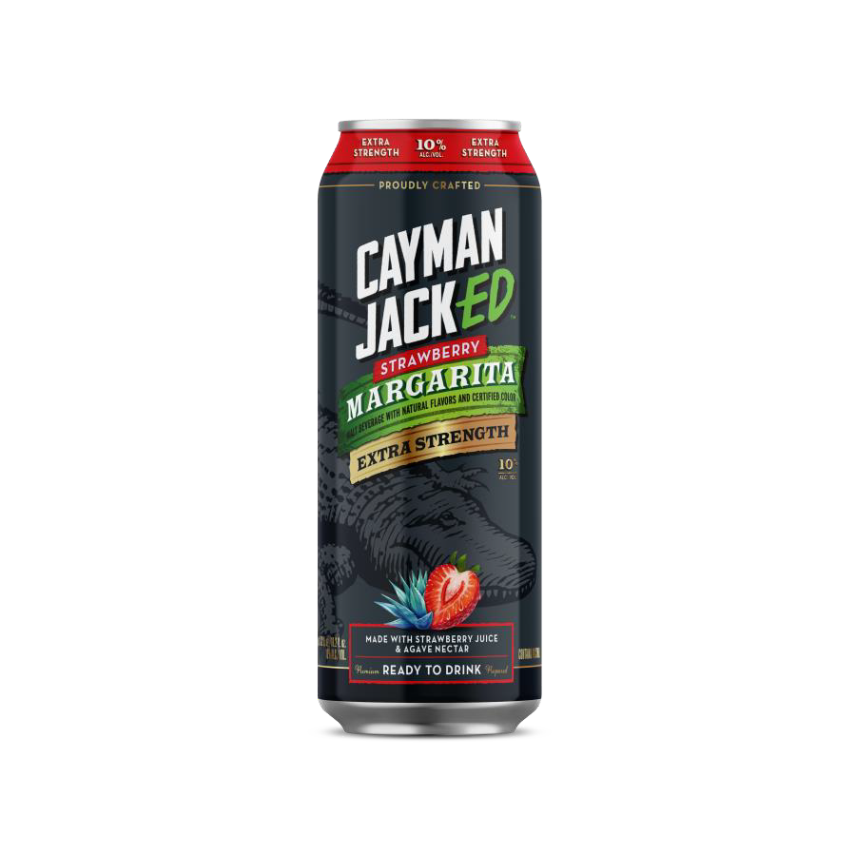
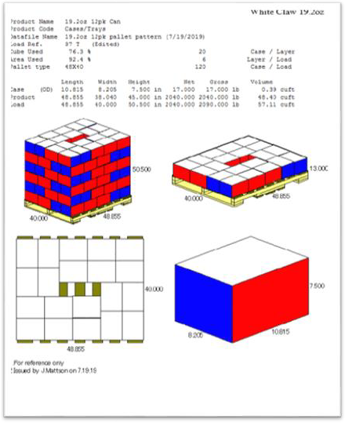




CAYMAN JACKED 19.2OZ SINGLES: NATIONAL
CAN
CAN
TRAY
TRAY
VIP: 27555
VIP: 27556
SHIPPING DECEMBER 2024 TENTATIVE

Slide 21
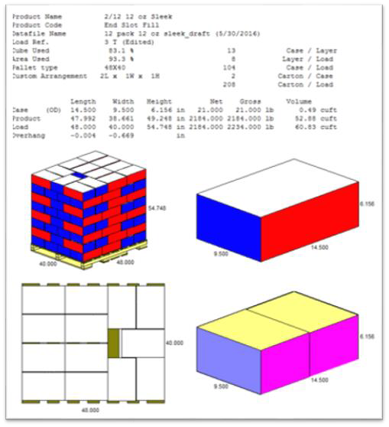
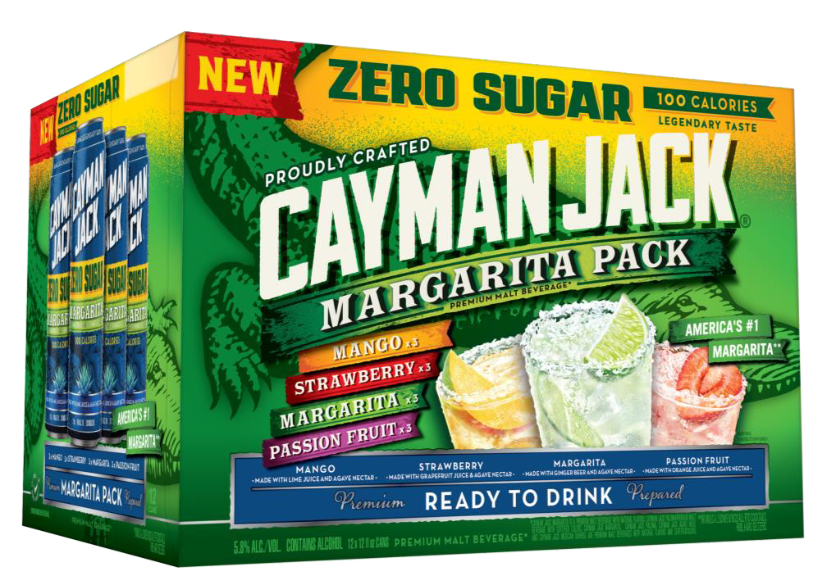


CAYMAN JACK ZERO SUGAR VARIETY PACK 12PK
VIP: 27554
CARRIER
TRAY
SHIPPING FEBRUARY 2025
Notes:
Replacing Cayman jack zaro sugar 12pk

Slide 22
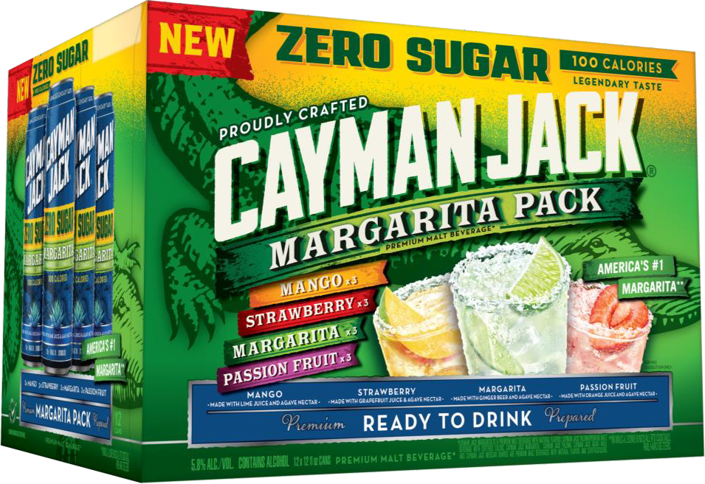
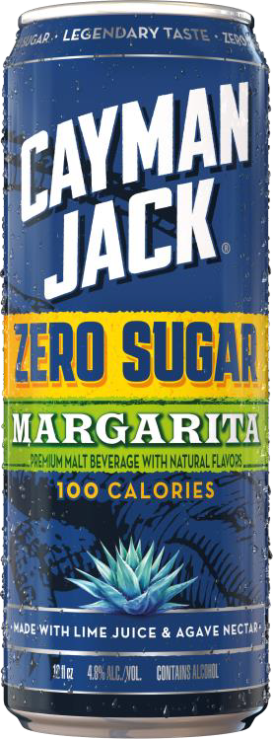
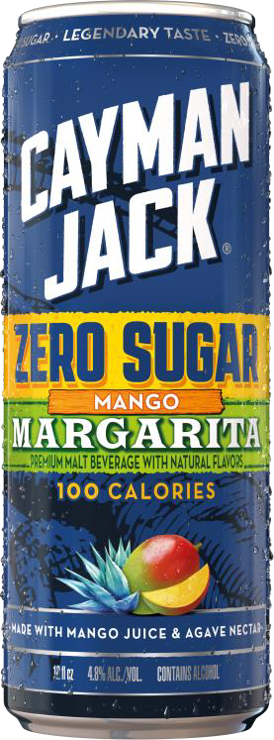
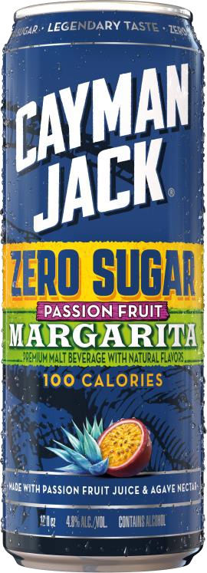
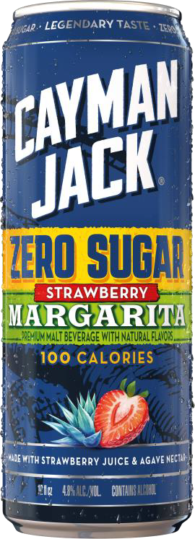




CAYMAN JACK ZERO SUGAR VP 12PK CANS
SHIPPING FEBRUARY 2025

Slide 23
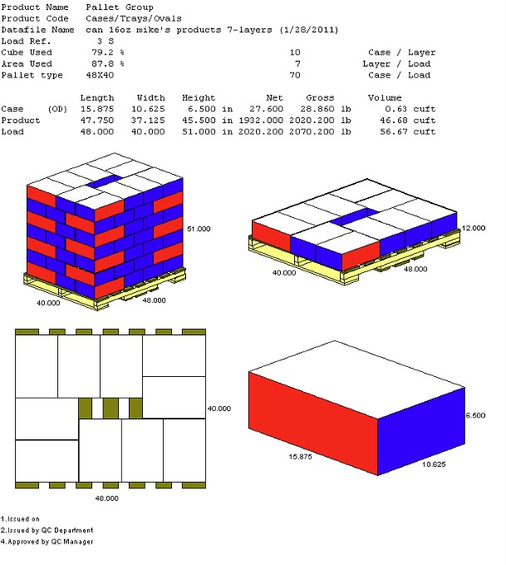



MXD BLACK CHERRY MARTINI
CAN (SELLABLE UNIT)
TRAY
VIP: 13031
SHIPPING FEBRUARY 2024

Slide 24

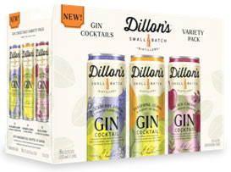



NEW 8PK VARIETY PACK PACKAGING
Can
Carton
(sellable unit)
Tray
Notes:
Circle K sets

Slide 25



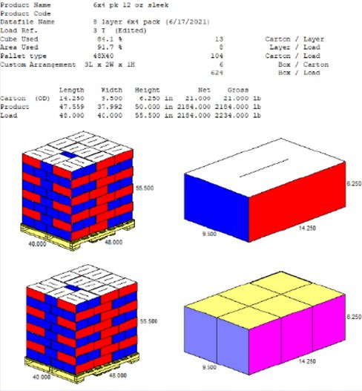


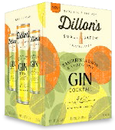
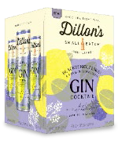




DILLON’S 4PK CODES & PALLET SPECS
Can
Can
Carton
(sellable unit)
Carton
(sellable unit)
Tray
Tray
Notes:
Meijer Sets

